Slide 1
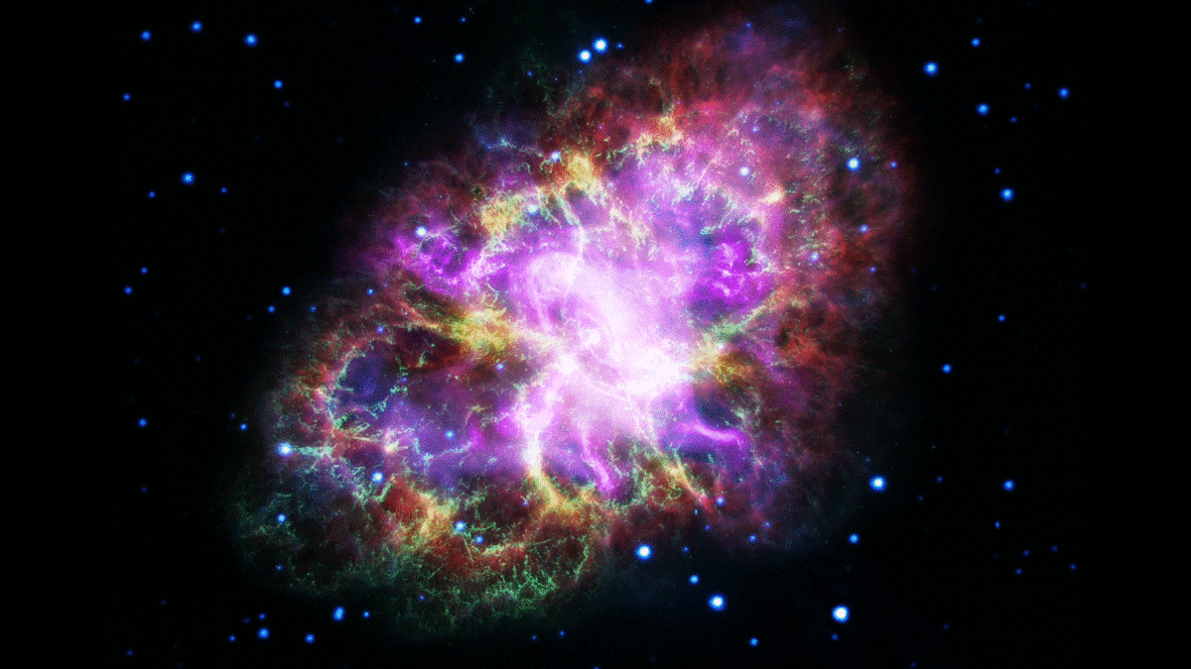
CH 13
Nuclear Structure
Dr. Tariq Al-Abdullah

Slide 2

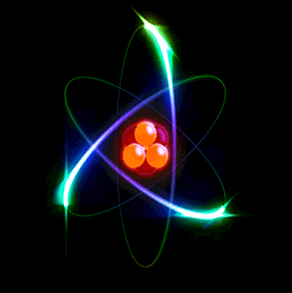
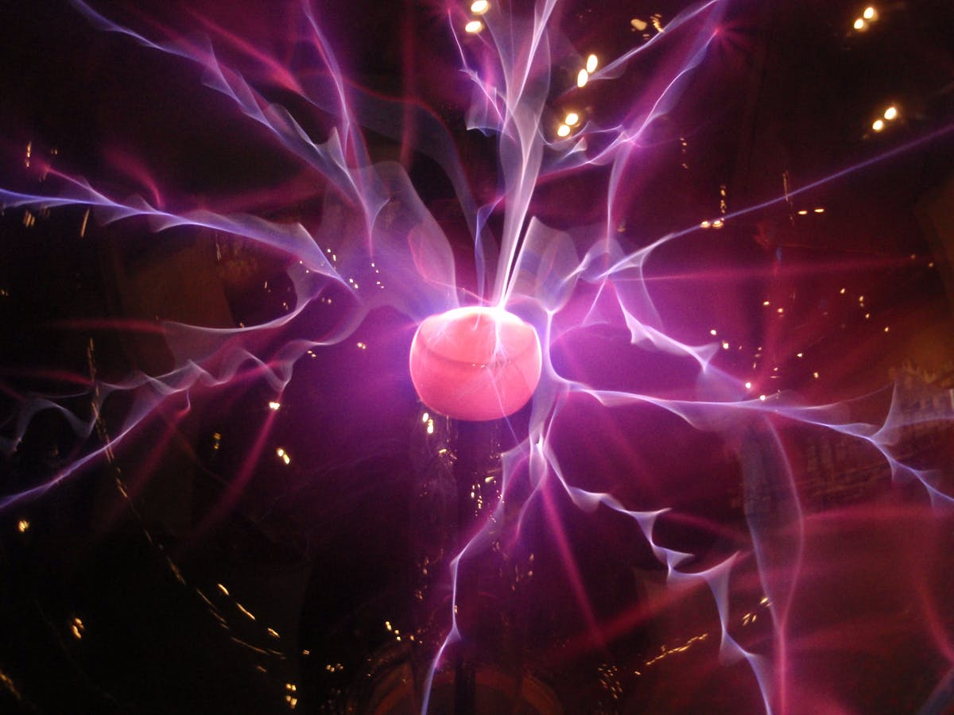
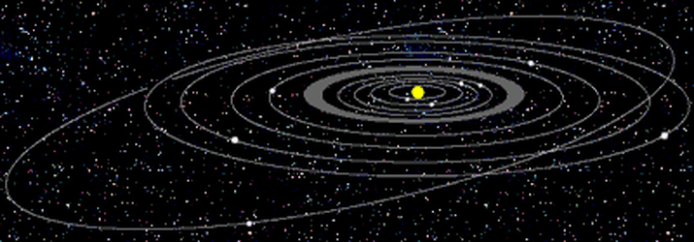
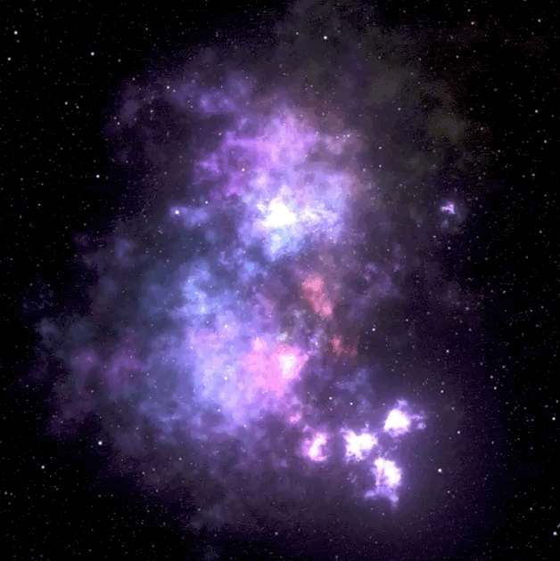
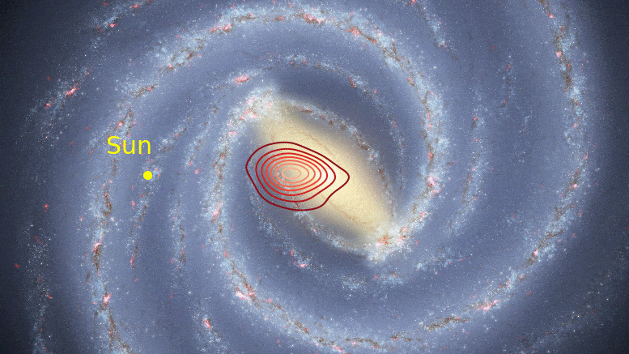

13 Nuclear Physics – Introduction

Slide 3
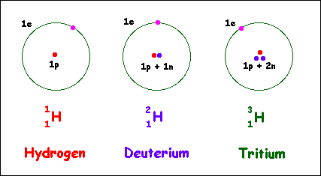
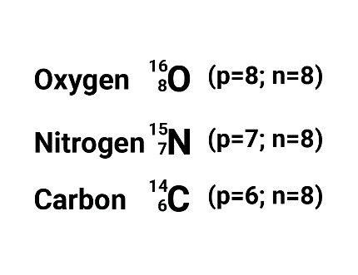
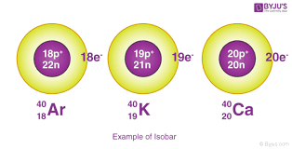
13.1 SOME PROPERTIES OF NUCLE – General
The atomic number, Z, which equals the number of protons in the nucleus.
The neutron number, N, which equals the number of neutrons in the nucleus.
The mass number, A, which equals the number of nucleons (neutrons plus protons) in the nucleus.
The nuclei of all atoms of a particular element contain the same number of protons but often contain different numbers of neutrons. Nuclei that are related in this way are called isotopes.

Slide 4
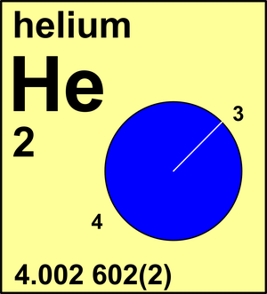
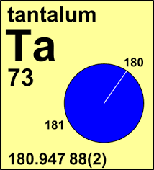
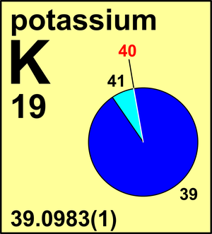
13.1 SOME PROPERTIES OF NUCLE – Charge and Mass
Because the rest energy of a particle is given by $E=mc^{2}$, it is often convenient to express the atomic mass unit in terms of its rest-energy equivalent. For one atomic mass unit, we have

Slide 5
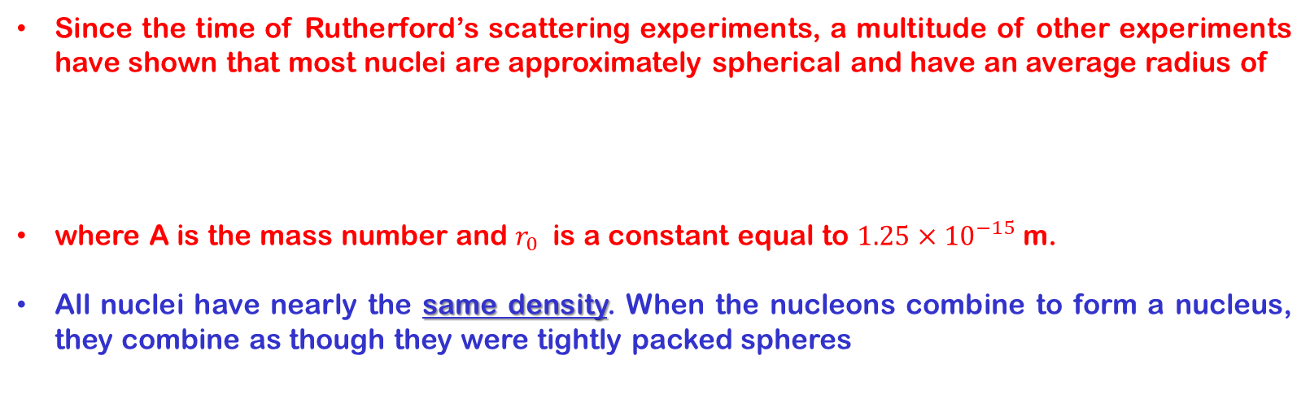
13.1 SOME PROPERTIES OF NUCLE – Size and Structure of Nuclei
Since the time of Rutherford’s scattering experiments, a multitude of other experiments have shown that most nuclei are approximately spherical and have an average radius of
where A is the mass number and $r_{0}$ is a constant equal to $1.25×{10}^{−15}$m.
All nuclei have nearly the same density. When the nucleons combine to form a nucleus, they combine as though they were tightly packed spheres

Slide 6


Slide 7
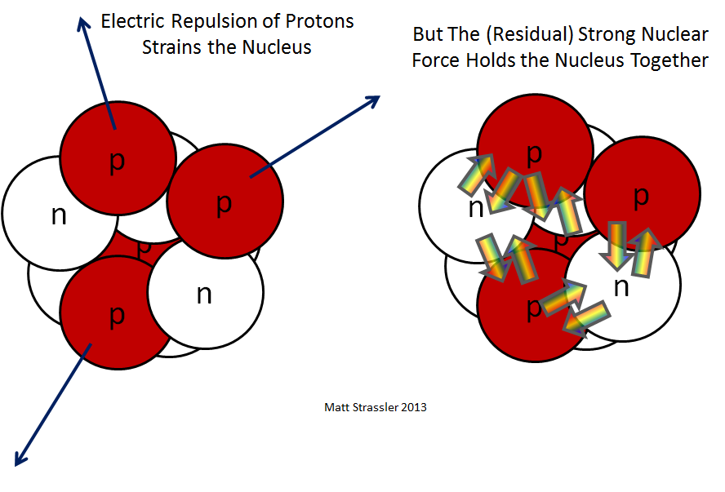
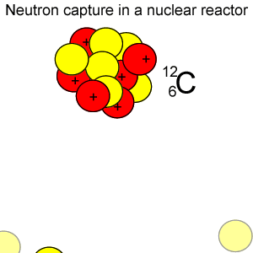
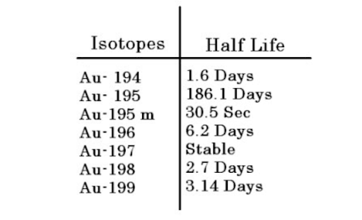
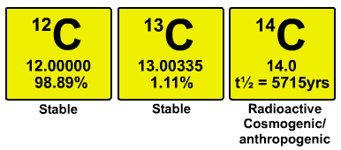
13.1 SOME PROPERTIES OF NUCLE – Nuclear Stability
Like charges (the protons) in proximity exert very large repulsive electrostatic forces on each other, which should cause the nucleus to fly apart.
However, nuclei are stable because of the presence of the nuclear force.
This is an attractive force, with a very short range (about 2 fm), that acts between all nuclear particles.
The attractive nuclear force also acts between pairs of neutrons and between neutrons and protons.
There are approximately 260 stable nuclei; hundreds of other nuclei have been observed but these are unstable.
Light nuclei are most stable if they contain equal numbers of protons and neutrons.
Furthermore, heavy nuclei are more stable if the number of neutrons exceeds the number of protons.

Slide 8
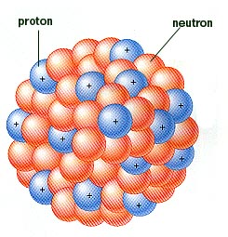
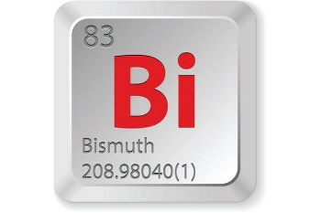
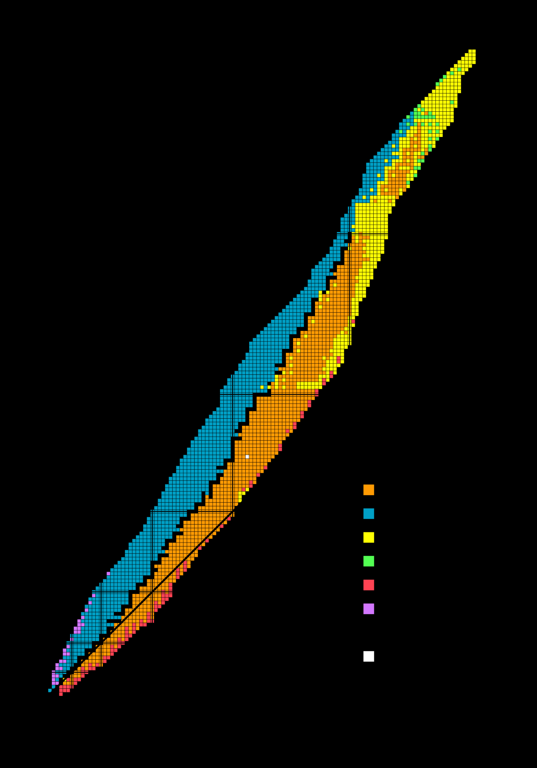
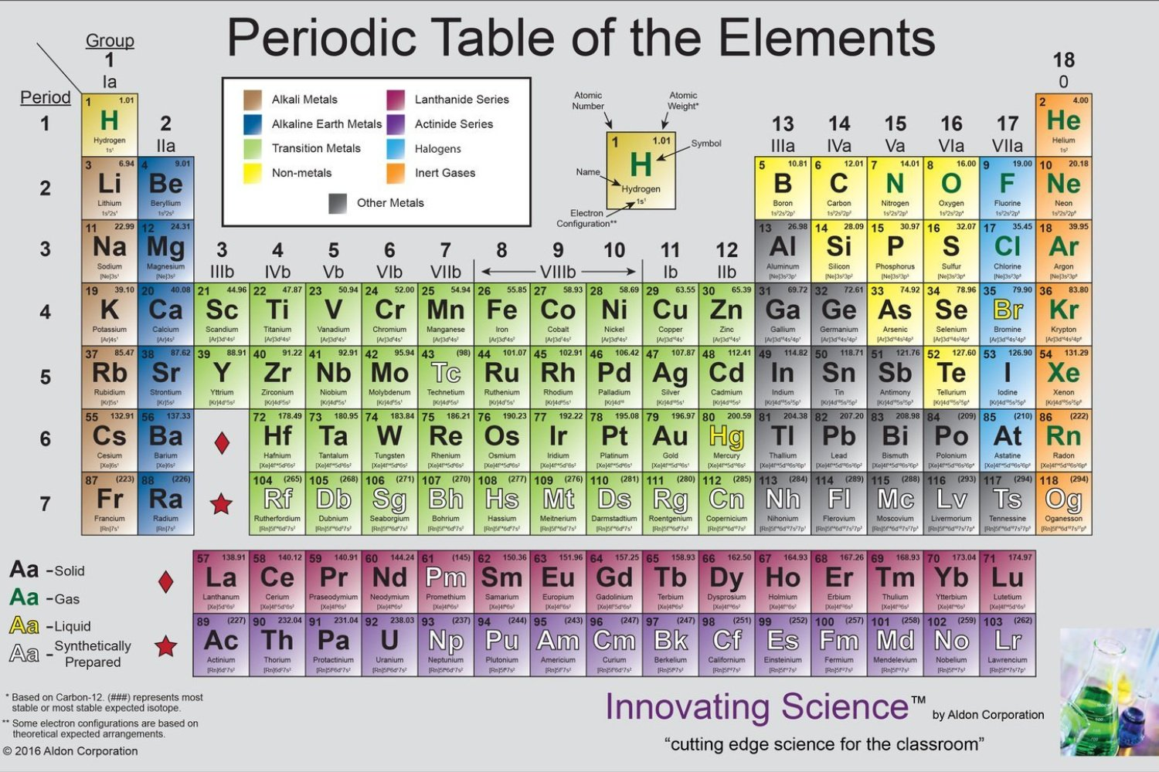
13.1 SOME PROPERTIES OF NUCLE – Nuclear Stability
We can understand this by recognizing that as the number of protons increases, the strength of the Coulomb force increases, which tends to break the nucleus apart. As a result, more neutrons are needed to keep the nucleus stable, since neutrons experience only attractive nuclear forces.
When Z = 83. Elements that contain more than 83 protons do not have stable nuclei.
https://nds.iaea.org/relnsd/vcharthtml/VChartHTML.html

Slide 9
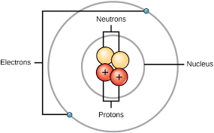
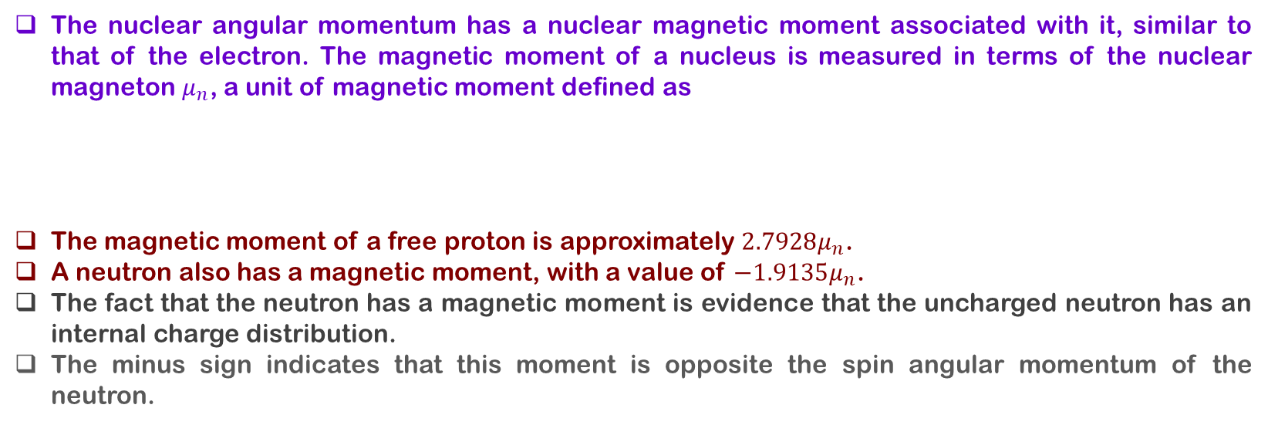
13.1 SOME PROPERTIES OF NUCLE – Nuclear Spin and Magnetic Moment
A nucleus, like an electron, has an intrinsic angular momentum that arises from relativistic properties.
$I$ is a quantum number called the nuclear spin and may be an integer or a half-integer.
The nuclear angular momentum has a nuclear magnetic moment associated with it, similar to that of the electron. The magnetic moment of a nucleus is measured in terms of the nuclear magneton $μ_{n}$, a unit of magnetic moment defined as
The magnetic moment of a free proton is approximately $2.7928μ_{n}$.
A neutron also has a magnetic moment, with a value of $−1.9135μ_{n}$.
The fact that the neutron has a magnetic moment is evidence that the uncharged neutron has an internal charge distribution.
The minus sign indicates that this moment is opposite the spin angular momentum of the neutron.

Slide 10
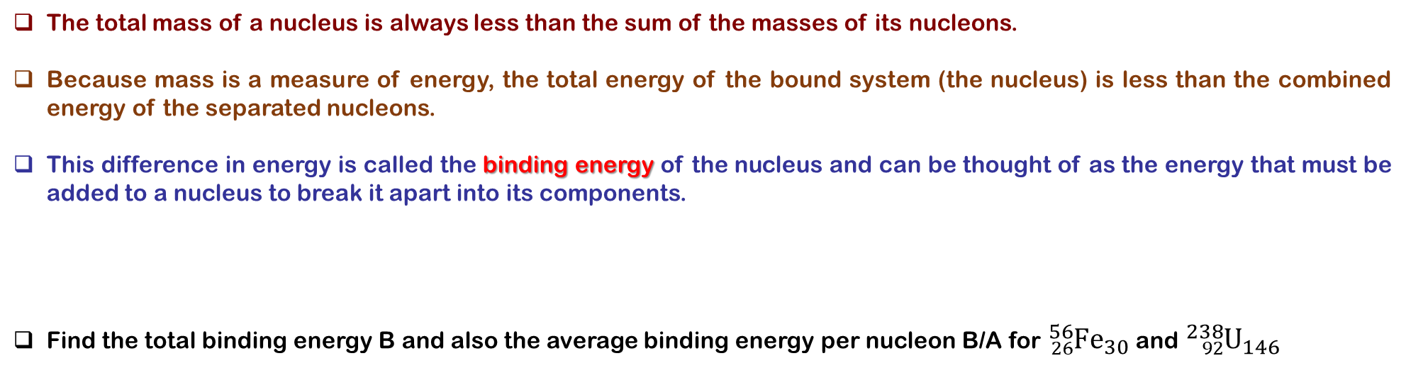
13.2 BINDING ENERGY AND NUCLEAR FORCES
The total mass of a nucleus is always less than the sum of the masses of its nucleons.
Because mass is a measure of energy, the total energy of the bound system (the nucleus) is less than the combined energy of the separated nucleons.
This difference in energy is called the binding energy of the nucleus and can be thought of as the energy that must be added to a nucleus to break it apart into its components.
Find the total binding energy B and also the average binding energy per nucleon B/A for ${}_{26}^{56}{Fe_{30}}$ and ${}_{92}^{238}{U_{146}}$

Slide 11
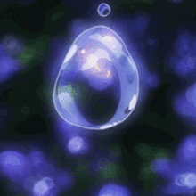

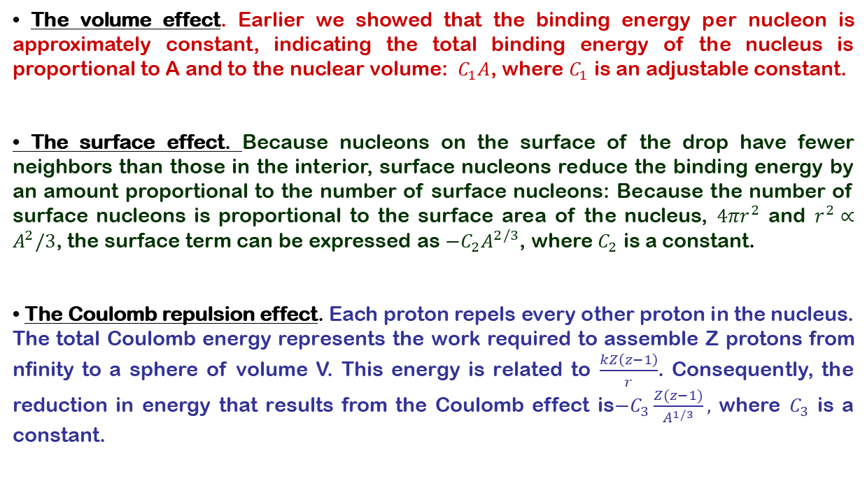
13.3 NUCLEAR MODELS – Liquid Drop Model
The liquid-drop model, proposed by C. F. von Weizsächer in 1935, treats the nucleons as though they were molecules in a drop of liquid.
Four major effects influence the binding energy of the nucleus in the liquid-drop model:
• The volume effect. Earlier we showed that the binding energy per nucleon is approximately constant, indicating the total binding energy of the nucleus is proportional to A and to the nuclear volume: $C_{1}A$, where $C_{1}$ is an adjustable constant.
• The surface effect. Because nucleons on the surface of the drop have fewer neighbors than those in the interior, surface nucleons reduce the binding energy by an amount proportional to the number of surface nucleons: Because the number of surface nucleons is proportional to the surface area of the nucleus, $4πr^{2}$ and $r^{2}∝A^{2}/3$, the surface term can be expressed as $−C_{2}A^{2/3}$, where $C_{2}$ is a constant.
• The Coulomb repulsion effect. Each proton repels every other proton in the nucleus. The total Coulomb energy represents the work required to assemble Z protons from nfinity to a sphere of volume V. This energy is related to $\frac{kZ\left(z−1\right)}{r}$. Consequently, the reduction in energy that results from the Coulomb effect is$−C_{3}\frac{Z(z−1)}{A^{1/3}},$ where $C_{3}$ is a constant.

Slide 12
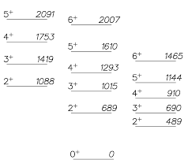
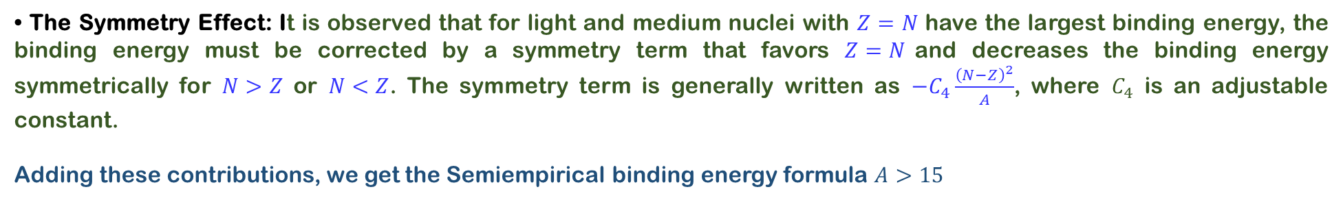
13.3 NUCLEAR MODELS – Liquid Drop Model
• The Symmetry Effect: It is observed that for light and medium nuclei with $Z=N$ have the largest binding energy, the binding energy must be corrected by a symmetry term that favors $Z=N$and decreases the binding energy symmetrically for $N>Z$ or $N<Z$. The symmetry term is generally written as $−C_{4}\frac{{\left(N−Z\right)}^{2}}{A}$, where $C_{4}$ is an adjustable constant.
Adding these contributions, we get the Semiempirical binding energy formula $A>15$

Slide 13
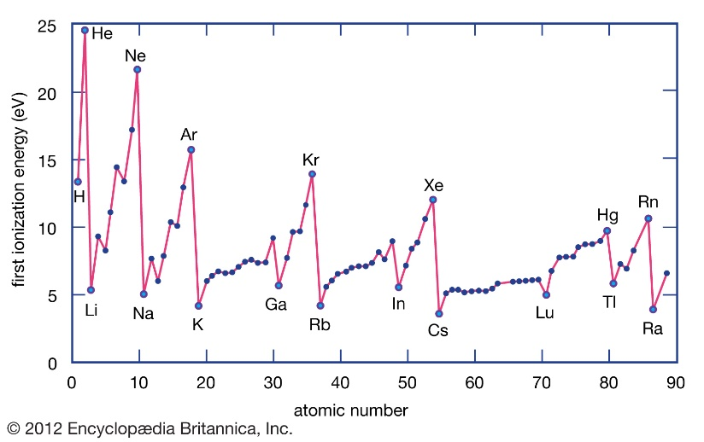
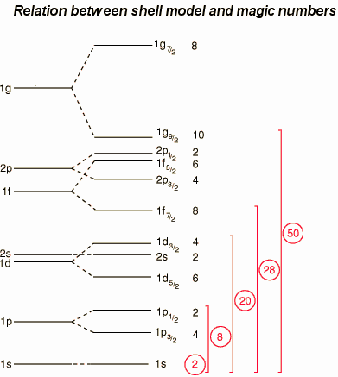
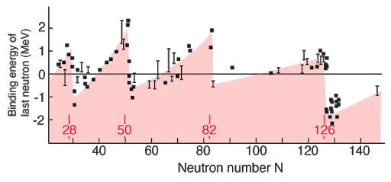
13.3 NUCLEAR MODELS – Independent-Particle Model
• The shell model is based upon the assumption that each nucleon moves in a well-defined orbital state within the nucleus in an average field produced by the other nucleons.

Slide 14
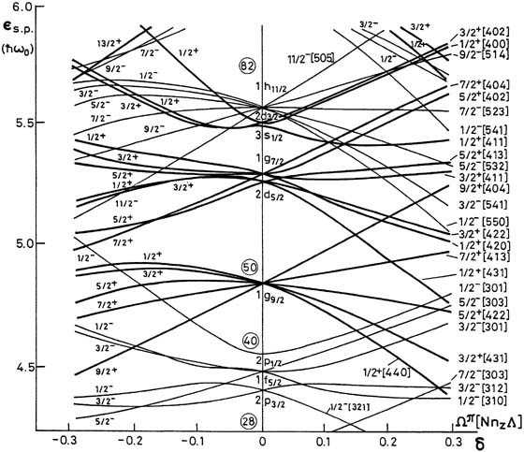
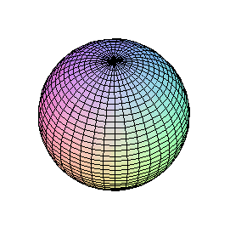
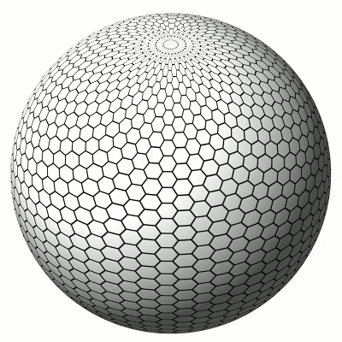
13.3 NUCLEAR MODELS – Collective Model
A third model of nuclear structure, known as the collective model.
It combines some features of the liquid-drop model and the independent-particle model.
The nucleus is considered to have some “extra” nucleons moving in quantized orbits in addition to the filled core of nucleons.
The extra nucleons are subject to the field produced by the core, as in the independent-particle scheme.
Deformations can be set up in the core as a result of a strong interaction between the core and the extra nucleons, thereby initiating vibrational and rotational motions, as in the liquid-drop model.

Slide 15
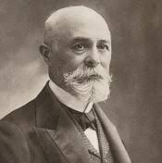
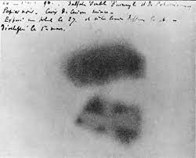
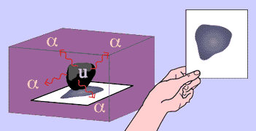
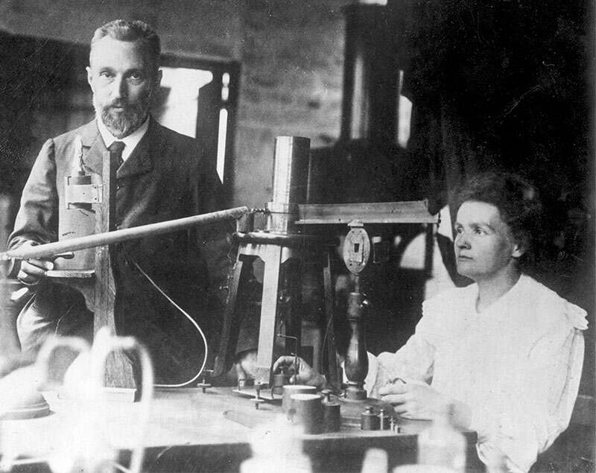
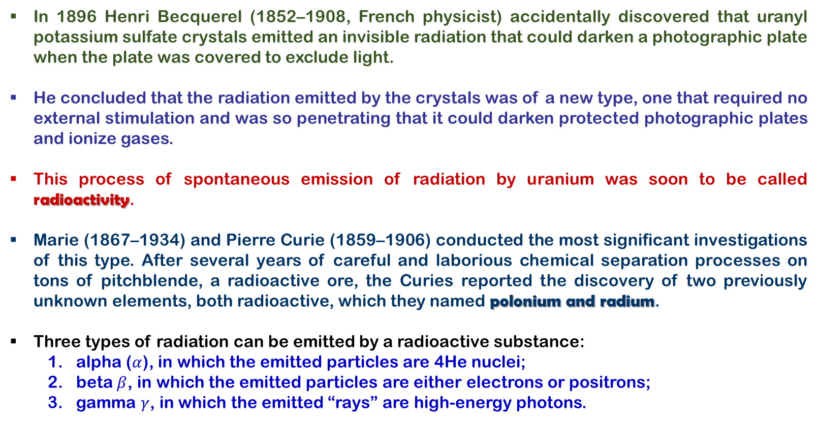
13.4 RADIOACTIVITY
In 1896 Henri Becquerel (1852–1908, French physicist) accidentally discovered that uranyl potassium sulfate crystals emitted an invisible radiation that could darken a photographic plate when the plate was covered to exclude light.
He concluded that the radiation emitted by the crystals was of a new type, one that required no external stimulation and was so penetrating that it could darken protected photographic plates and ionize gases.
This process of spontaneous emission of radiation by uranium was soon to be called radioactivity.
Marie (1867–1934) and Pierre Curie (1859–1906) conducted the most significant investigations of this type. After several years of careful and laborious chemical separation processes on tons of pitchblende, a radioactive ore, the Curies reported the discovery of two previously unknown elements, both radioactive, which they named polonium and radium.
Three types of radiation can be emitted by a radioactive substance:
  alpha ($α$), in which the emitted particles are 4He nuclei;
  beta $β$, in which the emitted particles are either electrons or positrons;
  gamma $γ$, in which the emitted “rays” are high-energy photons.
https://www.youtube.com/watch?v=-0Mg8Bu07fI

Slide 16
13.4 RADIOACTIVITY
The rate at which a particular decay process occurs in a radioactive sample is proportional to the number of radioactive nuclei present (that is, those nuclei that have not yet decayed). If N is the number of radioactive nuclei present at some instant, the rate of change of N is
The decay rate R, or the number of decays per unit time, can be obtained by
The half-life of a radioactive substance is the time it takes half of a given number of radioactive nuclei to decay.

Slide 17
13.4 RADIOACTIVITY
Example: The isotope ${}_{6}^{14}C$ is radioactive and has a half-life of 5730 years (yr). If you start with a sample of 1000 carbon-14 nuclei, how many will still be around in 22,920 yr?

Slide 18
13.5 DECAY PROCESSES – Alpha Decay
Example: The half-life of the radioactive nucleus ${}_{88}^{226}{Ra}$is about $1.6×{10}^{3}$yr. (a) What is the decay constant of ${}_{88}^{226}{Ra}?$ (b) If a sample contains $3.0×{10}^{16}$ such nuclei at $t=0$, determine its activity at this time. (c) What is the decay rate after the sample is $2.0×{10}^{3}$ yr old?

Slide 19
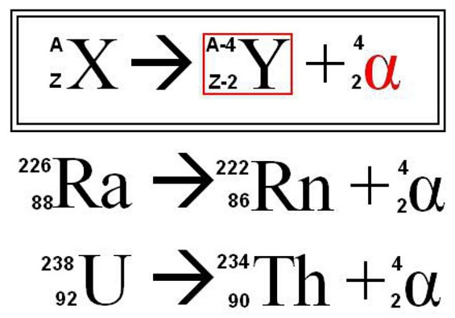
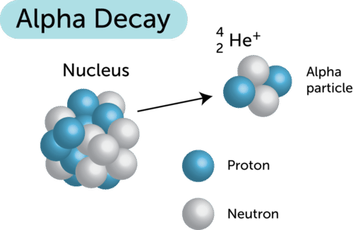
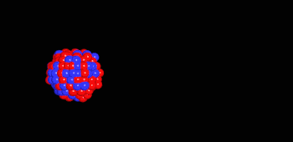

13.4 RADIOACTIVITY– Alpha Decay
If a nucleus emits an particle (${}_{2}^{4}{He}$), it loses two protons and two neutrons. Therefore, the atomic number Z decreases by 2, the mass number A decreases by 4, and the neutron number decreases by 2. The decay can be written as

Slide 20
13.5 DECAY PROCESSES – Alpha Decay
Example: The ${}_{88}^{226}{Ra}$ nucleus undergoes alpha decay. Calculate the Q value for this process. Take the atomic masses to be $226.025 406 u$for ${}_{88}^{226}{Ra}$, $222.017 574 u$for ${}_{86}^{222}{Rn}$, and $4.002 603 u$for ${}_{2}^{4}{He}$.

Slide 21

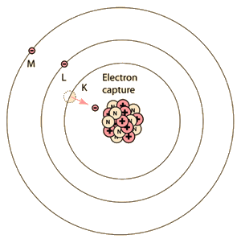

13.5 DECAY PROCESSES – Beta Decay
When a radioactive nucleus undergoes beta decay, the daughter nucleus has the same number of nucleons as the parent nucleus, but the atomic number is changed by 1:

Slide 22
13.5 DECAY PROCESSES – Beta Decay
Example: A ³H nucleus beta-decays into ³He by creating an electron and an antineutrino according to the reaction
Determine the total energy released in this reaction.

Slide 23
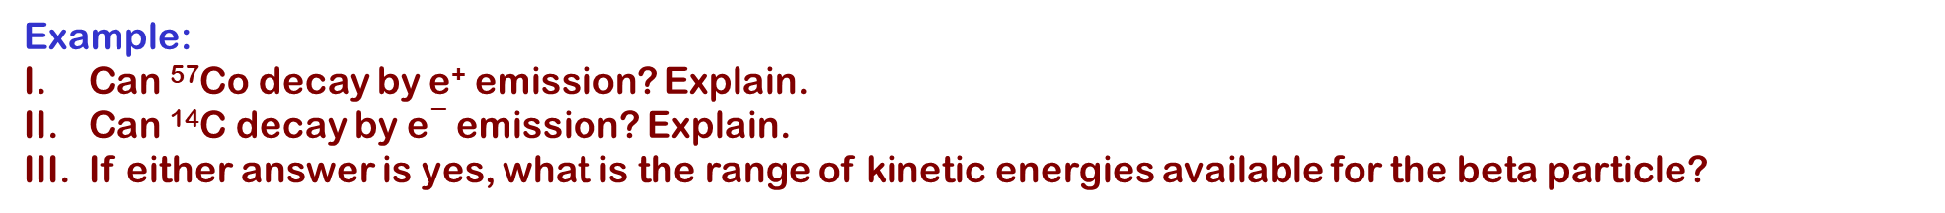
13.5 DECAY PROCESSES – Beta Decay
Example:
Can ⁵⁷Co decay by e⁺ emission? Explain.
Can ¹⁴C decay by e$−$ emission? Explain.
If either answer is yes, what is the range of kinetic energies available for the beta particle?

Slide 24
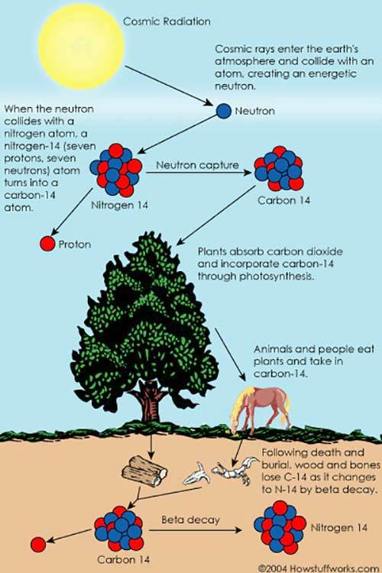
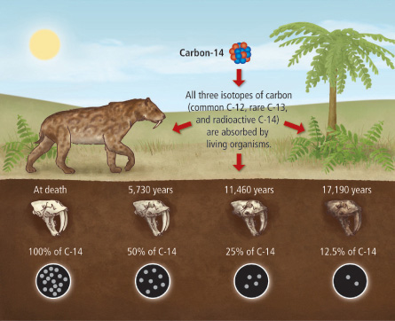
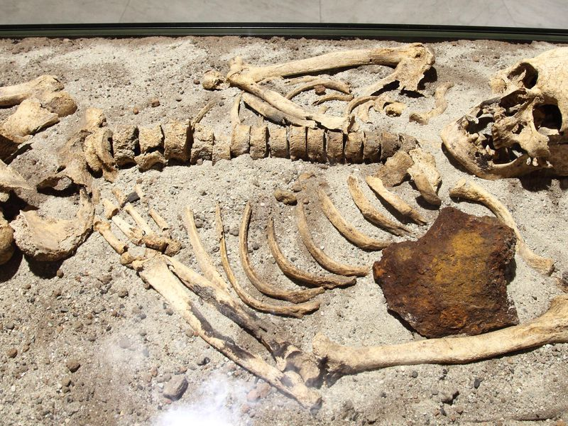


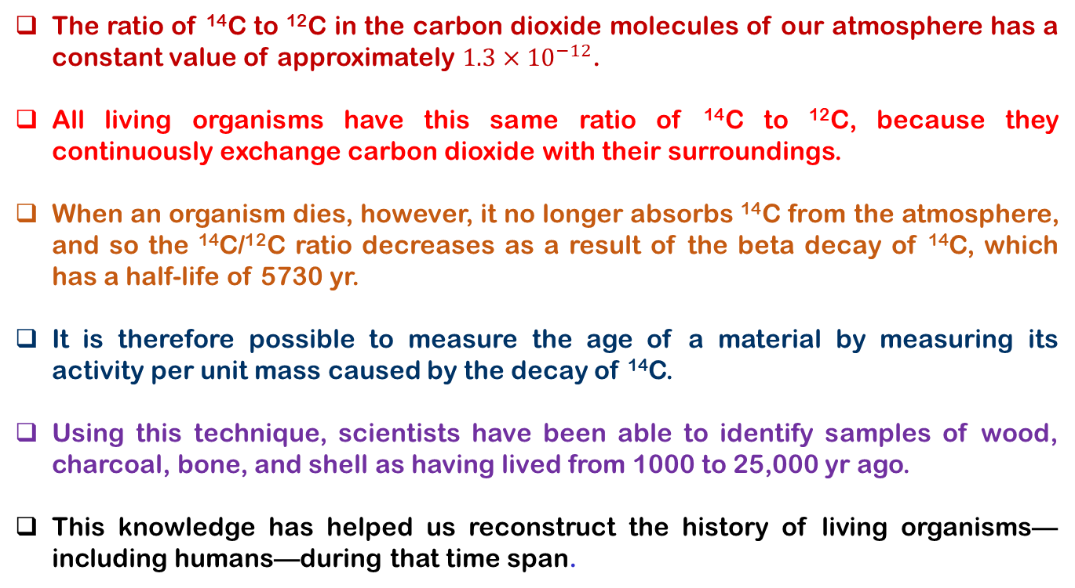
13.5 DECAY PROCESSES – Carbon Dating
The ratio of ¹⁴C to ¹²C in the carbon dioxide molecules of our atmosphere has a constant value of approximately $1.3×{10}^{−12}$.
All living organisms have this same ratio of ¹⁴C to ¹²C, because they continuously exchange carbon dioxide with their surroundings.
When an organism dies, however, it no longer absorbs ¹⁴C from the atmosphere, and so the ¹⁴C/¹²C ratio decreases as a result of the beta decay of ¹⁴C, which has a half-life of 5730 yr.
It is therefore possible to measure the age of a material by measuring its activity per unit mass caused by the decay of ¹⁴C.
Using this technique, scientists have been able to identify samples of wood, charcoal, bone, and shell as having lived from 1000 to 25,000 yr ago.
This knowledge has helped us reconstruct the history of living organisms—including humans—during that time span.

Slide 25
13.5 DECAY PROCESSES – Carbon Dating
Example: An archaeologist finds a 25.0-g piece of charcoal in the ruins of an ancient city. The sample shows a ¹⁴C activity of 250 decays/min. How long has the tree from which this charcoal came been dead?

Slide 26
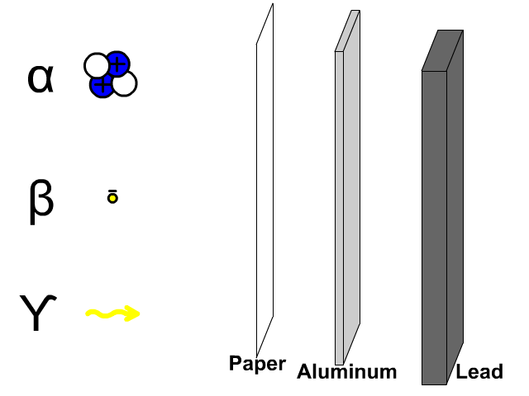
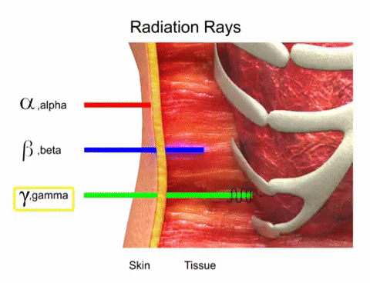

13.5 DECAY PROCESSES – Gamma Decay
A nucleus that undergoes radioactive decay is left in an excited energy state. The nucleus can then undergo a second decay to a lower energy state, perhaps to the ground state, by emitting a high-energy photon.
The typical half-life of an excited nuclear state is ${10}^{−10}$ s.
Gamma photons have very high energy (in the range of 1 MeV to 1 GeV)

Slide 27

13.6 NATURAL RADIOACTIVITY
Radioactive nuclei are generally classified into two groups:
Unstable nuclei found in nature, which give rise to what is called natural radioactivity,
  ²³⁸U (Uranium Series) ➔ ²⁰⁶Pb,
  ²³⁵U (Actinium Series) ➔ ²⁰⁷Pb,
  ²³²Th (Thorium Series) ➔ ²⁰⁸Pb
Nnuclei produced in the laboratory through nuclear reactions, which exhibit artificial radioactivity.
  Neptunium is the longest-lived member of the series other than its stable end product, ²⁰⁹Bi.

Slide 28

The End of CH 13

