Slide 1
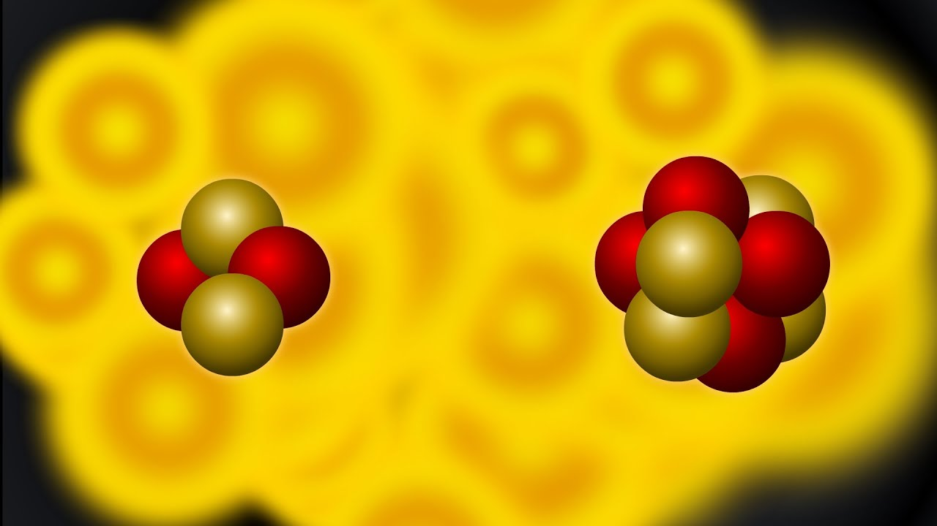
CH 14
Nuclear Reactions
Dr. Tariq Al-Abdullah

Slide 2
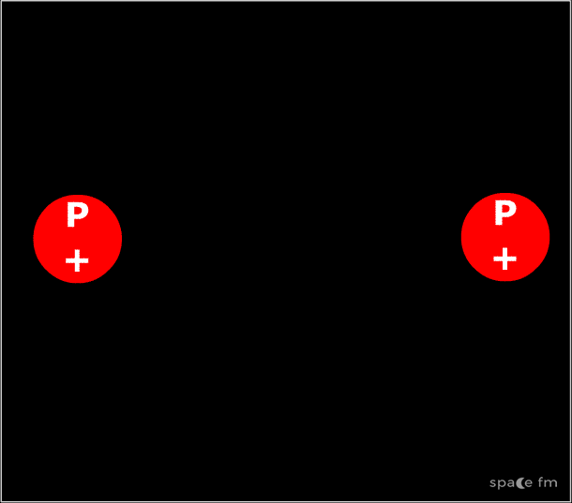
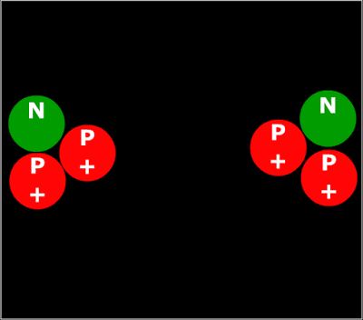
14.1 NUCLEAR REACTIONS
It is possible to change the structure of nuclei by bombarding them with energetic particles. Such collisions that change the identities of the target nuclei are called nuclear reactions.
Kinetic energy for the interacting nuclei should be greater than the Coulomb repulsive potential.
The conservation laws for nuclear reactions are
• Conservation of mass number, A. The total number of nucleons must be the same after the reaction as before. For the reaction under discussion, A_{before} = 1 + 7 = A_{after} = 4 + 4.
• Conservation of charge, q. Here the charged nuclear particles are protons, and q_{before} = 1 + 3 = q_{after} = 2 + 2.
• Conservation of energy, linear momentum, and angular momentum.

Slide 3
14.1 NUCLEAR REACTIONS
Example: (a) Calculate the Q value for the reaction
(b) Find the kinetic energy of the products if 600-keV protons are incident

Slide 4
14.1 NUCLEAR REACTIONS
Example: (a) Calculate the Q value for the reaction
(b) Find the threshold kinetic energy of the alpha particle.

Slide 5
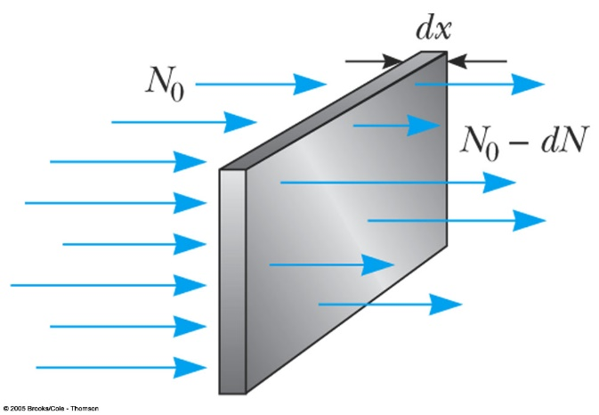
14.2 REACTION CROSS SECTION
The cross section, which is a measure of the probability that a particular nuclear reaction will occur.
When a beam of particles is incident on a target in the form of a thin foil, not every particle interacts with a target nucleus.
The total probability that an interaction will occur depends on the ratio of the “effective” area of the target nucleus to the area of the foil.
The cross section depends on:
R₀ = Rate at which incident particles strike the foil (particles/s)
R = Rate at which reaction events occur (reactions/s)
n = Number of target nuclei per unit volume (particles/m3)

Slide 6
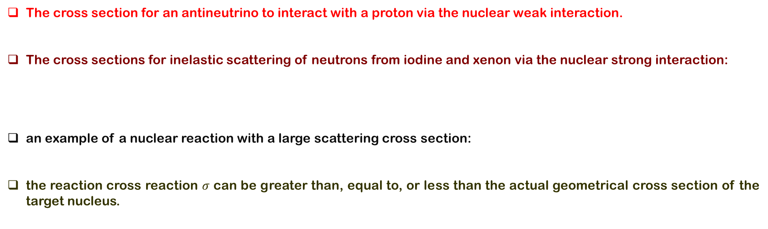
14.2 REACTION CROSS SECTION
The cross section for an antineutrino to interact with a proton via the nuclear weak interaction.
The cross sections for inelastic scattering of neutrons from iodine and xenon via the nuclear strong interaction:
an example of a nuclear reaction with a large scattering cross section:
the reaction cross reaction $σ$ can be greater than, equal to, or less than the actual geometrical cross section of the target nucleus.

Slide 7
14.2 REACTION CROSS SECTION
Example: For a certain incident proton energy the reaction p + ⁵⁶Fe → n + ⁵⁶Co has a cross section of 0.40 b. If we bombard a target in the form of a 1.0-cm-square, 1.0-μm-thick iron foil with a beam of protons equivalent to a current of 3.0μA, and if the beam is spread uniformly over the entire surface of the target, at what rate are the neutrons produced?

Slide 8
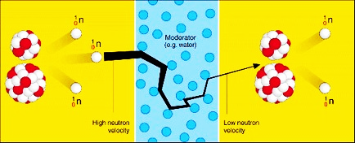
14.3 INTERACTIONS INVOLVING NEUTRONS
In order to understand the process of nuclear fission and the physics of the nuclear reactor, we must first understand the manner in which neutrons interact with nuclei.
Since neutrons interact very weakly with electrons, matter appears fairly transparent to neutrons.
In general, one finds that typical cross sections for neutron-induced reactions increase as the neutron energy decreases.
Free neutrons undergo beta decay with a mean lifetime of about 10 min. On the other hand, neutrons in matter are usually absorbed by nuclei before they decay.

Slide 9
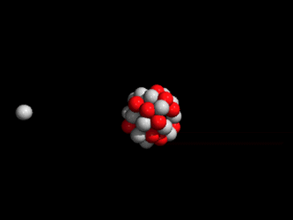
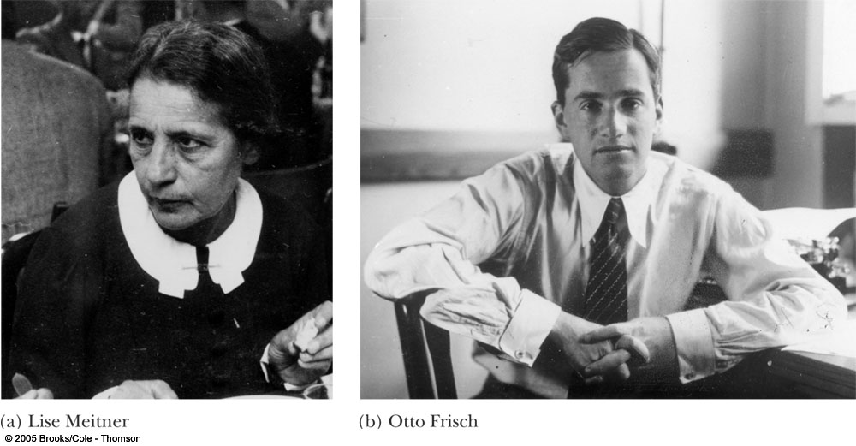
14.4 NUCLEAR FISSION
Nuclear fission occurs when a very heavy nucleus such as ²³⁵U splits, or fissions, into two particles of comparable mass.
In such a reaction, the total mass of the product particles is less than the original mass.
Fission is initiated by the capture of a thermal neutron by a heavy nucleus and involves the release of about 200 MeV per fission.
This energy release occurs because the smaller fission-product nuclei are more tightly bound by about 1 MeV per nucleon than the original heavy nucleus.

Slide 10
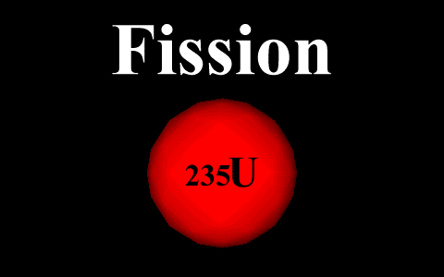
14.4 NUCLEAR FISSION
The ²³⁵U nucleus captures a thermal (slow-moving) neutron.
This capture results in the formation of ²³⁶U*, and the excess energy of this nucleus causes it to undergo violent oscillations.
The ²³⁶U* nucleus becomes highly distorted, and the force of repulsion between protons in the two halves of the dumbbell shape tends to increase the distortion.
The nucleus splits into two fragments, emitting several neutrons in the process.
The disintegration energy Q released in a typical fission process.
About 85% of this energy appears in the form of kinetic energy in the heavy fragments.
This energy is very large compared to the energy released in chemical processes.

Slide 11
14.4 NUCLEAR FISSION
EXAMPLE: Two other ways in which ²³⁵U can fission when bombarded with a neutron are (1) by forming ¹⁴⁰Xe and ⁹⁴Sr and (2) by forming ¹³²Sn and ¹⁰¹Mo. In each case, neutrons are also released. Find the number of neutrons released in each event.

Slide 12
14.4 NUCLEAR FISSION
EXAMPLE:. Consider the fission reaction ${}_{92}^{235}{U+n→{}_{56}^{141}{Ba+{}_{36}^{92}{Kr+2{}_{0}^{1}n}}}$. Find the Coulomb potential between the fragments inside the nucleus. What is the conclusion?

Slide 13
14.4 NUCLEAR FISSION
EXAMPLE:. Calculate the total energy released if 1.00 kg of ²³⁵U undergoes fission, taking the disintegration energy per event to be $Q=208$ MeV.

Slide 14
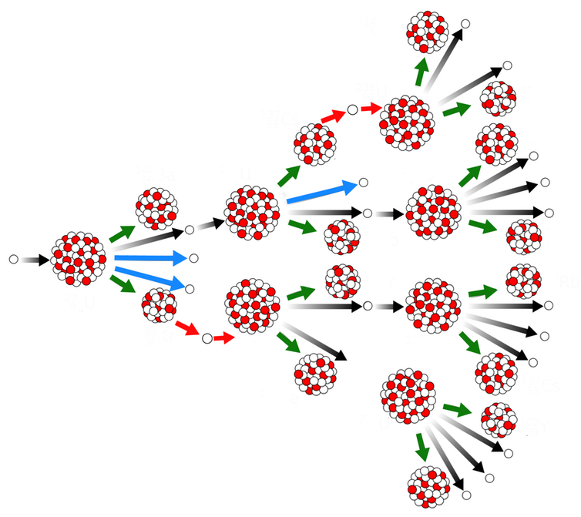
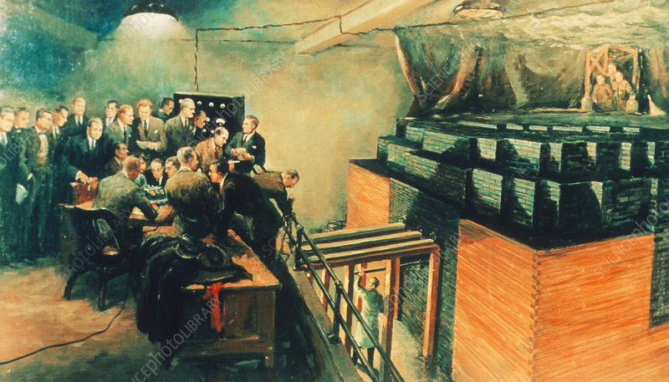
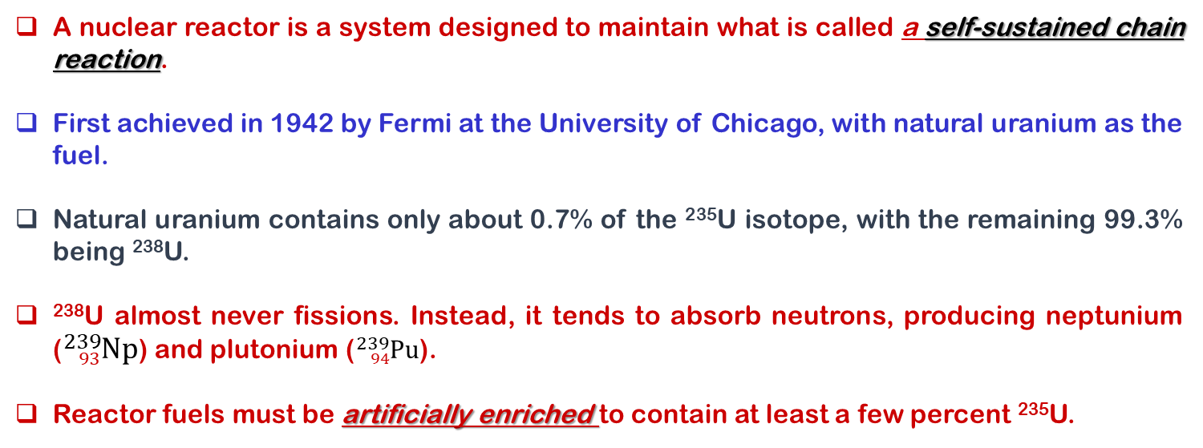
14.5 NUCLEAR REACTORS
A nuclear reactor is a system designed to maintain what is called a self-sustained chain reaction.
First achieved in 1942 by Fermi at the University of Chicago, with natural uranium as the fuel.
Natural uranium contains only about 0.7% of the ²³⁵U isotope, with the remaining 99.3% being ²³⁸U.
²³⁸U almost never fissions. Instead, it tends to absorb neutrons, producing neptunium (${}_{93}^{239}{Np}$) and plutonium (${}_{94}^{239}{Pu}$).
Reactor fuels must be artificially enriched to contain at least a few percent ²³⁵U.

Slide 15
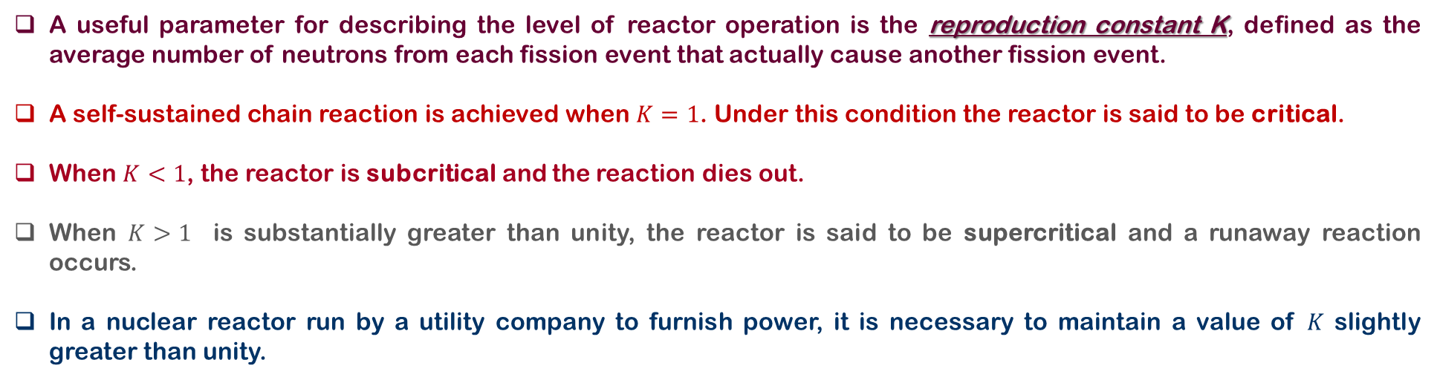
14.5 NUCLEAR REACTORS
A useful parameter for describing the level of reactor operation is the reproduction constant K, defined as the average number of neutrons from each fission event that actually cause another fission event.
A self-sustained chain reaction is achieved when $K=1$. Under this condition the reactor is said to be critical.
When $K<1$, the reactor is subcritical and the reaction dies out.
When $K>1$ is substantially greater than unity, the reactor is said to be supercritical and a runaway reaction occurs.
In a nuclear reactor run by a utility company to furnish power, it is necessary to maintain a value of $K$ slightly greater than unity.
Neutron Leakage
Therefore, a critical feature of the design of a reactor is to choose the correct surface-area-to-volume ratio so that a sustained reaction can be achieved.
Regulating Neutron Energies
Neutrons released in fission events with kinetic energies of about 2 MeV. It is necessary to slow these neutrons to thermal energies to produce fission of other ²³⁵U nuclei. Neutrons are slowed down by a moderator surrounding the fuel.

Slide 16
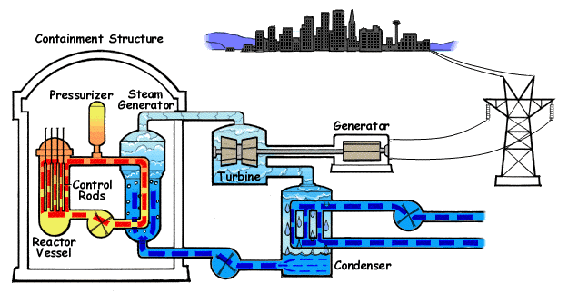
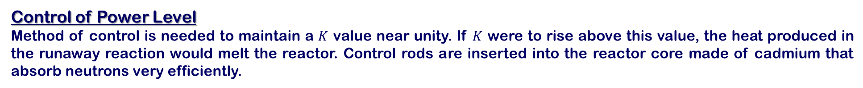
14.5 NUCLEAR REACTORS
Neutron Capture
²³⁸U, which constitutes over 90% of the uranium in the fuel elements captures neutrons with very high kinetic energies and very low when they have low kinetic energies. Thus the slowing down of the neutrons by the moderator serves the purpose of making them available for reaction with ²³⁵U.
Control of Power Level
Method of control is needed to maintain a $K$ value near unity. If $K$ were to rise above this value, the heat produced in the runaway reaction would melt the reactor. Control rods are inserted into the reactor core made of cadmium that absorb neutrons very efficiently.
Pressurized-water reactor is a common design for fission events. In the core, reactions supply heat to the water contained in the primary (closed) loop, which is maintained at high pressure to keep it from boiling. The hot water is pumped through a heat exchanger, and the heat is transferred to the water contained in the secondary loop, which is converted to steam, and then drives a turbine-generator system to create electric power.
Note that the water in the secondary loop is isolated from the water in the primary loop to prevent contamination of the secondary water and steam by radioactive nuclei from the reactor core.

Slide 17
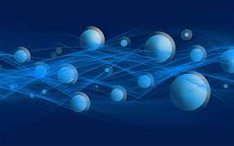
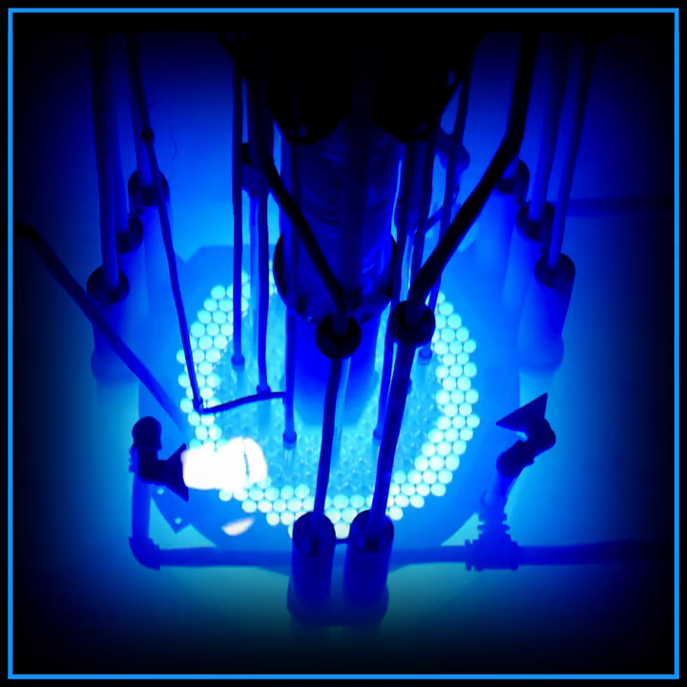
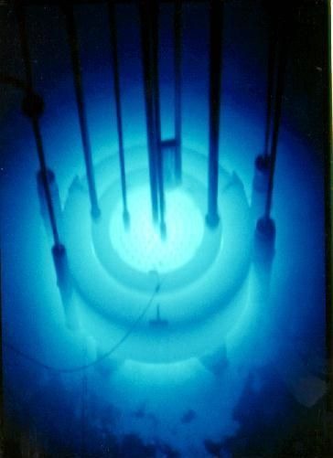
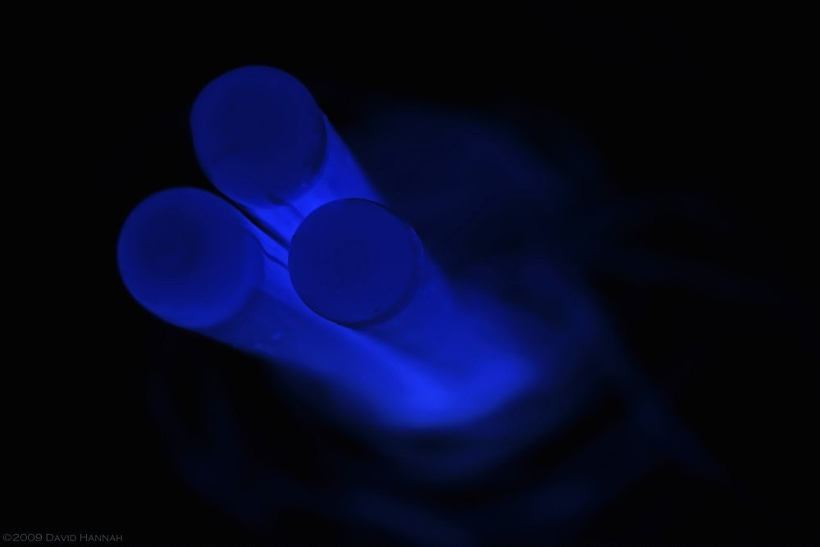
14.5 NUCLEAR REACTORS
Cherenkov radiation results when a charged particle, such as an electron, travels through a dielectric medium (an electrical insulator that can be polarized by an applied electric field) at a speed greater than the velocity of light in that medium.

Slide 18

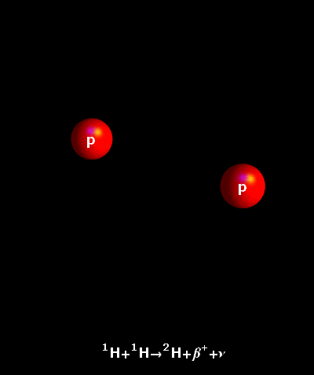
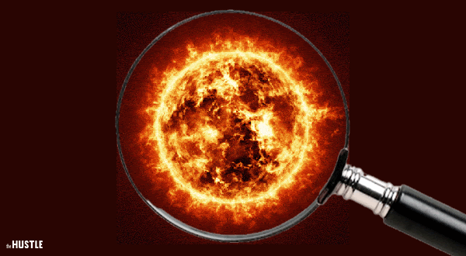
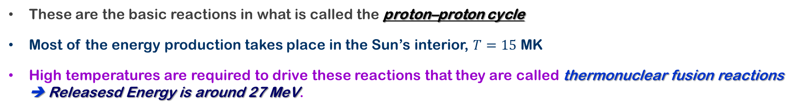
14.5 NUCLEAR FUSION
Nuclear fusion occurs when two light nuclei combine to form a heavier nucleus. Because the mass of the final nucleus is less than the combined rest masses of the original nuclei, a loss of mass occurs, accompanied by a release of energy.
This process can release energy as long as the final nucleus is less massive than about A = 56.
The following are examples of such energy-liberating fusion reactions occuring in the Sun.
These are the basic reactions in what is called the proton–proton cycle
Most of the energy production takes place in the Sun’s interior, $T=15$ MK
High temperatures are required to drive these reactions that they are called thermonuclear fusion reactions ➔ Releasesd Energy is around 27 MeV.

Slide 19
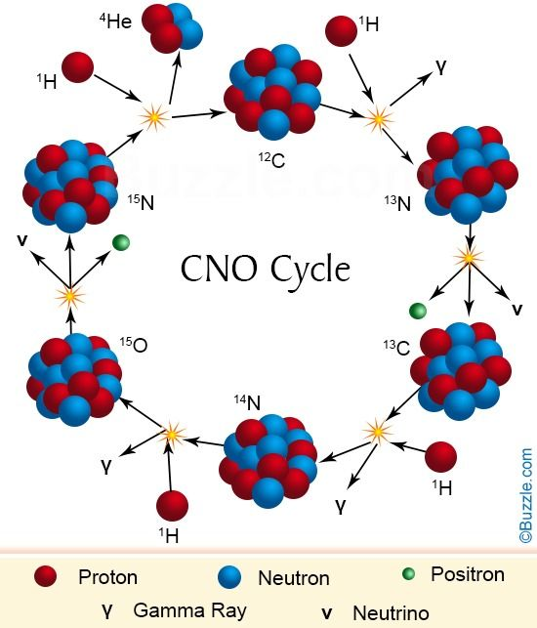
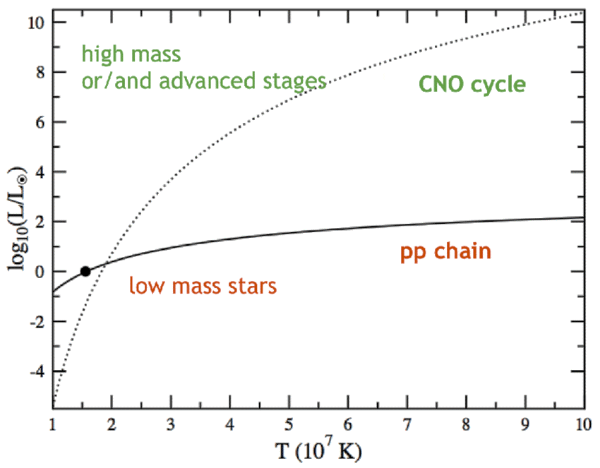
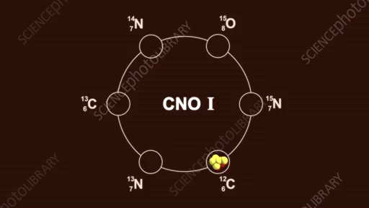
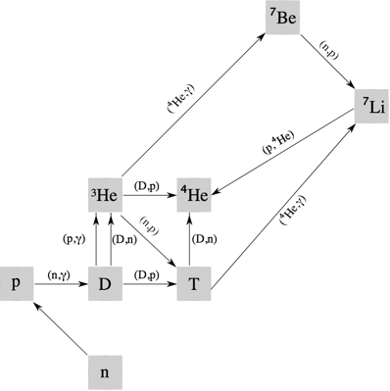
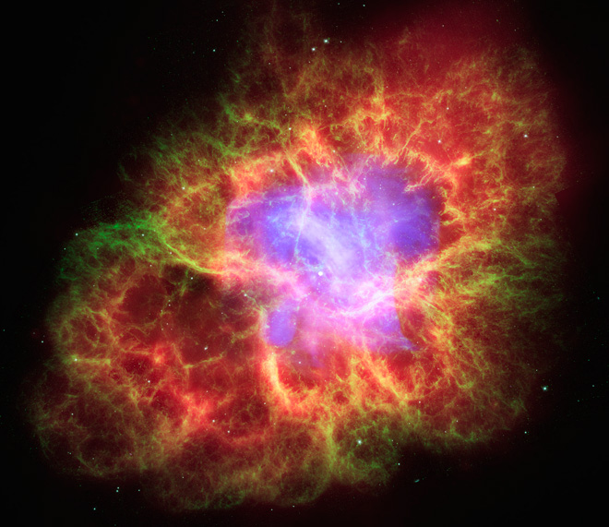
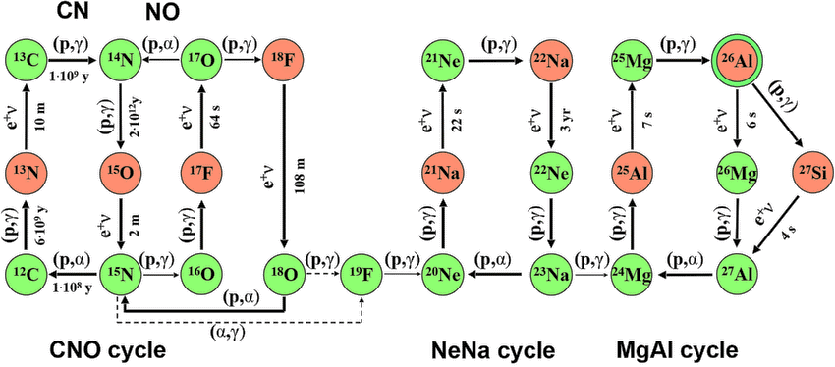
14.5 NUCLEAR FUSION
https://vimeo.com/205561634

Slide 20
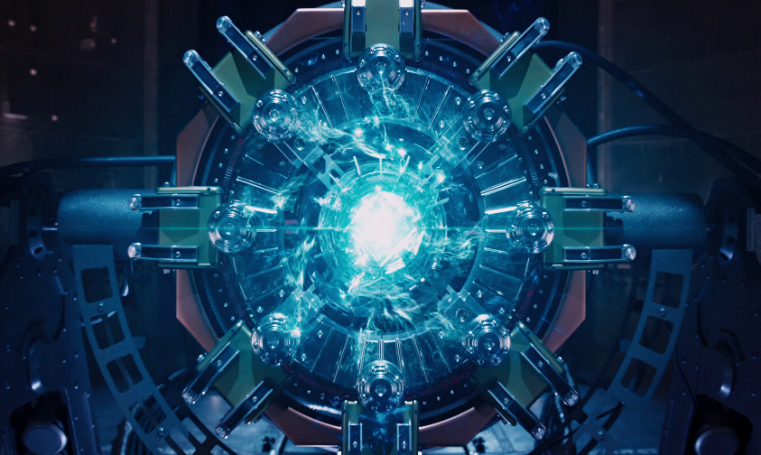
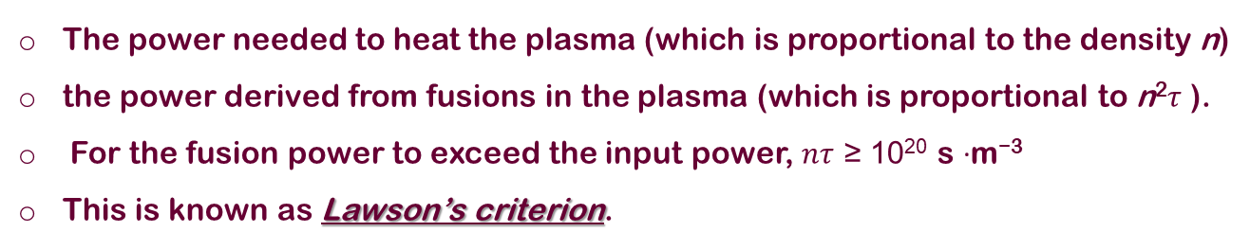
14.5 NUCLEAR FUSION – Reactors
For a controlled thermonuclear reactor, several reactions could be used, such as
The third reaction, known as the D-T (deuterium-tritium) reaction, has the largest energy release and is perhaps the best candidate for a fusion reactor.
When deuterium gas is heated to a high temperature, the atoms become ionized particles ➔ called a plasma.
To increase the probability of collisions between the ions ➔ increase fusion
a high density n, so that the particles have a high probability of collision;
a high temperature T ~ 10⁸ K, which increases the probability for the particles to penetrate their mutual Coulomb barrier.
a long confinement time τ , during which the high temperature and density must be maintained.
The power needed to heat the plasma (which is proportional to the density n)
the power derived from fusions in the plasma (which is proportional to n²$τ$ ).
For the fusion power to exceed the input power, $nτ$ ≥ 10²⁰ s ·m⁻³
This is known as Lawson’s criterion.
k_{B} =1.38× 10⁻²³ J/K

Slide 21
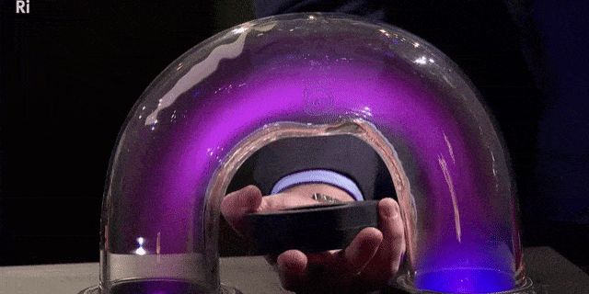
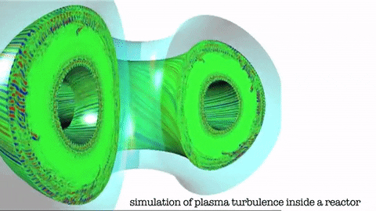
14.5 NUCLEAR FUSION – Reactors
Magnetic Confinement
There are two contributions to the magnetic field: One is along the toroid axis and another is around the axis. The
combination of these two fields gives a helical field along the toroid axis, and the charged particles are confined as they spiral about the field lines. This type of device is a called a tokamak.
Tokamak Fusion Test Reactor at Princeton University, which operated from 1982 to 1997 and achieved an ion temperature of $5.1×108$ K and a fusion power level of 10.7 MW. This device came very close to reaching Lawson’s criterion with a plasma density of $n = {10}^{20}$particles/m³ (five orders of magnitude smaller than an ordinary gas) and a confinement time of $τ = 0.2$s.
https://www.iter.org/proj/inafewlines

Slide 22
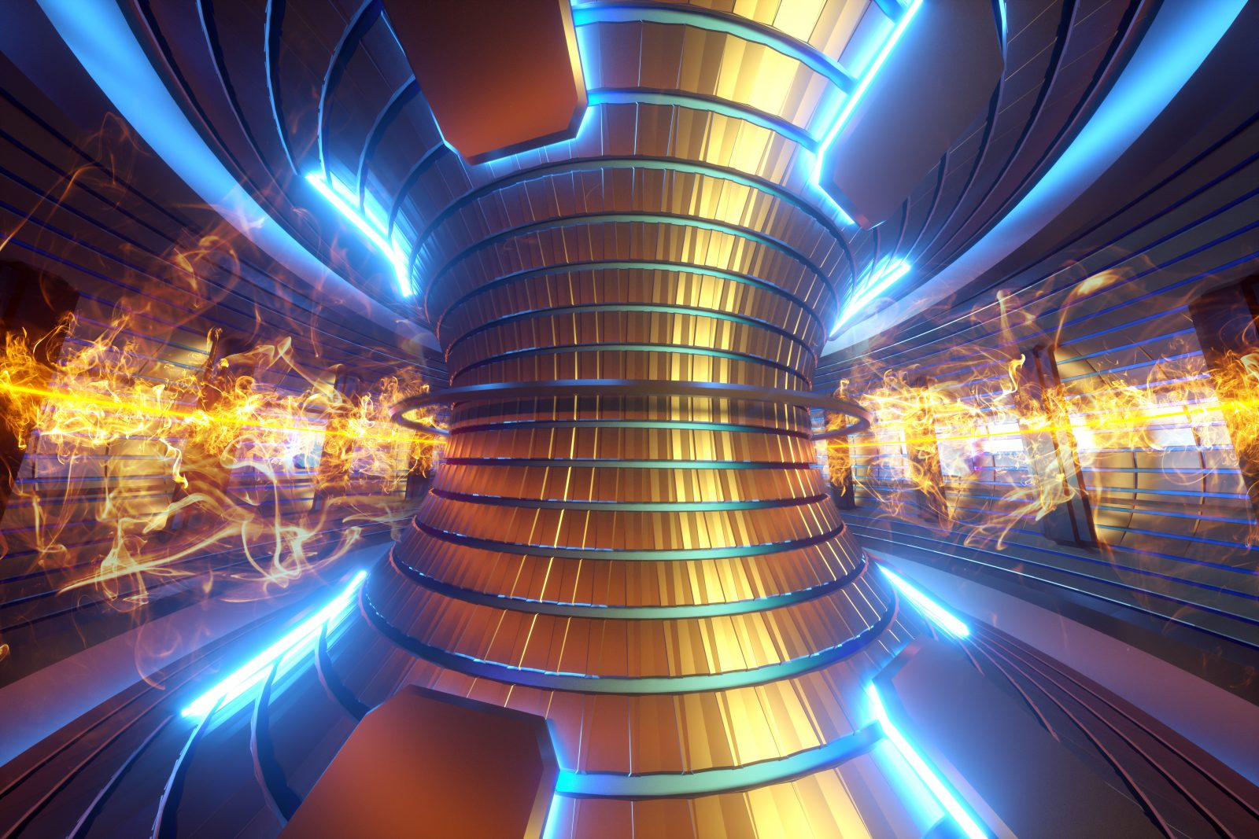
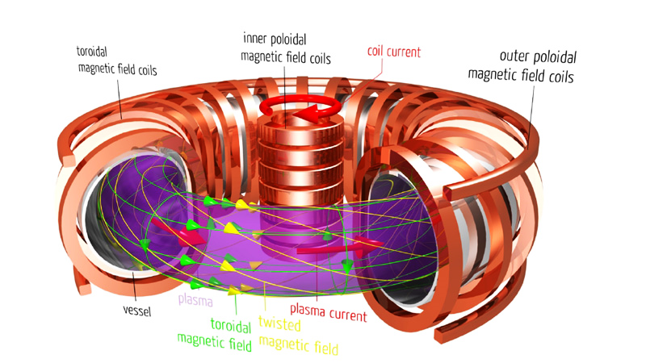
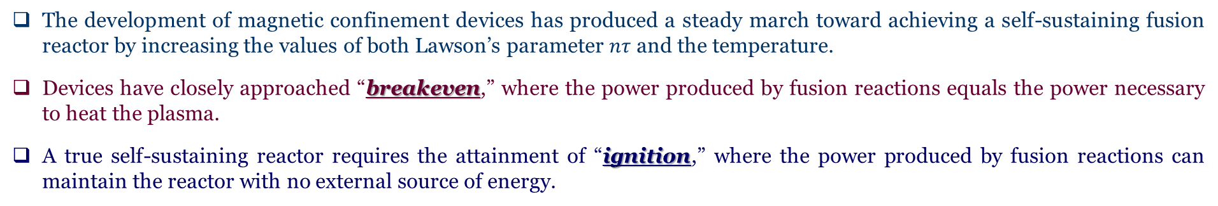
14.5 NUCLEAR FUSION – Reactors
The development of magnetic confinement devices has produced a steady march toward achieving a self-sustaining fusion reactor by increasing the values of both Lawson’s parameter $nτ$ and the temperature.
Devices have closely approached “breakeven,” where the power produced by fusion reactions equals the power necessary to heat the plasma.
A true self-sustaining reactor requires the attainment of “ignition,” where the power produced by fusion reactions can maintain the reactor with no external source of energy.
https://www.youtube.com/watch?v=vPS-epGPJmg

Slide 23
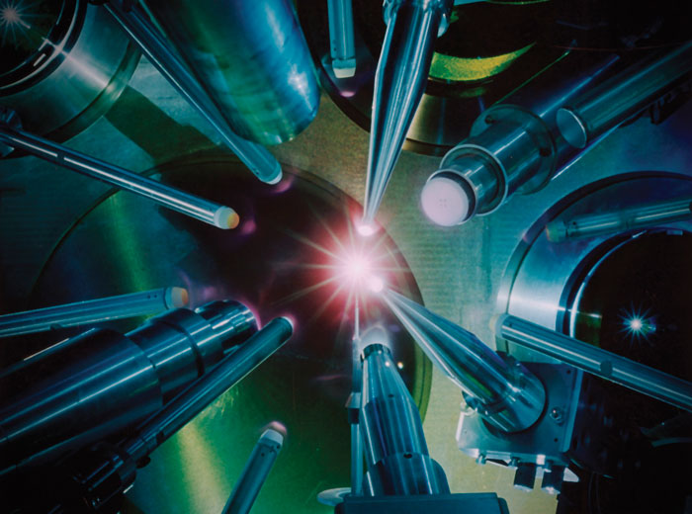


14.5 NUCLEAR FUSION – Reactors
Inertial confinement
Inertial confinement takes the opposite approach by compressing the fuel to high densities for very short confinement times.
A small pellet of D-T fuel is struck simultaneously from many directions by intense laser beams that first vaporize the pellet and convert it to a plasma, and then heat and compress it to the point at which fusion can occur.
The laser pulses are very short, typically lasting only about 1 ns, and thus according to Lawson’s criterion the density must exceed 10²⁹ particles/m³.
However, because of inefficiencies of the lasers and other losses a self-sustaining laser fusion reactor must exceed this minimum by perhaps 2–3 orders of magnitude.

Slide 24
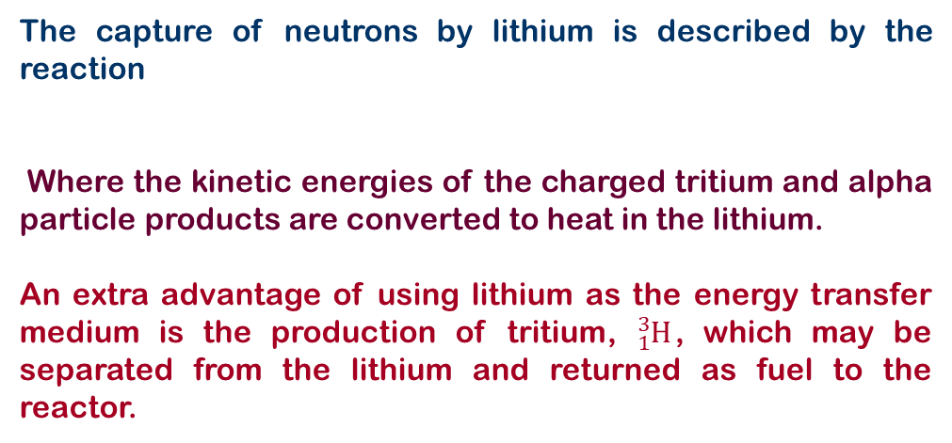
14.5 NUCLEAR FUSION – Reactors
In the D–T fusion reaction
the alpha particle carries 20% of the energy and the neutron carries 80%, or about 14 MeV.
Alphas are primarily absorbed in the plasma and produce additional plasma heating,
The 14-MeV neutrons pass through the plasma and must be absorbed in a surrounding blanket material to extract their large kinetic energy and generate electric power.
A frequently proposed scheme is to use molten lithium metal as neutron absorber and electricity producer.
Lithium about 1 m thick would capture nearly 100% of the neutrons from the fusion of a small D–T pellet
The capture of neutrons by lithium is described by the reaction
Where the kinetic energies of the charged tritium and alpha particle products are converted to heat in the lithium.
An extra advantage of using lithium as the energy transfer medium is the production of tritium, ${}_{1}^{3}H$, which may be separated from the lithium and returned as fuel to the reactor.

Slide 25
14.5 NUCLEAR FUSION – Reactors
Example: The half-life of tritium is 12 yr. If the TFTR fusion reactor contains 50 m³ of tritium at a density equal to 1.5 x 10¹⁴ particles/cm³, how many curies of tritium are in the plasma? Compare this with a fission reactor supply of 4 x 10¹⁰ Ci.

Slide 26
14.5 NUCLEAR FUSION – Reactors
Example: The Sun radiates energy at the rate of 4x10²³ kW. Assuming that the reaction accounts for all the energy released
calculate (a) the number of protons fused per second and (b) the mass transformed into energy per second.

Slide 27
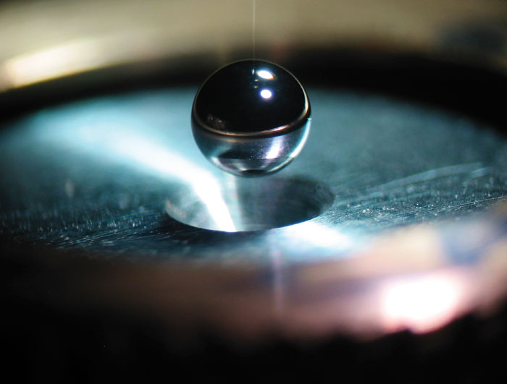
14.5 NUCLEAR FUSION – Example
Example: In a laser fusion reaction, a pellet containing a 50:50 mixture of D and T experiences a density increase of 1000 times when struck by a laser pulse. (a) Find the particle density in the compressed state if the normal density is 0.20 g/cm³. (b) How long must the D and T nuclei be confined at this density if the reaction is to achieve a break-even condition?

Slide 28
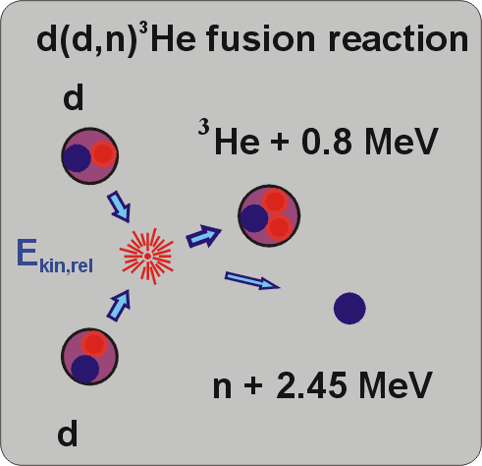
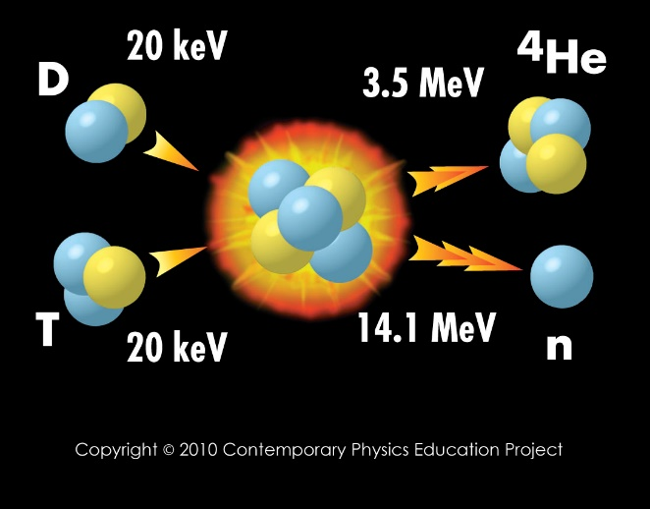
14.5 NUCLEAR FUSION – Example
Example: Two nuclei with atomic numbers Z₁ and Z₂ approach each other with a total energy E. (a) If the minimum distance of approach for fusion to occur is $r={10}^{−14}$ m, find E in terms of Z₁ and Z₂. (b) Calculate the minimum energy for fusion for the D–D and D–T reactions

Slide 29
14.5 NUCLEAR FUSION – Example
Example: Calculate the energy (in kWh) released if 1.0 kg of ²³⁹Pu undergoes complete fission and the energy released per fission event is 200 MeV.

Slide 31

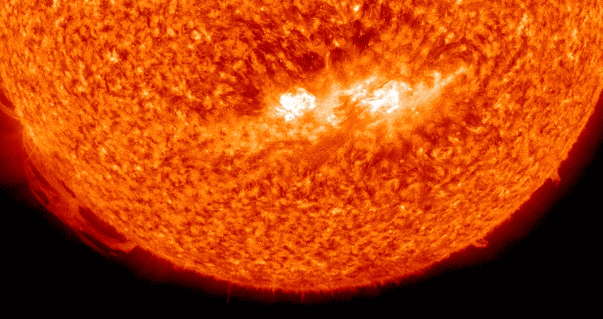
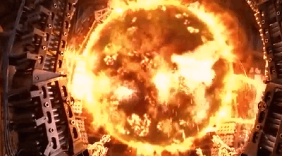
End of CH 14
Dr. Tariq Al-Abdullah

