Slide 1
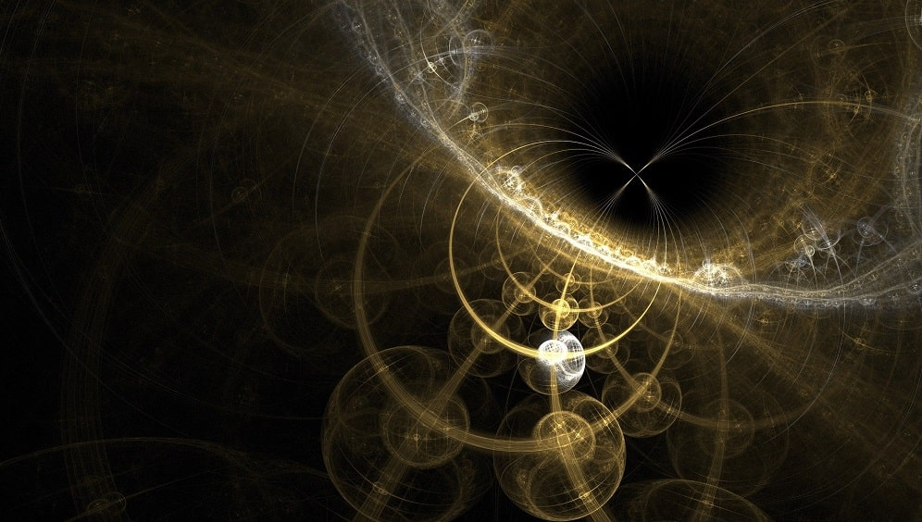
Modern Physics
CH 3
The Quantum Theory of Light
Dr. Tariq Al-Abdullah

Slide 2
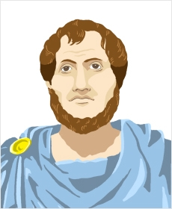
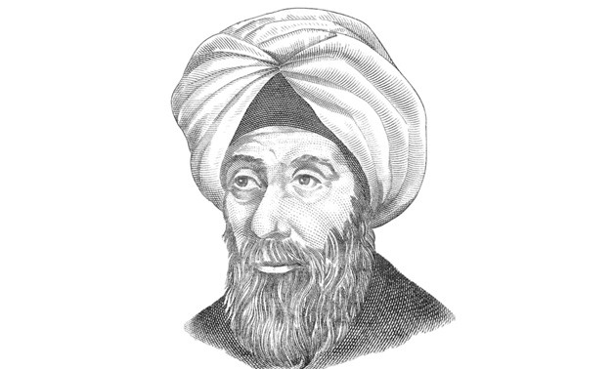

The Birth of Modern Physics:
5th-3rd B.C.
“The essence of light is white light. Colors are made up of a mixture of lightness and darkness.” Era of Ancient Greece (Aristotle)
10th-11th centuries
"Why does the moon appear larger near the horizon than it does when higher up in the sky ?“
“the father of optics.” As he suggested that light travels to the eye in rays from different points on an object.
Ibn al-Haytham (Alhazen) 965-1040
Ibn Sina, discussed the theory of motion and he suggested that any projectile in a vacuum would not stop unless it is acted upon by opposite force.
Abu’l-Barakat discussed the acceleration of a falling body as a result of its increasing momentum.
Ibn Bajjah explained that there is always a reaction force for any opposite force. But he did not note that these forces are equal.

Slide 3

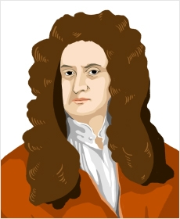
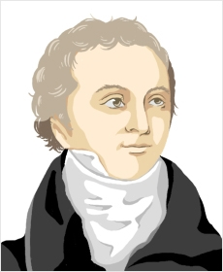
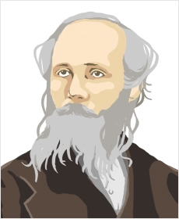
17th-18th centuries
“Light is comprised of colored particles.”
Sir Isaac Newton 1643-1727
“Light is a wave.”
Christiaan Huygens, 1629-1695
18th-19th centuries
“Proof of the wave theory of light”
Thomas Young, 1773-1829
“Predicted the existence of electromagnetic waves”
James Clerk Maxwell, 1831-1879

Slide 4
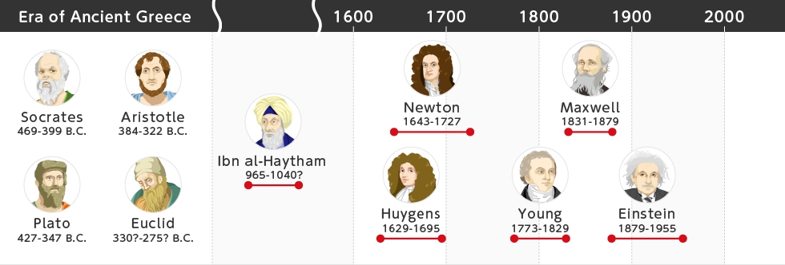
The Birth of Modern Physics:
The term modern physics means up-to-date physics. This term refers to the breakthrough that happened after Newton’s laws, Maxwell’s equations, and thermodynamics, these laws which are known as “classical” physics.
Despite the achievements of classical physics at the end of the nineteenth century, it faced a lot of limitations and serious crises that couldn’t be solved using the physics laws of that time.
Some examples for these limitations were the inability of classical physics to explain certain physical phenomena, such as the energy distribution in blackbody radiation and the photoelectric effect.

Slide 5
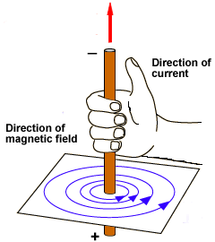
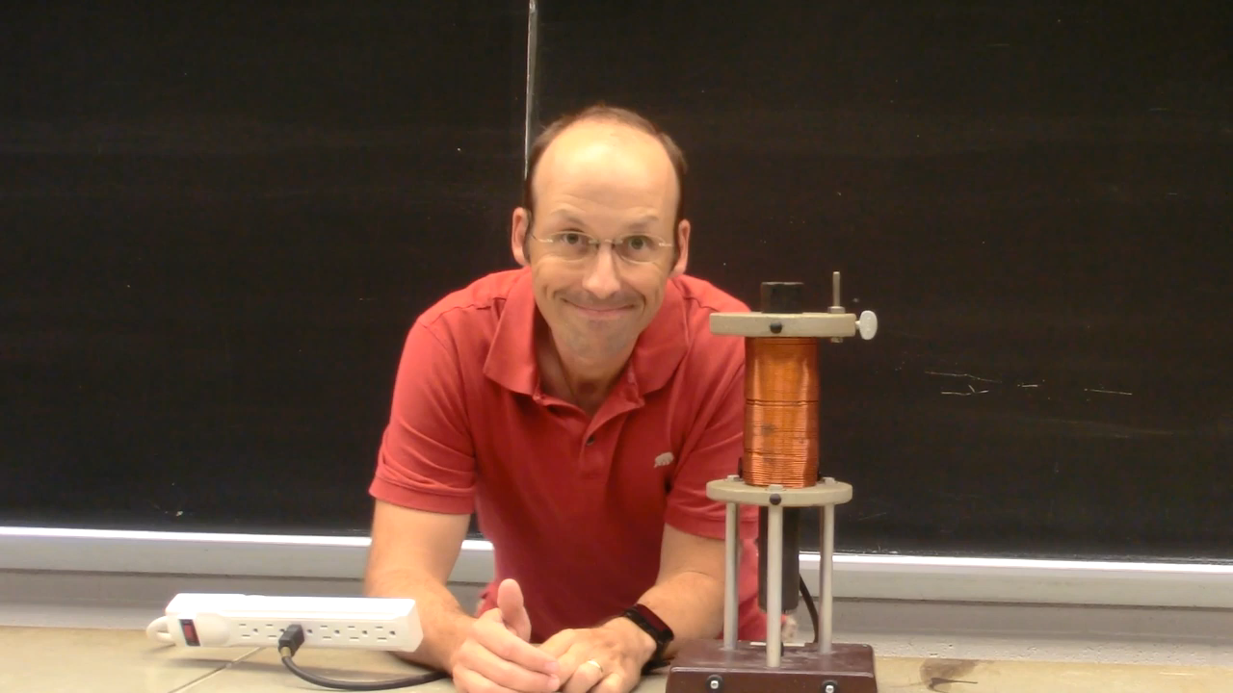
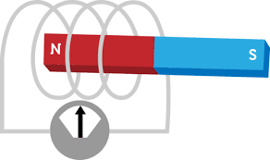
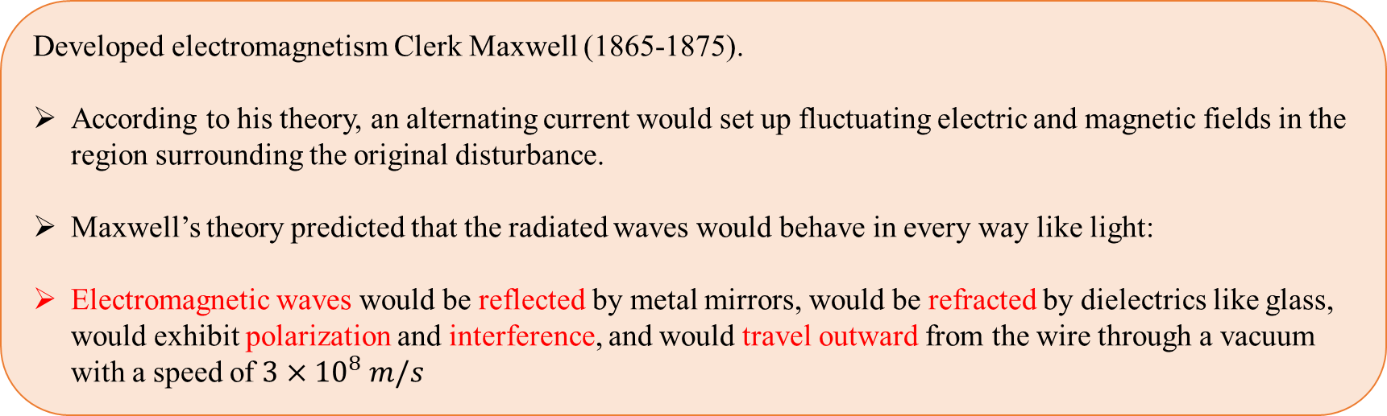
3.1 Hertz’s Experiments – Light as an EM wave
Developed electromagnetism Clerk Maxwell (1865-1875).
According to his theory, an alternating current would set up fluctuating electric and magnetic fields in the region surrounding the original disturbance.
Maxwell’s theory predicted that the radiated waves would behave in every way like light:
Electromagnetic waves would be reflected by metal mirrors, would be refracted by dielectrics like glass, would exhibit polarization and interference, and would travel outward from the wire through a vacuum with a speed of $3×{10}^{8} m/s$

Slide 6

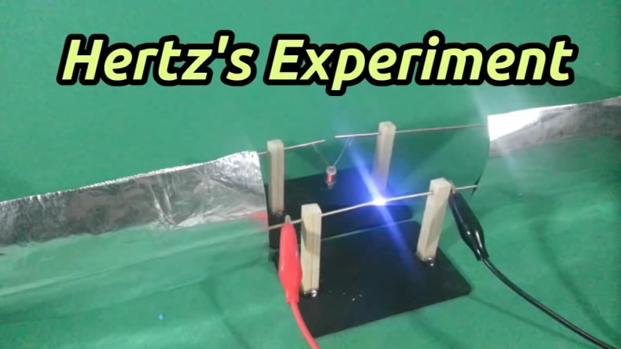

3.1 Hertz’s Experiments – Light as an EM wave
No direct experimental verification was capable for detecting such EM-waves??
Heinrich Hertz (1857-1894) performed a series of brilliant experiments ➔ proof Maxwell’s theory
He found the detected radiation to have a wavelength of about 60 cm, corresponding to the oscillator frequency of $5∗{10}^{8}$Hz. (Recall that $c=λf$, where is the wavelength and f is the frequency.)

Slide 7
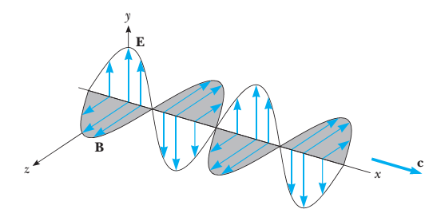
3.1 Hertz’s Experiments – Light as an EM wave
Hertz next proceeded to show that these electromagnetic waves could be reflected, refracted, focused, polarized, and made to interfere—in short, he convinced physicists of the period that Hertzian waves and light waves were one and the same.
A light or radio wave far from the source according to Maxwell and Hertz.

Slide 8
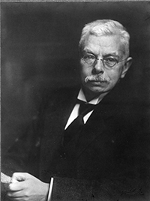
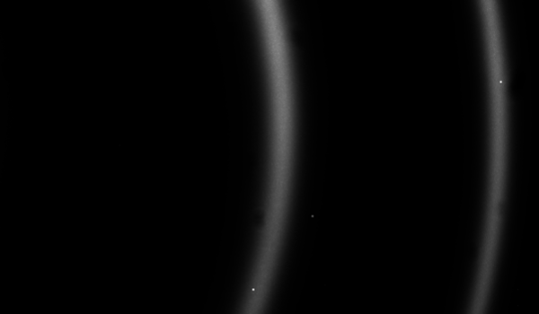
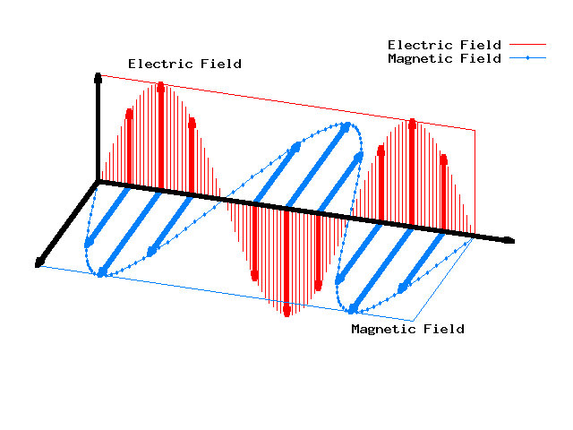
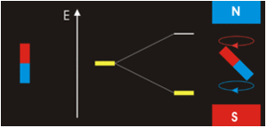
3.1 Hertz’s Experiments – Light as an EM wave
Zeeman effect (1896),
A strong magnetic field changes the frequency of the light emitted by a glowing gas.
➔ An impressive victory for Maxwell, it was found that Maxwell’s equations correctly predicted the change of vibration of the electric oscillators and hence, the change in frequency of the light emitted.
Maxwell, with Hertz had united the formerly independent kingdoms of electricity, magnetism, and light!

Slide 9

3.2 Black Body Radiation
a long-standing puzzle about radiation:
The problem is to predict the radiation intensity at a given wavelength emitted by a hot glowing solid at a specific temperature.
In 1792 Thomas Wedgwood observed that all the objects in his ovens, regardless of their chemical nature, size, or shape, became red at the same temperature.
By the mid-1800s it was known that glowing solids emit continuous spectra rather than the bands or lines emitted by heated gases.
In 1859, Gustav Kirchhoff proved a theorem that for any body in thermal equilibrium with radiation the emitted power is proportional to the power absorbed;
$$e_{f}=J\left(T,f\right)A_{f}$$
e_{f}: the power emitted per unit area per unit frequency by a particular heated object
A_{f}: the absorption power (fraction of the incident power absorbed per unit area per unit frequency by the heated object)
J( f, T) is a universal function (the same for all bodies) that depends only on f and T
A blackbody is defined as an object that absorbs all the electromagnetic radiation falling on it and consequently appears black.

Slide 10
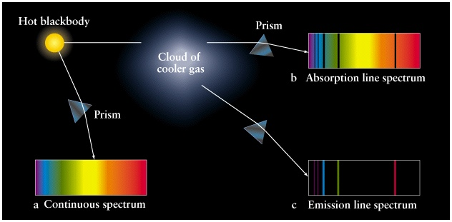
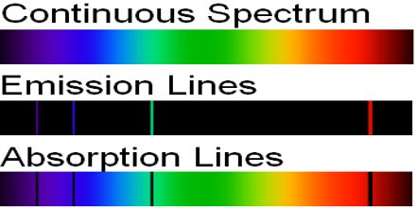
3.2 Black Body Radiation
Because absorption and emission are connected by Kirchhoff’s theorem:
A blackbody or perfect absorber is also an ideal radiator.
In practice, a small opening in any heated cavity, such as a port in an oven, behaves like a blackbody because such an opening traps all incident radiation.
If the direction of the radiation is reversed, the light emitted by a small opening is in thermal equilibrium with the walls, because it has been absorbed and re-emitted many times.

Slide 11
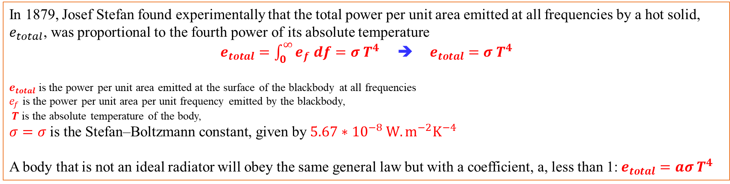
3.2 Black Body Radiation
In 1879, Josef Stefan found experimentally that the total power per unit area emitted at all frequencies by a hot solid, $e_{total}$, was proportional to the fourth power of its absolute temperature
$e_{total}=\int_{0}^{∞}{e_{f} df=σ T^{4}}$ ➔ $e_{total}=σ T^{4}$
$e_{total}$ is the power per unit area emitted at the surface of the blackbody at all frequencies
$e_{f}$ is the power per unit area per unit frequency emitted by the blackbody,
$T$ is the absolute temperature of the body,
$$σ=σ \text{is} \text{the} \text{Stefan}\text{–}\text{Boltzmann} \text{constant}\text{, }\text{given} \text{by} 5.67∗{10}^{−8} W.m^{−2}K^{−4}$$
A body that is not an ideal radiator will obey the same general law but with a coefficient, a, less than 1:$e_{total}=aσ T^{4}$
emissivity

Slide 12
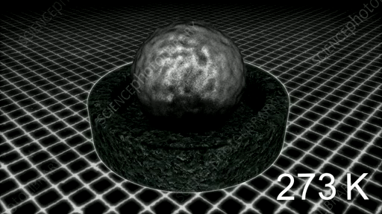
3.2 Black Body Radiation
Like the total radiated power e_{tot}, the spectral distribution of the radiation emitted by a blackbody is found empirically to depend only on the absolute temperature T.
The spectral distribution is determined experimentally as illustrated
The measured spectral distribution function e(λ) versus λ for several values of T ranging from 1000 K to 6000 K.
The wavelength at which the distribution has its maximum value varies inversely with the temperature:

Slide 13
3.2 Black Body Radiation
How Big Is a Star? Measurement of the wavelength at which the spectral distribution e(λ) from a certain star is maximum indicates that the star’s surface temperature is 3000 K. If the star is also found to radiate 100 times the power radiated by the Sun, how big is the star? The Sun’s surface temperature is 5800 K.

Slide 14
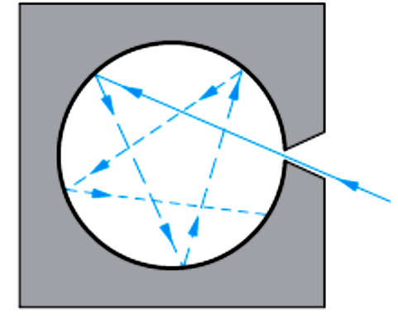

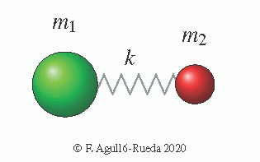
3.3 The Rayleigh-Jeans Law and Plank Law
The power radiated out of the hole is proportional to the total energy density U (the energy per unit volume of the radiation in the cavity). The proportionality constant is c / 4, where c is the speed of light
The method involves finding the number of modes of oscillation of the electromagnetic field in the cavity with wavelengths in the interval d λ and multiplying by the average energy per mode.
According to classical kinetic theory, the average energy per mode of oscillation is kT, the same as for a one-dimensional harmonic oscillator, where k is the Boltzmann constant; Rayleigh-Jeans equation:

Slide 15
3.3 The Rayleigh-Jeans Law and Plank Law
At very long wavelengths the Rayleigh-Jeans equation agrees with the experimentally determined spectral distribution, but at short wavelengths this equation predicts that u(λ) becomes large, approaching infinity as λ → 0, whereas experiment shows that the distribution actually approaches zero as λ → 0.

Slide 16
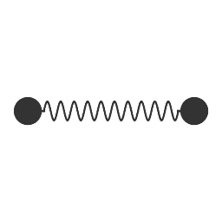
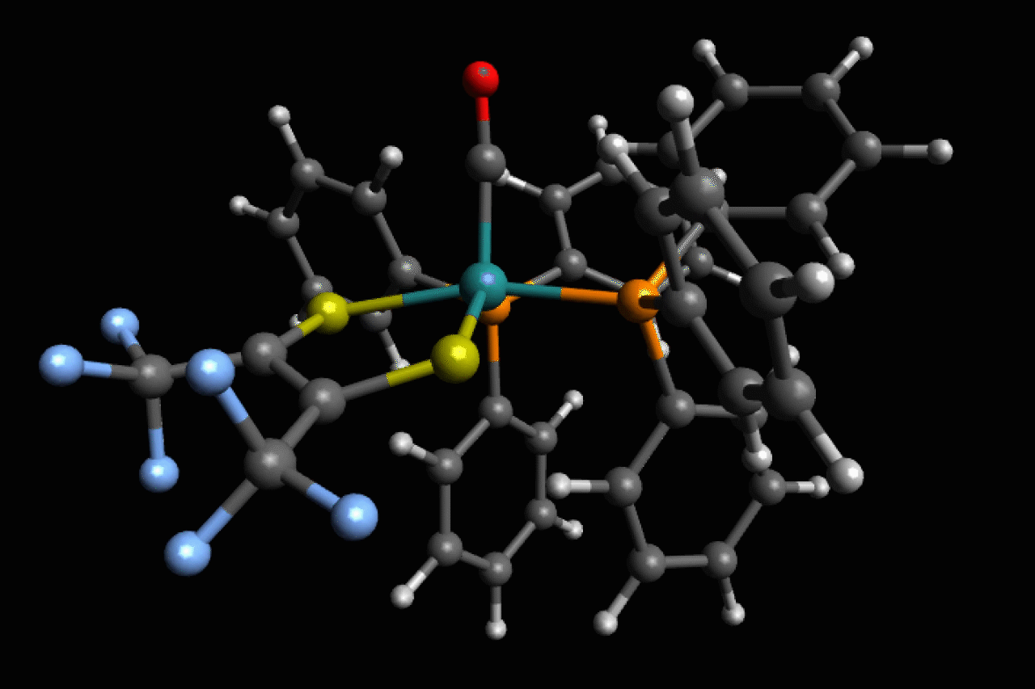
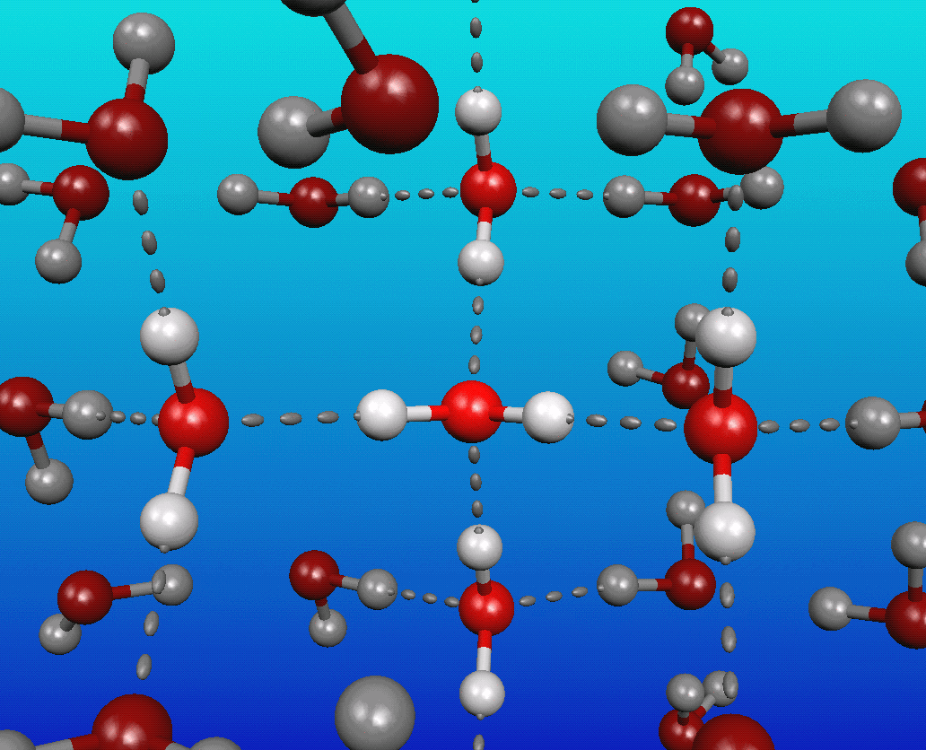
3.3 The Rayleigh-Jeans Law and Plank Law
In 1900 the German physicist Max Planck could derive a function u (λ) that agreed with the experimental data. (empirical function).
Electromagnetic waves in the cavity are produced by accelerated electric charges in the walls of the cavity.
The average energy for a one-dimensional simple harmonic oscillator is calculated classically from the energy distribution function, which in turn is found from the Maxwell-Boltzmann distribution function.

Slide 17
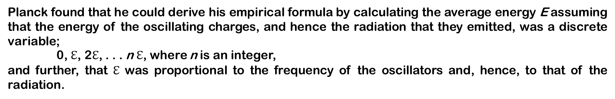
3.3 The Rayleigh-Jeans Law and Plank Law
Planck found that he could derive his empirical formula by calculating the average energy E assuming that the energy of the oscillating charges, and hence the radiation that they emitted, was a discrete variable;
0, $ℇ$, 2$ℇ$, . . . n $ℇ$, where n is an integer,
and further, that $ℇ$ was proportional to the frequency of the oscillators and, hence, to that of the radiation.

Slide 18
3.3 The Rayleigh-Jeans Law and Plank Law

Slide 19
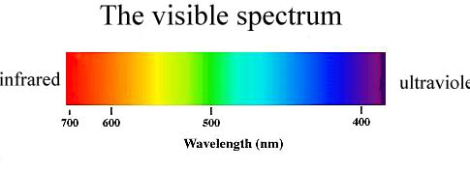
3.3 The Rayleigh-Jeans Law and Plank Law
Peak of the Solar Spectrum The surface temperature of the Sun is about 5800 K, and measurements of the Sun’s spectral distribution show that it radiates very nearly like a blackbody, deviating mainly at very short wavelengths. Assuming that the Sun radiates like an ideal blackbody, at what wavelength does the peak of the solar spectrum occur?

Slide 20
3.3 The Rayleigh-Jeans Law and Plank Law
Average Energy of an Oscillator What is the average energy $\overline{E}$ of an oscillator that has a frequency given by hf = kT according to Planck’s calculation?

Slide 21
3.3 The Rayleigh-Jeans Law and Plank Law
Stefan-Boltzmann from Planck Show that the total energy density in a blackbody cavity is proportional to T⁴ in accordance with the Stefan-Boltzmann law.

Slide 22
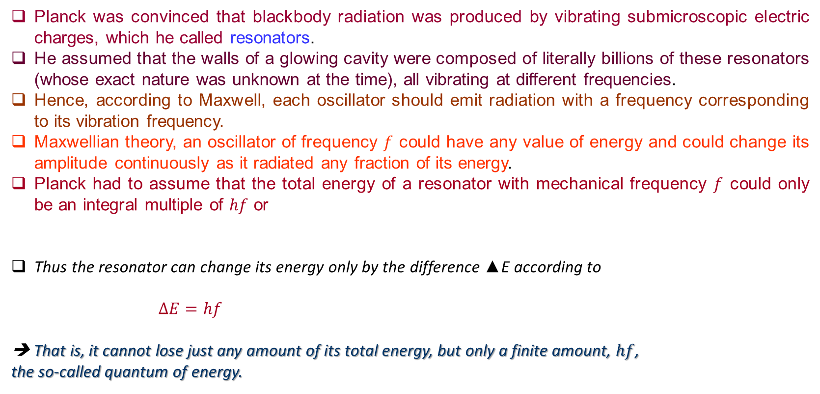
3.4 Light Quantization and the Photoelectric Effect
Planck was convinced that blackbody radiation was produced by vibrating submicroscopic electric charges, which he called resonators.
He assumed that the walls of a glowing cavity were composed of literally billions of these resonators (whose exact nature was unknown at the time), all vibrating at different frequencies.
Hence, according to Maxwell, each oscillator should emit radiation with a frequency corresponding to its vibration frequency.
Maxwellian theory, an oscillator of frequency $f$ could have any value of energy and could change its amplitude continuously as it radiated any fraction of its energy.
Planck had to assume that the total energy of a resonator with mechanical frequency $f$ could only be an integral multiple of $hf$ or
Thus the resonator can change its energy only by the difference ▲E according to
$∆E=hf$
➔ That is, it cannot lose just any amount of its total energy, but only a finite amount, $hf$,
the so-called quantum of energy.

Slide 23
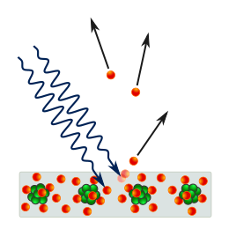
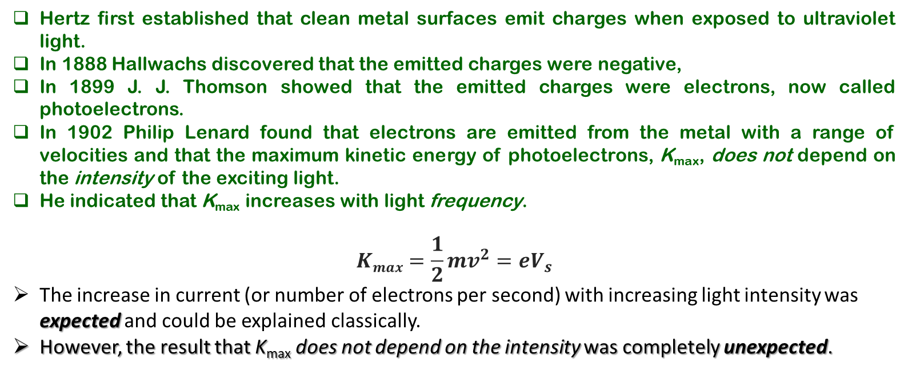
3.4 Light Quantization and the Photoelectric Effect
Einstein recognized an inconsistency between Planck’s quantization of oscillators in the walls of the blackbody and Planck’s insistence that the cavity radiation consisted of classical electromagnetic waves.
The change in entropy of blackbody radiation was like the change in entropy of an ideal gas consisting of independent particles Einstein concluded that light itself is composed of “grains,” irreducible finite amounts, or quanta of energy
Hertz first established that clean metal surfaces emit charges when exposed to ultraviolet light.
In 1888 Hallwachs discovered that the emitted charges were negative,
In 1899 J. J. Thomson showed that the emitted charges were electrons, now called photoelectrons.
In 1902 Philip Lenard found that electrons are emitted from the metal with a range of velocities and that the maximum kinetic energy of photoelectrons, K_{max}, does not depend on the intensity of the exciting light.
He indicated that K_{max} increases with light frequency.
$$Kmax=\frac{1}{2}mv^{2}=eV_{s}$$
The increase in current (or number of electrons per second) with increasing light intensity was expected and could be explained classically.
However, the result that K_{max} does not depend on the intensity was completely unexpected.

Slide 24

3.4 Light Quantization and the Photoelectric Effect
https://phet.colorado.edu/sims/cheerpj/photoelectric/latest/photoelectric.html?simulation=photoelectric
https://www.thephysicsaviary.com/Physics/Programs/Labs/PhotoelectricEffect/index.html

Slide 25
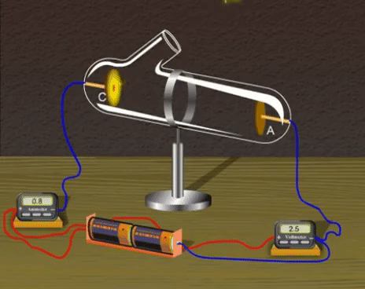
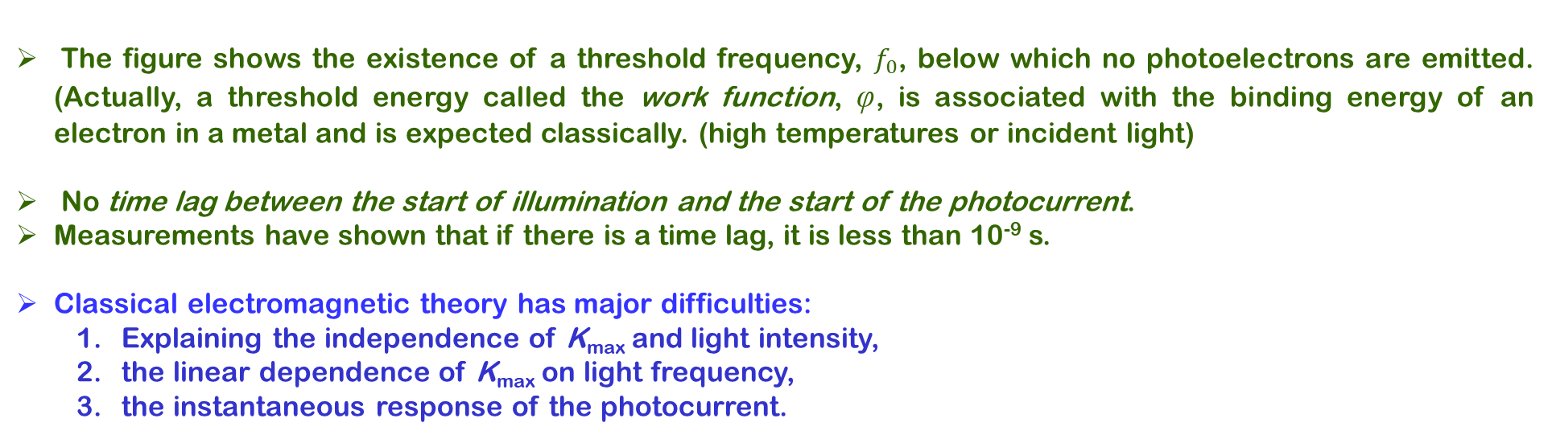
3.4 Light Quantization and the Photoelectric Effect
The figure shows the existence of a threshold frequency, $f_{0}$, below which no photoelectrons are emitted. (Actually, a threshold energy called the work function, φ, is associated with the binding energy of an electron in a metal and is expected classically. (high temperatures or incident light)
No time lag between the start of illumination and the start of the photocurrent.
Measurements have shown that if there is a time lag, it is less than 10⁻⁹ s.
Classical electromagnetic theory has major difficulties:
Explaining the independence of K_{max} and light intensity,
the linear dependence of K_{max} on light frequency,
the instantaneous response of the photocurrent.

Slide 26

3.4 Light Quantization and the Photoelectric Effect
Einstein maintained that the energy of light is not distributed evenly over the classical wavefront, but is concentrated in discrete regions (or in “bundles”), called quanta, each containing energy, $hf$.
Einstein’s picture was that a light quantum was so localized that it gave all its energy, hf, directly to a single electron in the metal. Therefore, according to Einstein, the maximum kinetic energy for emitted electrons is
where $φ$ is the work function of the metal, which corresponds to the minimum energy with which an electron is bound in the metal.
For a fixed light frequency $f,$ an increase in light intensity means more photons and more photoelectrons per second, although $Kmax$remains unchanged

Slide 27
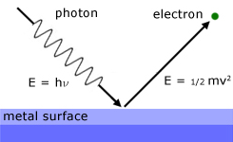
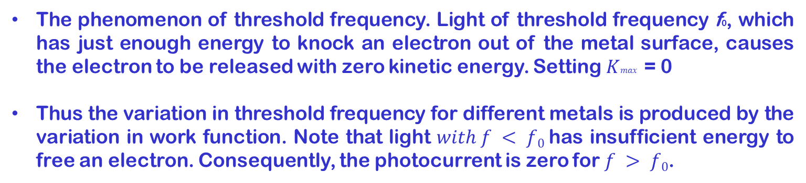
3.4 Light Quantization and the Photoelectric Effect
The phenomenon of threshold frequency. Light of threshold frequency f0, which has just enough energy to knock an electron out of the metal surface, causes the electron to be released with zero kinetic energy. Setting $Kmax$ = 0
Thus the variation in threshold frequency for different metals is produced by the variation in work function. Note that light $with f < f0$has insufficient energy to free an electron. Consequently, the photocurrent is zero for $f > f0$.

Slide 28
3.4 Light Quantization and the Photoelectric Effect
3-10: An FM radio transmitter has a power output of 100 kW and operates at a frequency of 94 MHz. How many photons per second does the transmitter emit?

Slide 29
3.4 Light Quantization and the Photoelectric Effect
3-13: The photocurrent of a photocell is cut off by a retarding potential of 2.92 V for radiation of wavelength 250 nm. Find the work function for the material.

Slide 30
3.4 Light Quantization and the Photoelectric Effect
3-16: When cesium metal is illuminated with light of wavelength 300 nm, the photoelectrons emitted have a maximum kinetic energy of 2.23 eV. Find:
the work function of cesium and
the stopping potential if the incident light has a wavelength of 400 nm.

Slide 31
3.4 Light Quantization and the Photoelectric Effect
3-16: A light source of wavelength illuminates a metal and ejects photoelectrons with a maximum kinetic energy of 1.00 eV. A second light source with half the wavelength of the first ejects photoelectrons with a maximum kinetic energy of 4.00 eV. What is the work function of the metal?

Slide 32
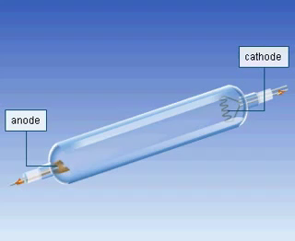
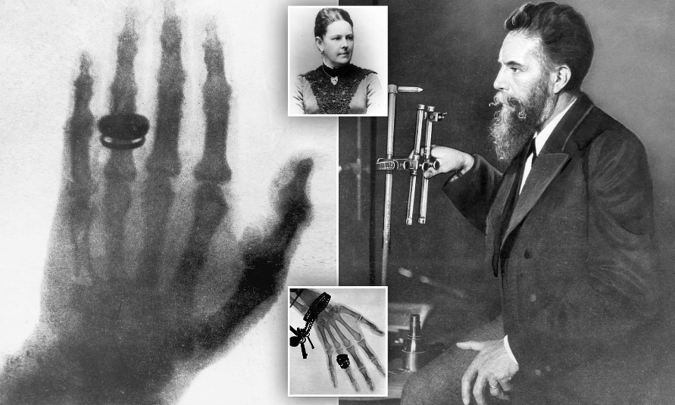
3.5 The Compton Effect and X-Rays
X-rays were discovered in 1895 by the German physicist Wilhelm Roentgen.
He found that a beam of high-speed electrons striking a metal target produced a new and extremely penetrating type of radiation.
The first medical x-ray pictures were taken, and within several years it became evident that x-rays were electromagnetic vibrations similar to light but with extremely short wavelengths and great penetrating power

Slide 33
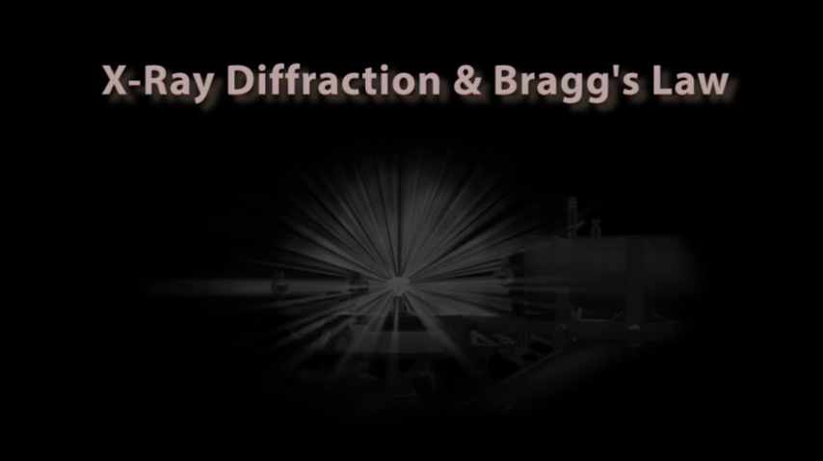
3.5 The Compton Effect and X-Rays
A particularly simple method of analyzing the scattering of x-rays from parallel crystal planes was proposed by W. L. Bragg in 1912.
Consider two successive planes of atoms. Note that adjacent atoms in a single plane, A, will scatter constructively if the angle of incidence,

Slide 34
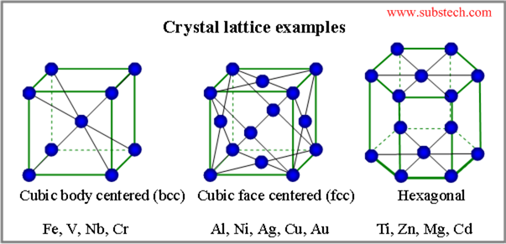
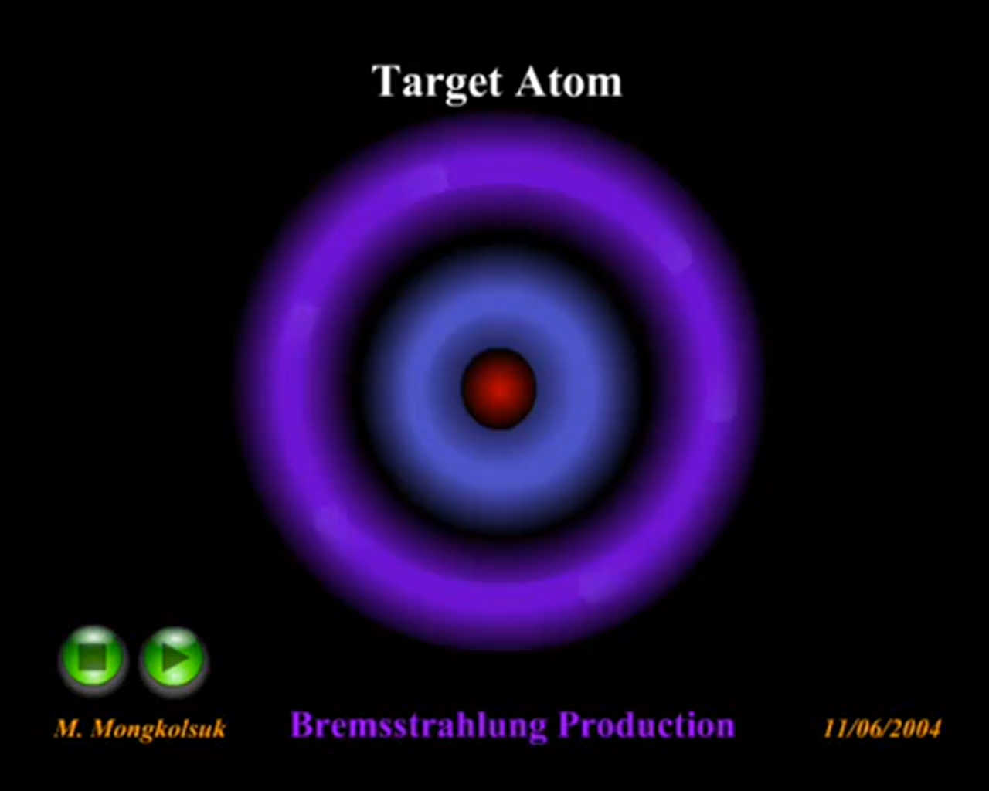
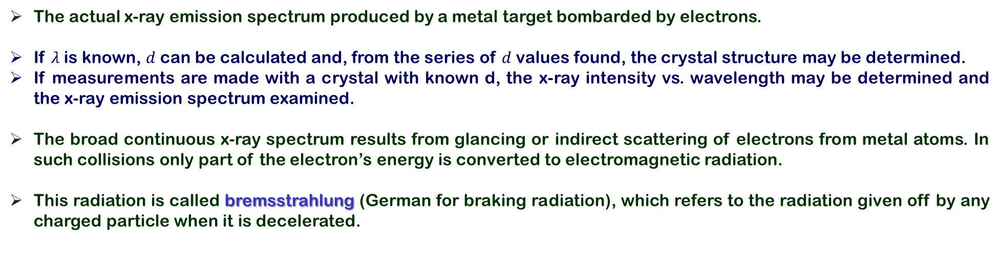
3.5 The Compton Effect and X-Rays
The actual x-ray emission spectrum produced by a metal target bombarded by electrons.
If $λ$is known, $d$ can be calculated and, from the series of $d$ values found, the crystal structure may be determined.
If measurements are made with a crystal with known d, the x-ray intensity vs. wavelength may be determined and the x-ray emission spectrum examined.
The broad continuous x-ray spectrum results from glancing or indirect scattering of electrons from metal atoms. In such collisions only part of the electron’s energy is converted to electromagnetic radiation.
This radiation is called bremsstrahlung (German for braking radiation), which refers to the radiation given off by any charged particle when it is decelerated.

Slide 35
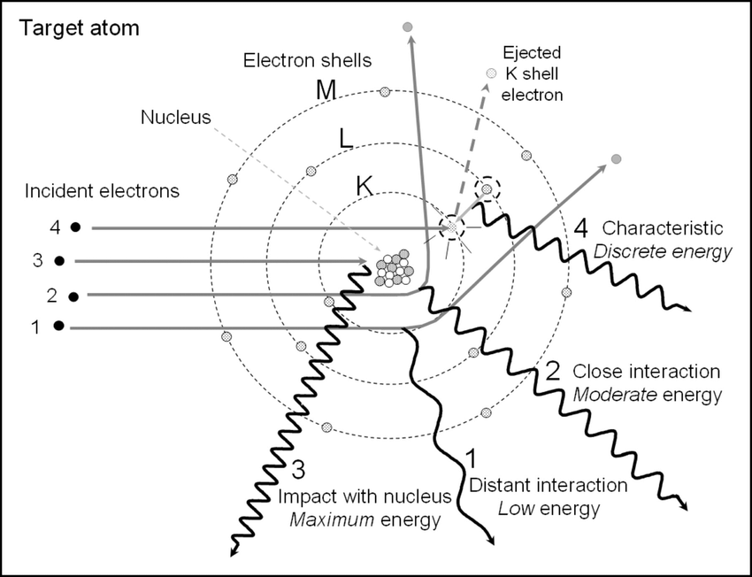
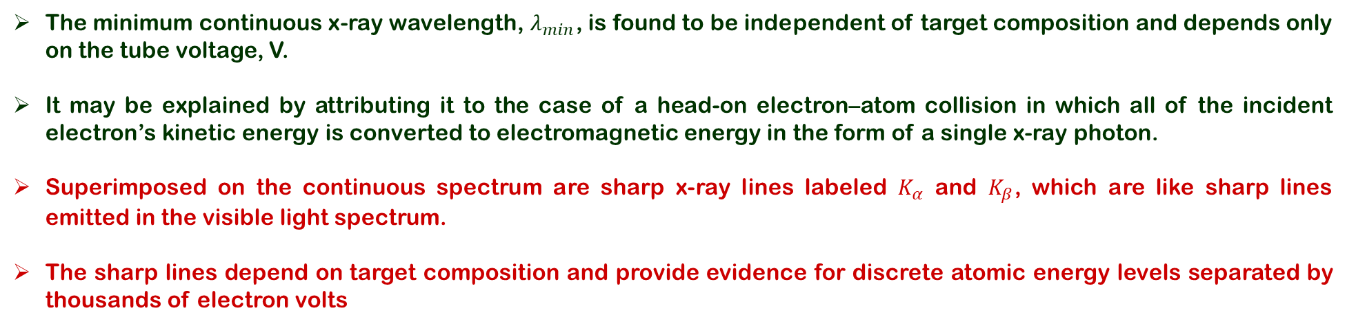
3.5 The Compton Effect and X-Rays
The minimum continuous x-ray wavelength, $λ_{min}$, is found to be independent of target composition and depends only on the tube voltage, V.
It may be explained by attributing it to the case of a head-on electron–atom collision in which all of the incident electron’s kinetic energy is converted to electromagnetic energy in the form of a single x-ray photon.
Superimposed on the continuous spectrum are sharp x-ray lines labeled $K_{α}$ and $K_{β}$, which are like sharp lines emitted in the visible light spectrum.
The sharp lines depend on target composition and provide evidence for discrete atomic energy levels separated by thousands of electron volts

Slide 36
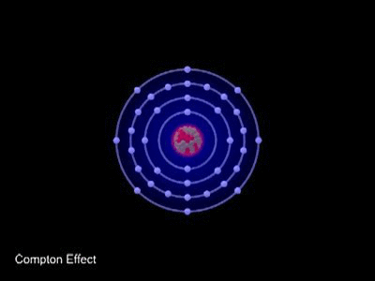
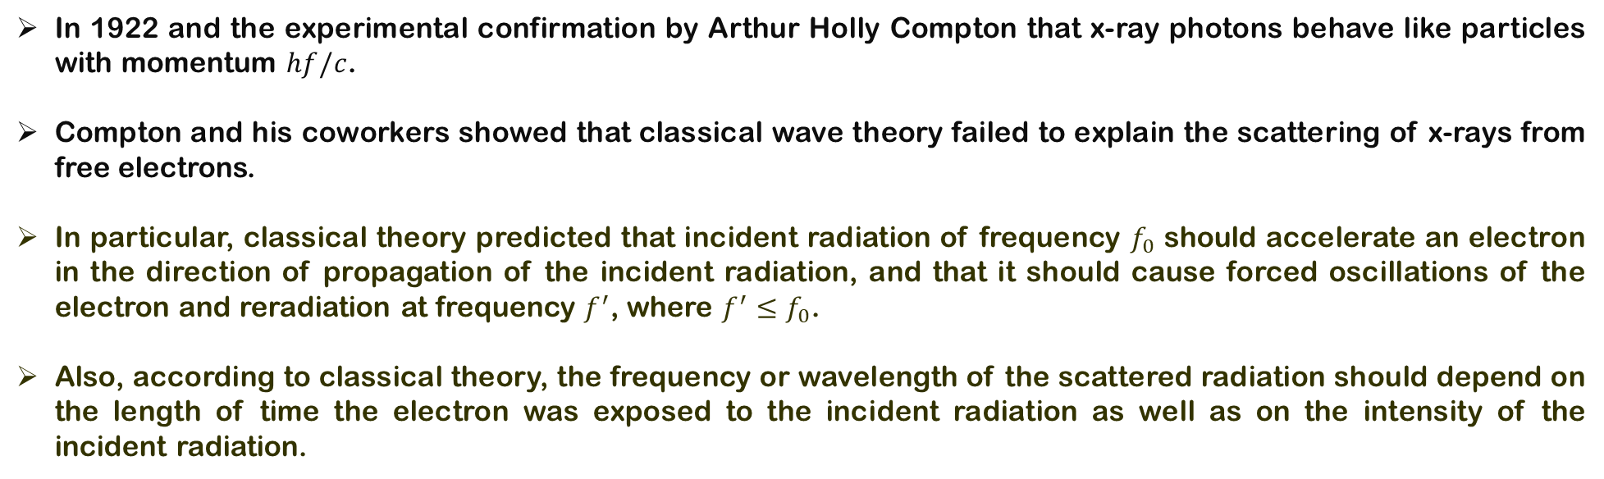
3.5 The Compton Effect and X Ray
In 1922 and the experimental confirmation by Arthur Holly Compton that x-ray photons behave like particles with momentum $hf/c$.
Compton and his coworkers showed that classical wave theory failed to explain the scattering of x-rays from free electrons.
In particular, classical theory predicted that incident radiation of frequency $f_{0}$ should accelerate an electron in the direction of propagation of the incident radiation, and that it should cause forced oscillations of the electron and reradiation at frequency $f^{′}$, where $f^{′}≤f_{0}$.
Also, according to classical theory, the frequency or wavelength of the scattered radiation should depend on the length of time the electron was exposed to the incident radiation as well as on the intensity of the incident radiation.

Slide 37
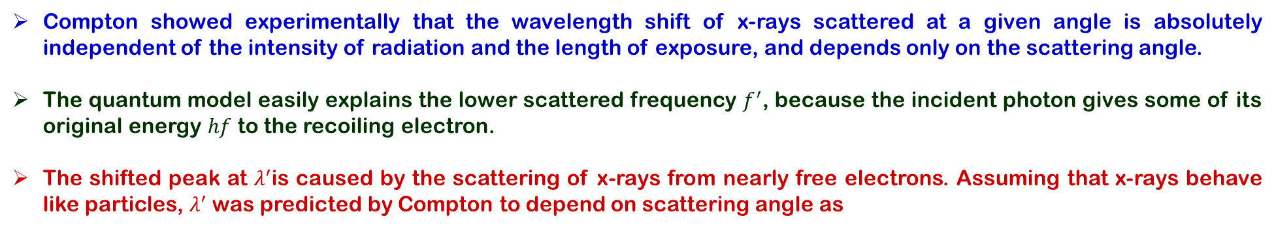
3.5 The Compton Effect and X-Rays
Compton showed experimentally that the wavelength shift of x-rays scattered at a given angle is absolutely independent of the intensity of radiation and the length of exposure, and depends only on the scattering angle.
The quantum model easily explains the lower scattered frequency $f^{′}$, because the incident photon gives some of its original energy $hf$ to the recoiling electron.
The shifted peak at $λ^{′}$is caused by the scattering of x-rays from nearly free electrons. Assuming that x-rays behave like particles, $λ^{′}$ was predicted by Compton to depend on scattering angle as

Slide 38
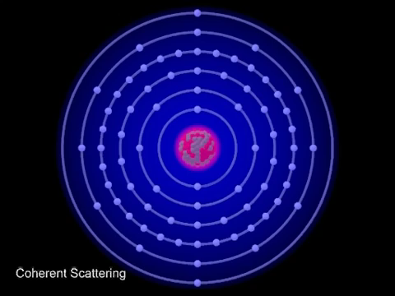
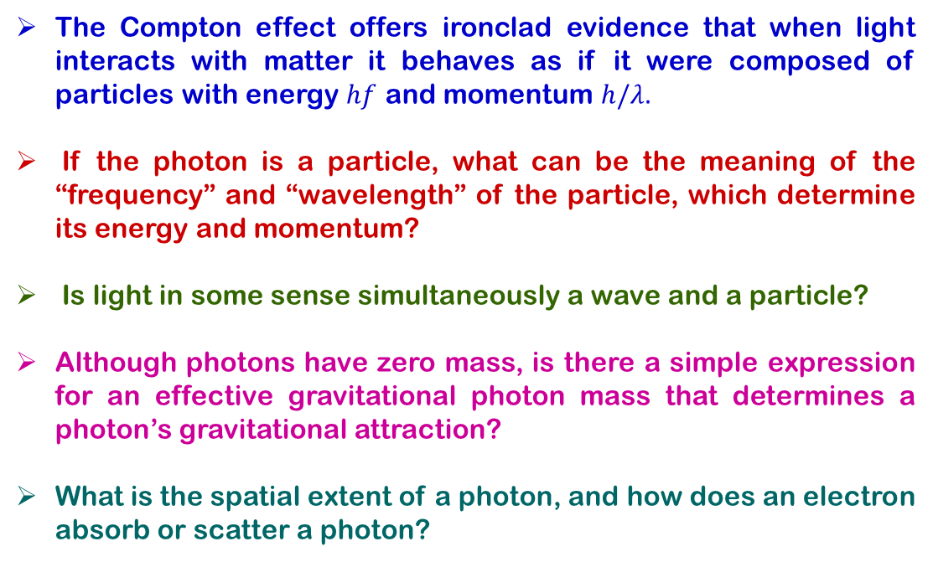
3.6 PARTICLE–WAVE COMPLEMENTARITY
The Compton effect offers ironclad evidence that when light interacts with matter it behaves as if it were composed of particles with energy $hf$ and momentum $h/λ.$
If the photon is a particle, what can be the meaning of the “frequency” and “wavelength” of the particle, which determine its energy and momentum?
Is light in some sense simultaneously a wave and a particle?
Although photons have zero mass, is there a simple expression for an effective gravitational photon mass that determines a photon’s gravitational attraction?
What is the spatial extent of a photon, and how does an electron absorb or scatter a photon?

Slide 39
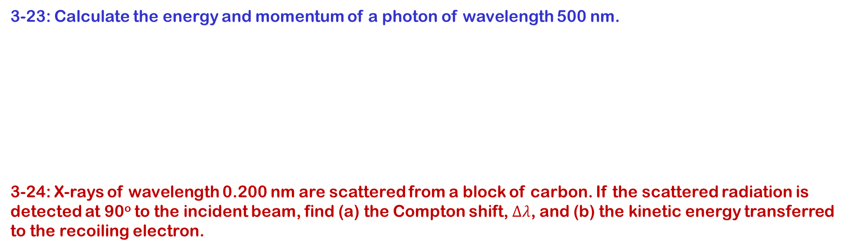
3.4 Light Quantization and the Photoelectric Effect
3-23: Calculate the energy and momentum of a photon of wavelength 500 nm.
3-24: X-rays of wavelength 0.200 nm are scattered from a block of carbon. If the scattered radiation is detected at 90º to the incident beam, find (a) the Compton shift,$∆λ$, and (b) the kinetic energy transferred to the recoiling electron.

Slide 40
3.4 Light Quantization and the Photoelectric Effect
3-25: X-rays with an energy of 300 keV undergo Compton scattering from a target. If the scattered rays are detected at 30º relative to the incident rays, find (a) the Compton shift at this angle, (b) the energy of the scattered x-ray, and (c) the energy of the recoiling electron.

Slide 41

3.4 Light Quantization and the Photoelectric Effect
3-28: In the Compton scattering event, the scattered photon has an energy of 120 keV and the recoiling electron has an energy of 40 keV. Find (a) the wavelength of the incident photon, (b) the angle $θ$ at which the photon is scattered, and (c) the recoil angle $φ$ of the electron.

Slide 42
Suggested Problems from the text book:
2,3,4,18,20,22,26,27,29,31,34,35,37

