Slide 1

CH 4
The Particle Nature of Matter
Dr. Tariq Al-Abdullah

Slide 2

4.2 THE COMPOSITION OF ATOMS
“If matter is primarily composed of atoms, what are atoms composed of?”
In 1833, M. Faraday performed experiments in electrolysis by passing electrical charges through a chemical solution of sodium chloride, NaCl.
Faraday found that if 96,500 C of charge (1 faraday) is passed through such a molten solution, 23.0 g of Na will deposit on the cathode and 35.5 g of chlorine gas will bubble off the anode.
Michael Faraday reported that the mass of elements deposited at an electrode is directly proportional to the charge.
Faraday’s Law of electrolysis:
$$m=ZIt$$
Z is called the Electro-Chemical Equivalent
Ch 4 Dr. Tariq Al-Abdullah

Slide 3

4.2 THE COMPOSITION OF ATOMS
“Example?”
How many grams of barium and chlorine will you get if you pass a current of 10.0 A through molten BaCl₂ for 1 h?
$$m=ZIt$$
Ch 4 Dr. Tariq Al-Abdullah

Slide 4
4.2 THE COMPOSITION OF ATOMS
Charge passes through the molten solution in the form of ions, which possess an excess or deficiency of one or more electrons.
Under the influence of the electric field produced by the battery, these ions move to the anode or cathode, where they respectively lose or gain electrons and are liberated as neutral atoms.
Faraday’s law of electrolysis confirmed three important parts of the atomic picture.
  First, it offered proof that matter consists of molecules and that molecules consist of atoms.
  Second, it showed that charge is quantized, because only integral numbers of charges are transferred at the electrodes.
  Third, it showed that the subatomic parts of atoms are positive and negative charges, although the mass and the size of the charge of these subatomic particles remained unknown.
Ch 4 Dr. Tariq Al-Abdullah

Slide 5
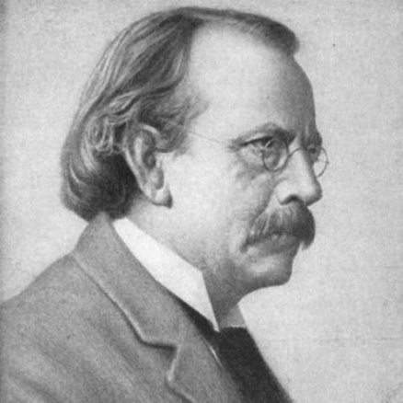
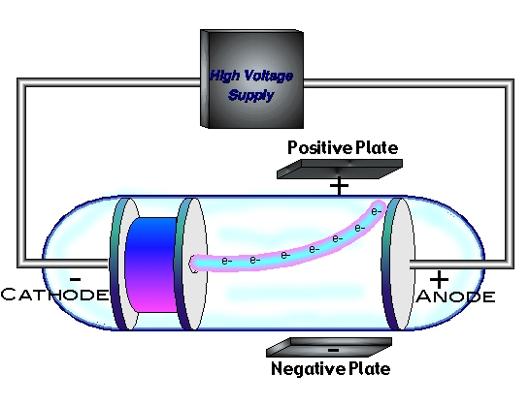
4.2 THE COMPOSITION OF ATOMS – JJ Thomson
In 1897, The next major step explaining the composition of atoms
was taken by Joseph John ( J. J.) Thomson
He discovered that the “rays” seen in low-pressure gas discharges were actually caused by negative particles (electrons) ended a debate dating back nearly 30 years: Were cathode rays material particles or waves? established concept of the atom as an indivisible entity.
Thomson’s discovery of the electron disturbed this newly established order in atomic theory and provoked startling new developments—Rutherford’s nuclear model and the first satisfactory theory of the emission of light by atomic systems, the Bohr model of the atom.
Ch 4 Dr. Tariq Al-Abdullah

Slide 6
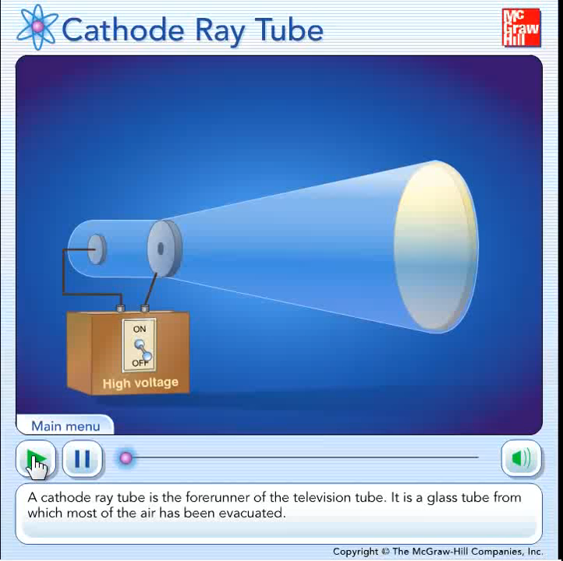
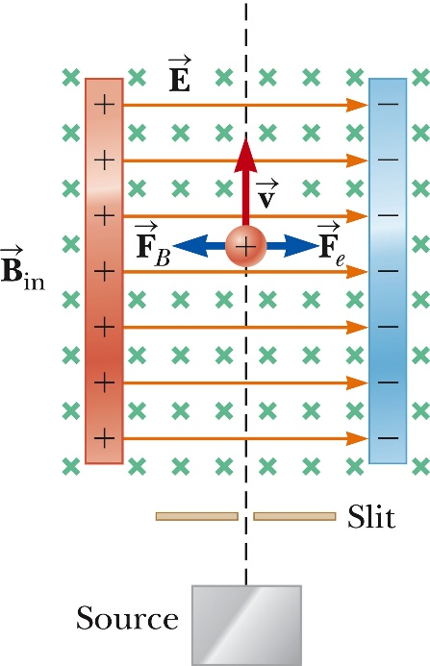

4.2 THE COMPOSITION OF ATOMS
Electrons are accelerated from the cathode to the anode, collimated by slits in the anodes
The simultaneously applied E and B fields are first adjusted to produce an undeflected beam.
If the B field is then turned off, the E field alone produces a measurable beam deflection on the phosphorescent screen.
From the size of the deflection and the measured values of E and B, the charge-to-mass ratio, e/me, may be determined.
In effect, he created a velocity selector, which could select out of the beam those particles having a velocity within a narrow range of values.
Ch 4 Dr. Tariq Al-Abdullah

Slide 7
4.2 THE COMPOSITION OF ATOMS
Ch 4 Dr. Tariq Al-Abdullah

Slide 8
4.2 THE COMPOSITION OF ATOMS
Ch 4 Dr. Tariq Al-Abdullah

Slide 9
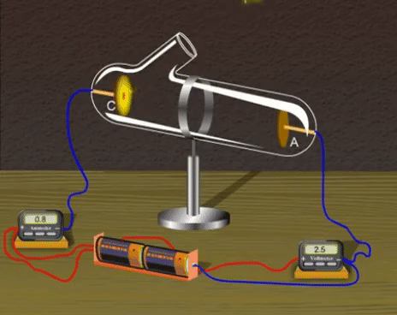
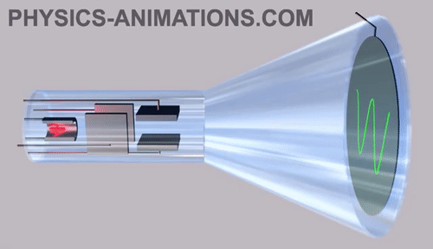
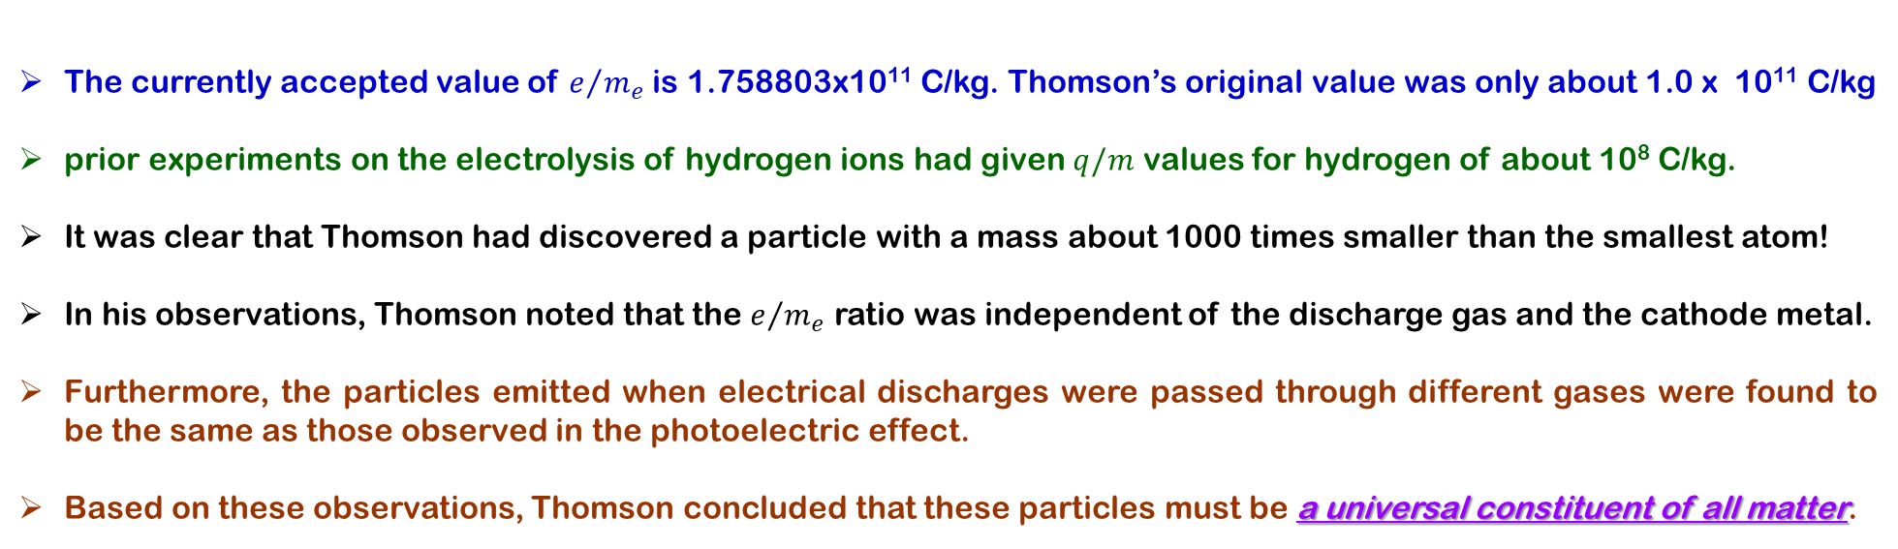
4.2 THE COMPOSITION OF ATOMS – JJ Thomson
The currently accepted value of $e/{m_{e}}$is 1.758803x10¹¹ C/kg. Thomson’s original value was only about 1.0 x 10¹¹ C/kg
prior experiments on the electrolysis of hydrogen ions had given $q/m$ values for hydrogen of about 10⁸ C/kg.
It was clear that Thomson had discovered a particle with a mass about 1000 times smaller than the smallest atom!
In his observations, Thomson noted that the $e/{m_{e}}$ ratio was independent of the discharge gas and the cathode metal.
Furthermore, the particles emitted when electrical discharges were passed through different gases were found to be the same as those observed in the photoelectric effect.
Based on these observations, Thomson concluded that these particles must be a universal constituent of all matter.
Ch 4 Dr. Tariq Al-Abdullah

Slide 10
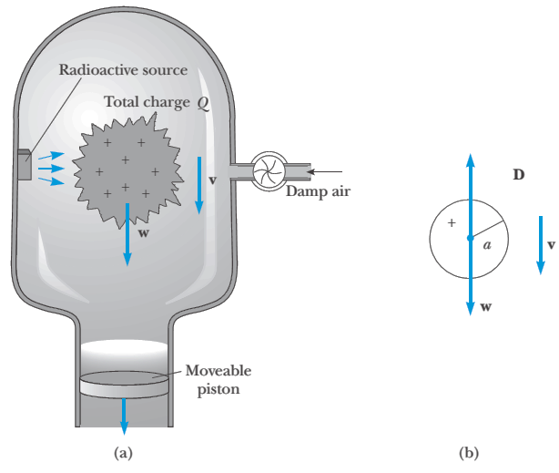

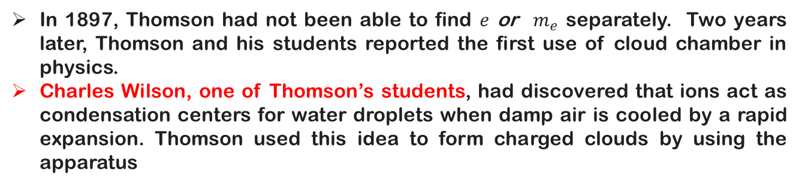
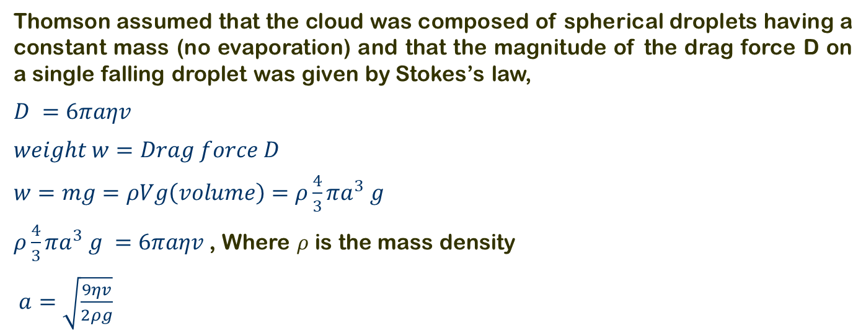
4.2 THE COMPOSITION OF ATOMS – Wilson & Thomson
In 1897, Thomson had not been able to find $e$ or $m_{e}$ separately. Two years later, Thomson and his students reported the first use of cloud chamber in physics.
Charles Wilson, one of Thomson’s students, had discovered that ions act as condensation centers for water droplets when damp air is cooled by a rapid expansion. Thomson used this idea to form charged clouds by using the apparatus
Thomson assumed that the cloud was composed of spherical droplets having a constant mass (no evaporation) and that the magnitude of the drag force D on a single falling droplet was given by Stokes’s law,
$D =6πaηv$
$weight w=Drag force D$
$w=mg=ρVg\left(volume\right)=ρ\frac{4}{3}πa^{3} g$
$ρ\frac{4}{3}πa^{3} g =6πaηv$ , Where $ρ$ is the mass density
$a=\sqrt{\frac{9ηv}{2ρg}}$
Ch 4 Dr. Tariq Al-Abdullah

Slide 11
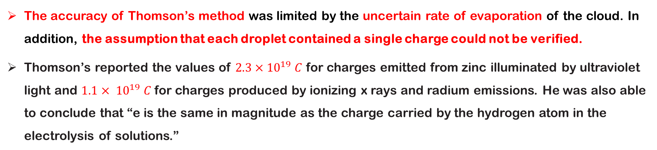
4.2 THE COMPOSITION OF ATOMS
The accuracy of Thomson’s method was limited by the uncertain rate of evaporation of the cloud. In addition, the assumption that each droplet contained a single charge could not be verified.
Thomson’s reported the values of $2.3×{10}^{19} C$ for charges emitted from zinc illuminated by ultraviolet light and $1.1× {10}^{19} C$ for charges produced by ionizing x rays and radium emissions. He was also able to conclude that “e is the same in magnitude as the charge carried by the hydrogen atom in the electrolysis of solutions.”
Ch 4 Dr. Tariq Al-Abdullah

Slide 12
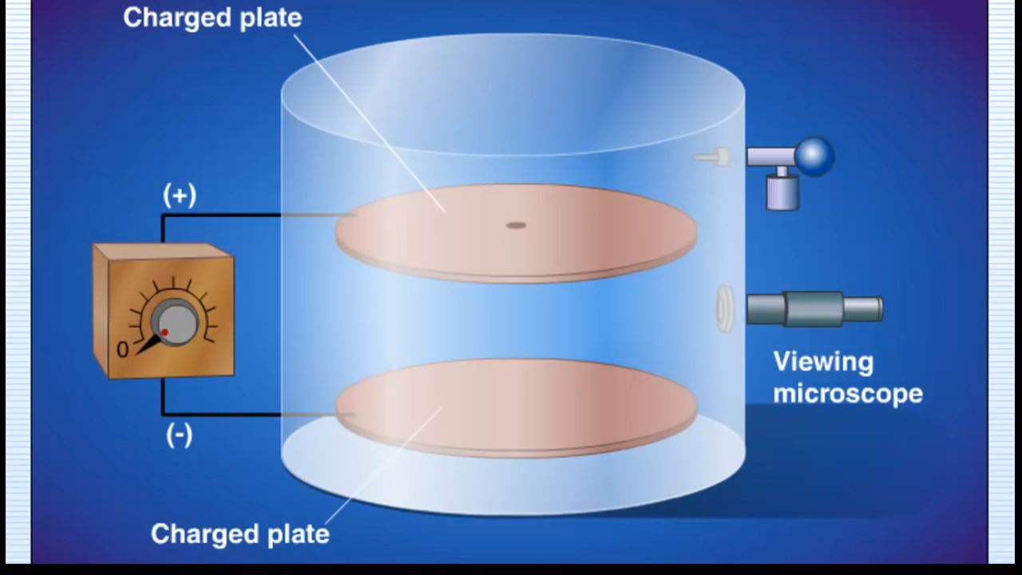
4.2 THE COMPOSITION OF ATOMS
Millikan’s Oil drop experiment.
Oil droplets charged by an atomizer are allowed to pass through a small hole in the upper plate of a parallel-plate capacitor. If these droplets are illuminated from the side, they appear as brilliant stars against a dark background.
Ch 4 Dr. Tariq Al-Abdullah

Slide 13
4.2 THE COMPOSITION OF ATOMS
If an electrostatic field of several thousand volts per meter is applied to the capacitor plates, the drop may move slowly upward.
after a long series of measurements of constant upward velocities one observes a discontinuous change or jump to a different upward velocity (higher or lower).
This discontinuous change is caused by the attraction of an ion to the charged droplet and a consequent change in droplet charge.
A source of ionizing radiation is placed between the plates.
https://ophysics.com/em2.html
Ch 4 Dr. Tariq Al-Abdullah

Slide 14

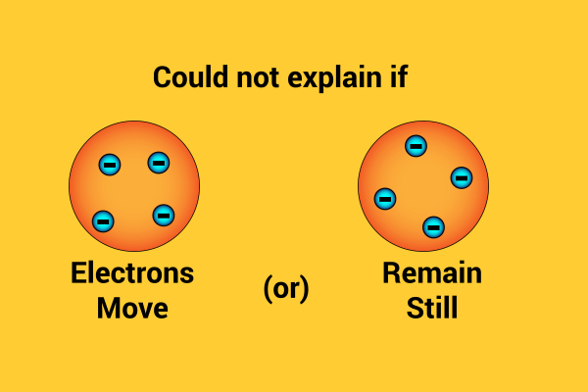
Thomson’s Atomic Model
4.2 THE COMPOSITION OF ATOMS
Thomson’s “plum-pudding” model of the atom had the positive charges spread uniformly throughout a sphere the size of the atom with, the newly discovered “negative” electrons embedded in the uniform background.
In Thomson’s view, when the atom was heated, the electrons could vibrate about their equilibrium positions, thus producing electromagnetic radiation.

Slide 15


4.2 THE COMPOSITION OF ATOMS – Rutherford Scattering
The key to understand the mysterious line spectra and the correct model of the atom were both furnished by Ernest Rutherford and his students Hans Geiger (1882–1945, German physicist) and Ernest Marsden (1899–1970, British physicist) through a series of experiments conducted from 1909 to 1914.
In thin pieces of heavy metal, that the scattering was usually small, of the order of one degree.
The target is so thin that only a single scattering occurs.
the α -particle was a very fast, massive particle, with a great deal of energy, and you could show that if the scattering was due to the accumulated effect of a number of small scatterings the chance of an -particle’s being scattered backwards was very small.
The backwards scattering must be the result of a single collision.
An atom with a minute massive center carrying a charge.

Slide 16
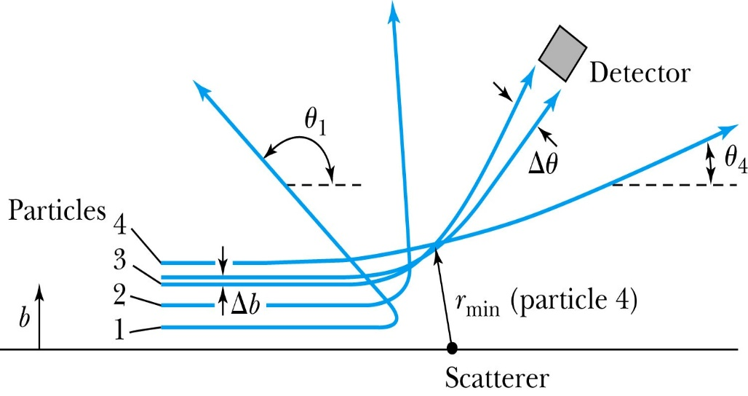
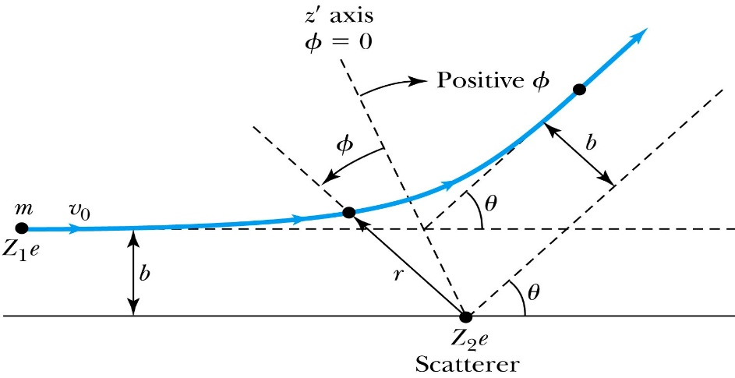
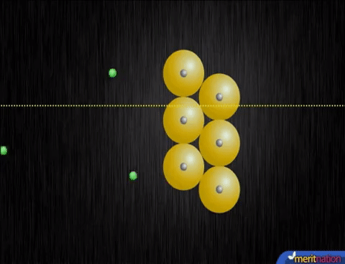
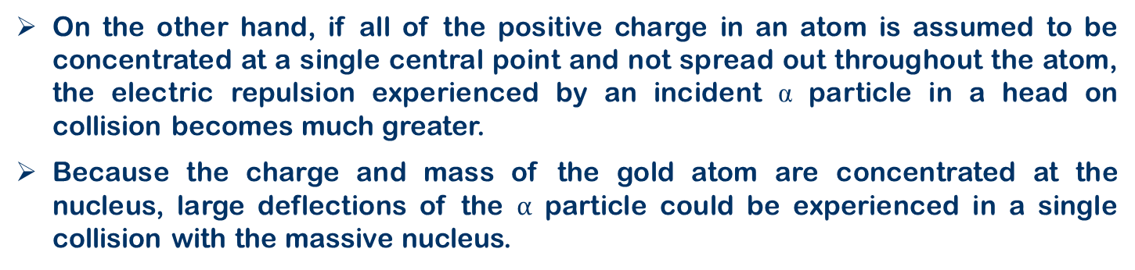
4.2 THE COMPOSITION OF ATOMS – Rutherford Scattering
On the other hand, if all of the positive charge in an atom is assumed to be concentrated at a single central point and not spread out throughout the atom, the electric repulsion experienced by an incident α particle in a head on collision becomes much greater.
Because the charge and mass of the gold atom are concentrated at the nucleus, large deflections of the $α$ particle could be experienced in a single collision with the massive nucleus.
https://phet.colorado.edu/sims/html/rutherford-scattering/latest/rutherford-scattering_en.html

Slide 17
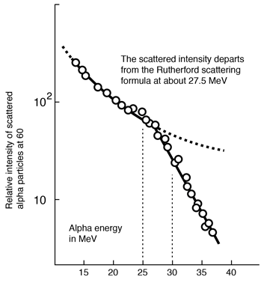
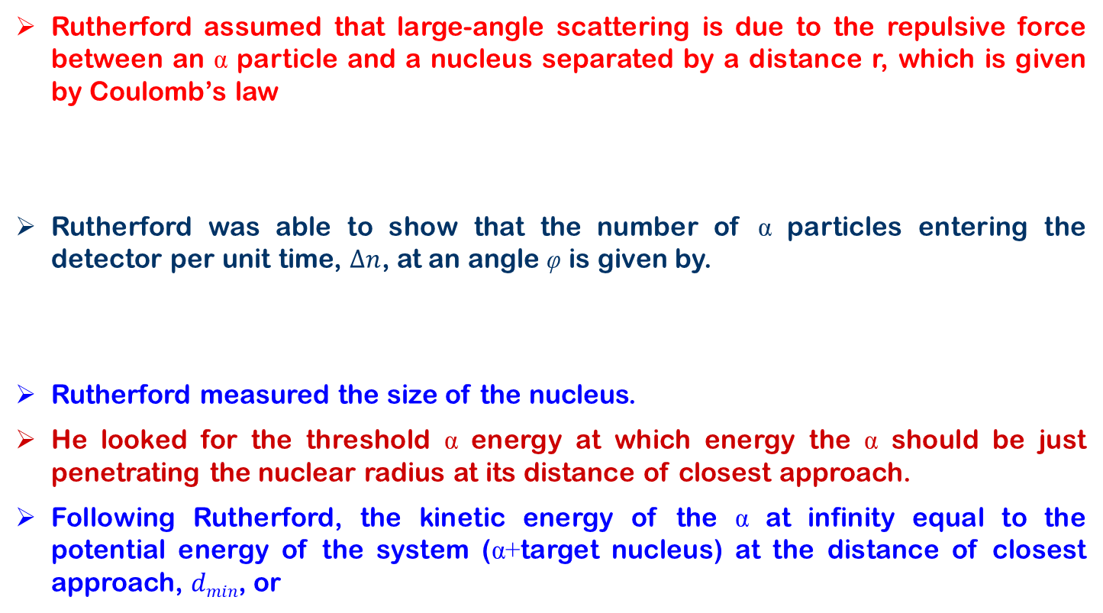
4.2 THE COMPOSITION OF ATOMS – Rutherford Scattering
Rutherford assumed that large-angle scattering is due to the repulsive force between an α particle and a nucleus separated by a distance r, which is given by Coulomb’s law
Rutherford was able to show that the number of α particles entering the detector per unit time, $∆n$, at an angle φ is given by.
Rutherford measured the size of the nucleus.
He looked for the threshold α energy at which energy the α should be just penetrating the nuclear radius at its distance of closest approach.
Following Rutherford, the kinetic energy of the α at infinity equal to the potential energy of the system (α+target nucleus) at the distance of closest approach, $dmin$, or

Slide 18
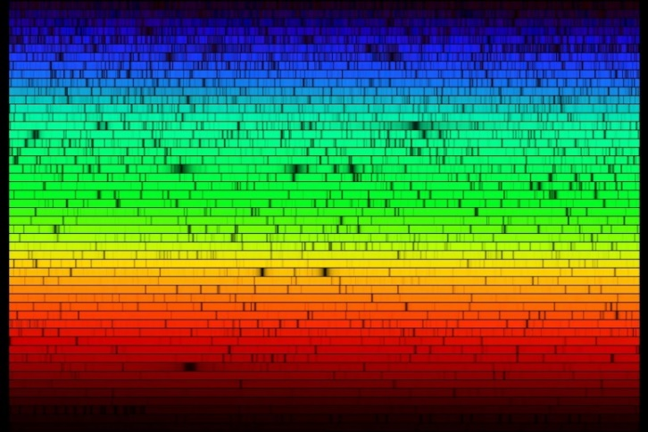
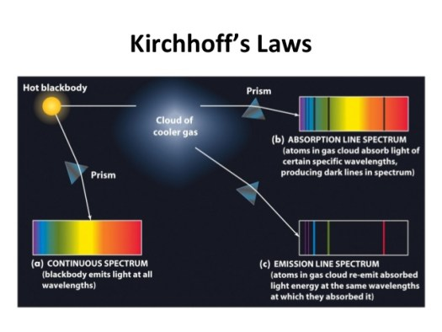
4.3 The Bohr Atom
In sharp contrast to the black body radiation (this continuous spectrum) is the discrete line spectrum emitted by a low-pressure gas subject to an electric discharge.
The spectrum was found to consist of a few bright lines of pure color on a dark background. Those wavelengths are characteristic of the particular element emitting the light.
In 1814, Joseph Fraunhofer had passed the continuous spectrum from the Sun through a narrow slit and then through a prism. He observed the surprising result of nearly 600 fine dark lines, or gaps, in the continuous rainbow spectrum of the Sun, and he assigned the letters A, B, C, D . . . .
Kirchhoff’s in 1859—the foundation of absorption spectroscopy and the explanation of Fraunhofer’s dark D-lines in the solar spectrum.

Slide 19
4.3 Bohr’s Quantum Model of the Atom
In 1913, the Danish physicist Niels H. D. Bohr proposed a model of the hydrogen atom that combined the work of Planck, Einstein, and Rutherford and was remarkably successful in predicting the observed spectrum of hydrogen.
The Rutherford model assigned charge and mass to the nucleus but was silent regarding the distribution of the charge and mass of the electrons.
Bohr, who had been working in Rutherford’s laboratory during the experiments of Geiger and Marsden, made the assumption that the electron in the hydrogen atom moved in an orbit about the positive nucleus, bound by the electrostatic attraction of the nucleus.
Classical mechanics allows circular or elliptical orbits in this system, just as in the case of the planets orbiting the Sun.

Slide 20
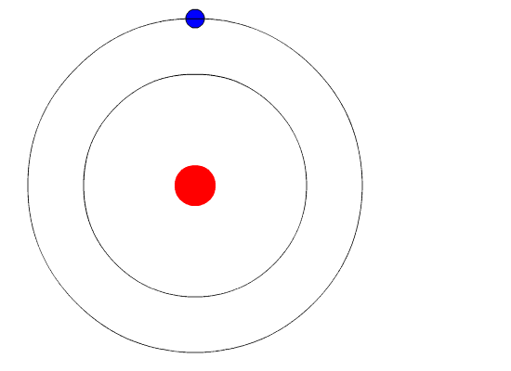

4.3 Bohr’s Quantum Model of the Atom
Thus, classical physics predicts that, as energy is lost to radiation, the electron’s orbit will become smaller and smaller while the frequency of the emitted radiation will become higher and higher, further increasing the rate at which energy is lost and ending when the electron reaches the nucleus.
The time required for the electron to spiral into the nucleus can be calculated from classical mechanics and electrodynamics; it turns out to be less than a microsecond. Thus, at first sight, this model predicts that the atom will radiate a continuous spectrum.
The atom will collapse after a very short time, a result that fortunately does not occur. Unless excited by some external means, atoms do not radiate at all, and when excited atoms do radiate, a line spectrum is emitted, not a continuous one.
Bohr “solved” these formidable difficulties with two decidedly nonclassical postulates.
  first postulate was that electrons could move in certain orbits without radiating. He called these orbits stationary states.
  second postulate was to assume that the atom radiates when the electron makes a transition from one stationary state to another
$$hf=E_{i}−E_{f}$$

Slide 21
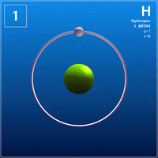
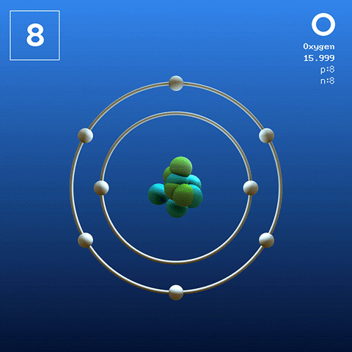
4.3 Bohr’s Quantum Model of the Atom

Slide 22
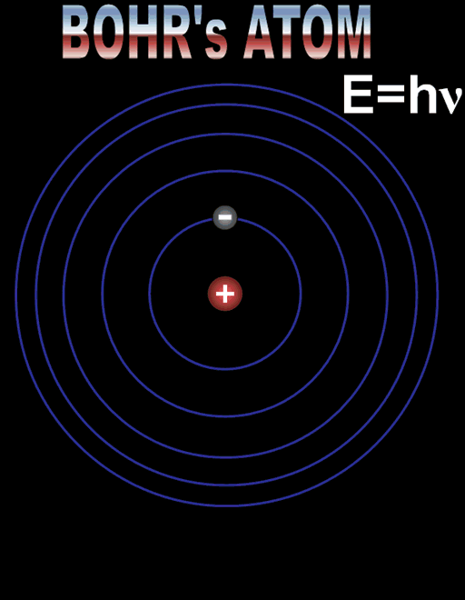
4.3 Bohr’s Quantum Model of the Atom

Slide 23

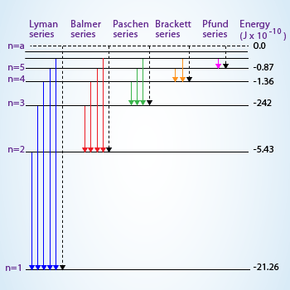
4.3 Bohr’s Quantum Model of the Atom

Slide 24
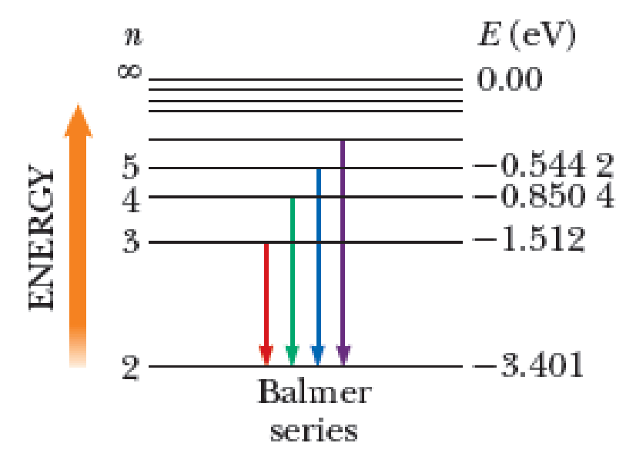
4.3 Bohr’s Quantum Model of the Atom
Wavelength of the H_{β}: Line Compute the wavelength of the H_{β} spectral line, that is, the second line of the Balmer series predicted by Bohr’s model. The H_{β} line is emitted in the transition from $ni=4$to $nf=2$.

Slide 25
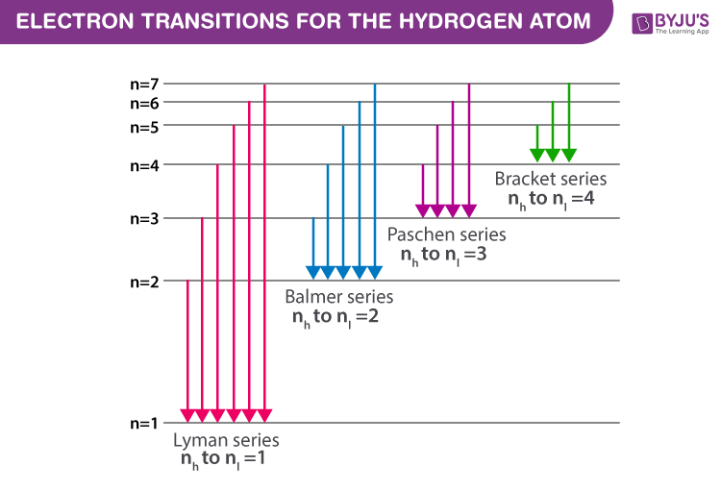
4.3 Bohr’s Quantum Model of the Atom
Wavelength of the H_{α}: The electron in a hydrogen atom at rest makes a transition from the n = 2 energy state to the n = 1 ground state. Find the wavelength, frequency, and energy (eV) of the emitted photon.

Slide 26
4.4 BOHR’S CORRESPONDENCE PRINCIPLE
To reduce the gap between the revolutionary new laws that apply to atomic systems and those that hold for classical systems.
Bohr provided the correspondence principle.
((This principle states that predictions of quantum theory must correspond to the predictions of classical physics in the region of sizes where classical theory is known to hold.))
These classical sizes for length, mass, and time are on the order of centimeters, grams, and seconds and typically involve very large quantum numbers,

Slide 27
4.4 WHY IS ANGULAR MOMENTUM QUANTIZED?

Slide 28
4.5 THE FRANCK–HERTZ EXPERIMENT
This experiment carried out by James Franck and Gustav Ludwig Hertz in 1914 was intended to support Niels Bohr's model of the atom, according to which electrons occupy discrete energy levels that can absorb or emit energy in only certain quantized amounts.
1. In the first section, nothing is happening that is different. If any of the electrons are hitting atoms of mercury, they must be bouncing right off and continuing. Mercury atoms will not absorb amounts of energy less than 4.9eV (sounds like quantum stuff to me!).
2. At 4.9eV, the mercury happily absorbs energy from electrons that hit it. Mercury will absorb this quantum of energy (4.9eV), this specific amount of energy. Since the mercury atom has absorbed exactly 4.9eV from the electron, the electron can’t go any further to the anode, so the current drops. Some electrons still sneak by without hitting mercury atoms, so we do get a little current still flowing.
3. For a while after 4.9eV, the mercury atoms will grab 4.9eV, but the electron still has enough energy to make it to the anode. For example, let’s say an electron has 6.0eV. It will hit a mercury atom (which absorbs 4.9eV) but it still has kinetic energy to continue moving (6.0 – 4.9 = 1.1eV).
4. At 6.7eV and 8.8eV, mercury will again absorb energy, but there is a smaller probability of it happening. It’s almost as if mercury will eat up those amounts of energy if it has to, but it doesn’t really like the flavour. So the drop in current isn’t as great.
5. Finally at 9.8eV, they figured out that two collisions must be happening. An electron is moving with 9.8eV of energy when it hits one mercury atom. The mercury atom absorbs exactly 4.9eV and the electron moves off with 4.9eV. Now the electron hits a second mercury atom which absorbs the remaining 4.9eV, leaving the electron with none.

Slide 29
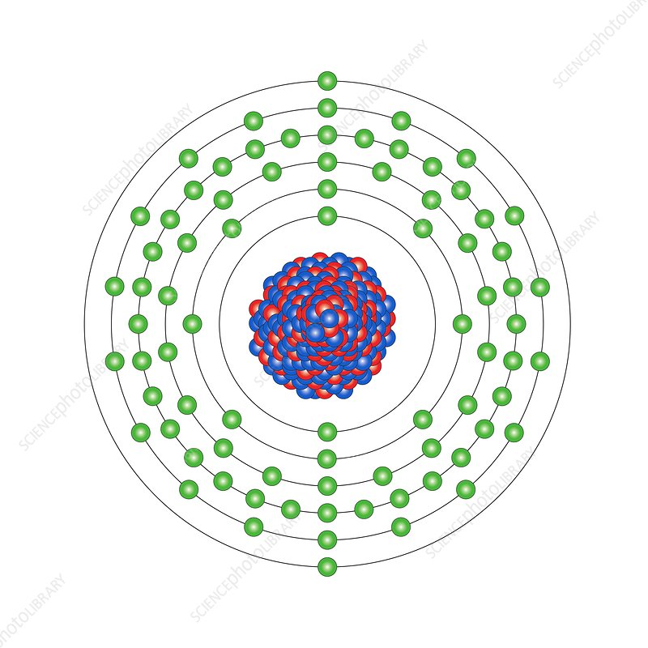
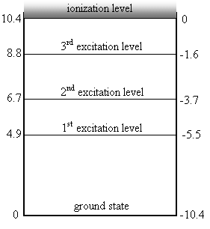
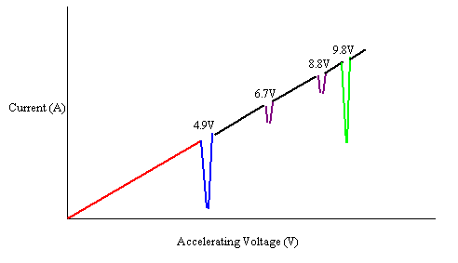
4.5 THE FRANCK–HERTZ EXPERIMENT
This internal energy is stored in electrons jumping up to higher excitation levels within the atom.
Usually this energy is released again quite quickly as the electron drops back down to the ground state.
This drop will release the energy out of the atom in the form of a photon.
For this direct experimental confirmation of Bohr’s basic ideas of discrete energy levels in atoms and the process of photon emission, Franck and Hertz were awarded the Nobel prize in 1925.

Slide 30
4.5 THE FRANCK–HERTZ EXPERIMENT
Example: I apply a voltage of 7.0 V across a Franck-Hertz apparatus. What frequencies of EM will you see emitted by the mercury?
The final answer is that we will see frequencies of 1.2 x 10¹⁵ Hz, 1.6 x 10¹⁵ Hz, and 4.3 x 10¹⁴ Hz. These frequencies correspond to the release of 4.9eV, 6.7eV and 1.8eV.

Slide 31
