Slide 1

CH 5
Matter Waves
Dr. Tariq Al-Abdullah

Slide 2
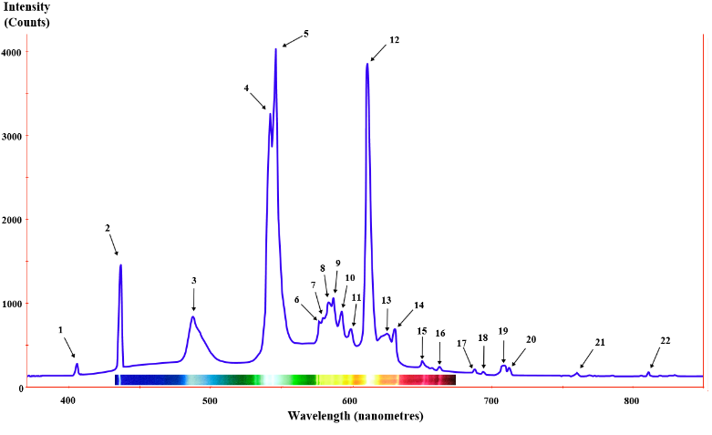
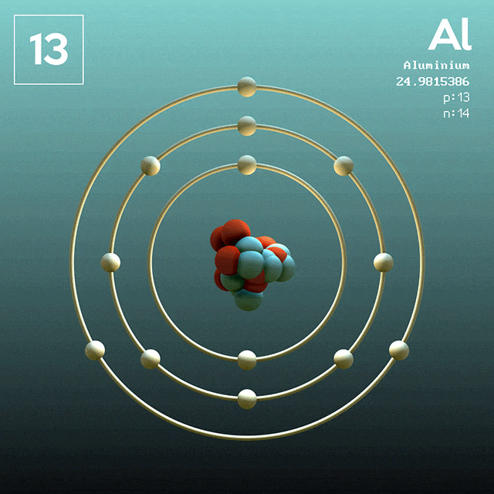
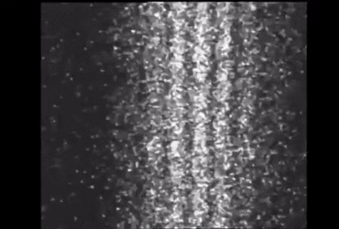
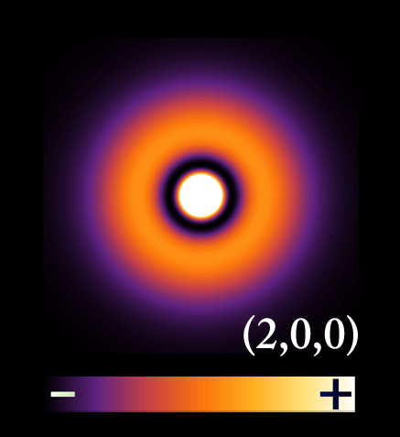
5.1 THE PILOT WAVES OF DE BROGLIE
By the early 1920s scientists recognized that the Bohr theory contained many inadequacies:
It failed to predict the observed intensities of spectral lines.
It had only limited success in predicting emission and absorption wavelengths for multielectron atoms.
It failed to provide an equation of motion governing the time development of atomic systems starting from some initial state.
It overemphasized the particle nature of matter and could not explain the newly discovered wave–particle duality of light.
It did not supply a general scheme for “quantizing” other systems, especially those without periodic motion.
Bohr’s model: as the electrons revolve around the nucleus, how can one understand the fact that only certain electronic energies are allowed?
Why do all atoms of a given element have precisely the same physical properties regardless of the infinite variety of starting velocities and positions of the electrons in each atom?
Ch 5 Dr. Tariq Al-Abdullah

Slide 3

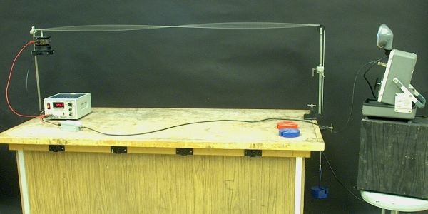
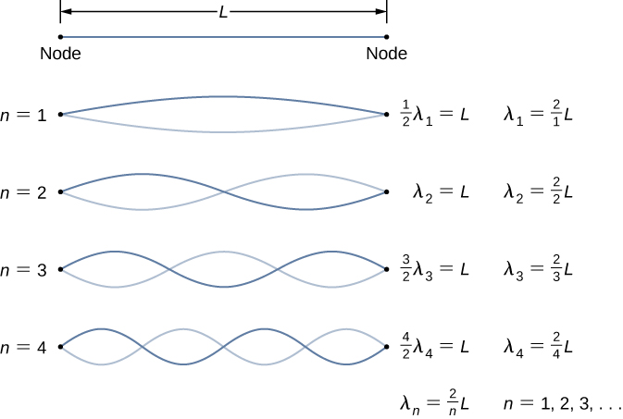
5.1 THE PILOT WAVES OF DE BROGLIE
Only a discrete set of wavelengths is allowed for standing waves, while other wavelengths not included in this discrete set rapidly vanish by destructive interference.

Slide 4
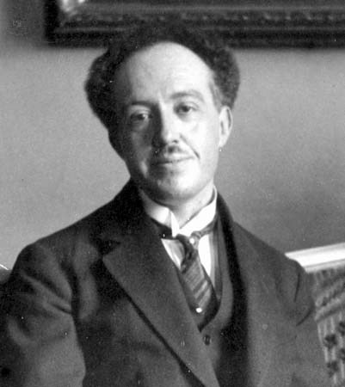

5.1 THE PILOT WAVES OF DE BROGLIE
The first bold step toward a new mechanics of atomic systems was taken by Louis Victor de Broglie in 1923.
In his doctoral dissertation he postulated that because photons have wave and particle characteristics, perhaps all forms of matter have wave as well as particle properties.
The allowed Bohr orbits arise because the electron matter waves interfere constructively when an integral number of wavelengths exactly fits into the circumference of a circular orbit
Ch 5 Dr. Tariq Al-Abdullah

Slide 5
5.1 THE PILOT WAVES OF DE BROGLIE
Example: An object will appear “wavelike” if it exhibits interference or diffraction, both of which require scattering objects or apertures of about the same size as the wavelength. A baseball of mass 140 g traveling at a speed of 27 m/s. what is the value of its wavelength?
Ch 5 Dr. Tariq Al-Abdullah

Slide 6
5.1 THE PILOT WAVES OF DE BROGLIE
Example: A particle of charge $q$ and mass m is accelerated from rest through a small potential difference $V$. Find its de Broglie wavelength, assuming that the particle is nonrelativistic.
Ch 5 Dr. Tariq Al-Abdullah

Slide 7

5.2 THE DAVISSON–GERMER EXPERIMENT
Direct experimental proof that electrons possess a wavelength $λ = h/p$ was furnished by the diffraction experiments of American physicists Clinton J. Davisson (1881–1958) and Lester H. Germer (1896–1971).
https://phet.colorado.edu/en/simulation/davisson-germer
Ch 5 Dr. Tariq Al-Abdullah

Slide 8
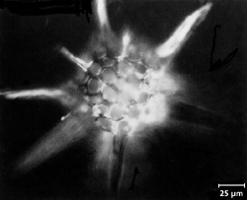

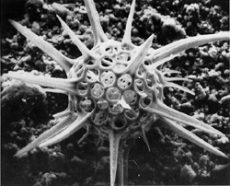
5.2 Electron Microscope
First transmission electron microscope (TEM) with magnetic lenses by electrical engineers Max Knoll and Ernst Ruska in Berlin in 1931.
The best optical microscopes using ultraviolet light have a magnification of about 2000 and can resolve two objects separated by 100 nm, but a TEM using electrons accelerated through 100 kV has a magnification of as much as 1,000,000 and a maximum resolution of 0.2 nm.

Slide 9
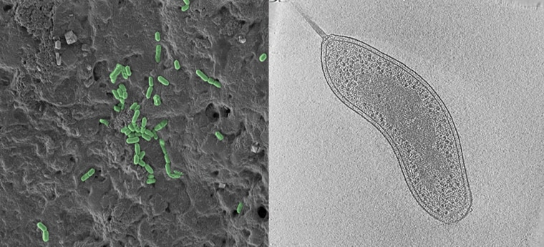

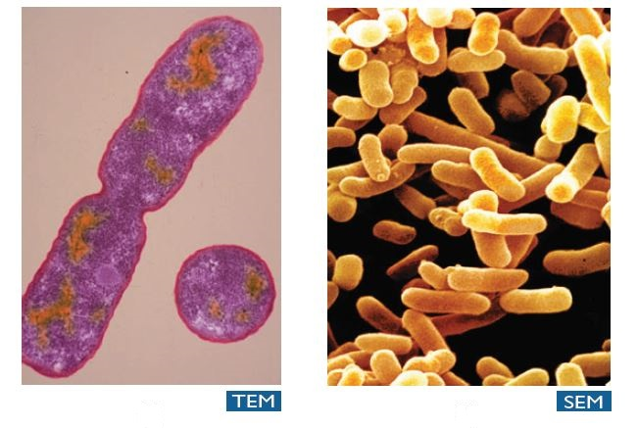
5.2 Electron Microscope
A second type of electron microscope with less resolution and magnification than the TEM, but capable of producing striking three-dimensional images, is the scanning electron microscope (SEM).
A typical SEM works. Such a device might be operated with 20-keV electrons and have a resolution of about 10 nm and a magnification ranging from 10 to 100,000.
The newer, higher-resolution scanning tunneling microscope (STM) and atomic force microscope (AFM), which can image individual atoms and molecules, are discussed in Chapter 7.
https://www.youtube.com/watch?v=MK2Kz_BH20k

Slide 10
5.3 WAVE GROUPS AND DISPERSION
The matter wave representing a moving particle must reflect the fact that the particle has a large probability of being found in a small region of space only at a specific time.
So what is waving for matter waves? For matter waves as for light waves, there is no “ether.” The particle is in a sense smeared out” over the extent of the wave, so for matter it is the probability of finding the particle that waves.

Slide 11
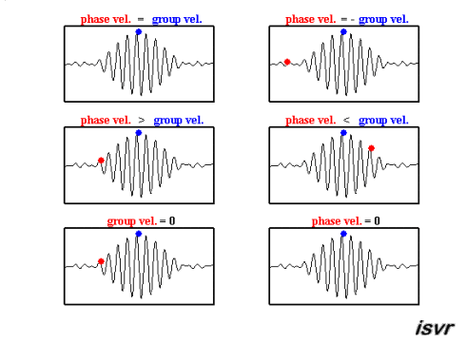
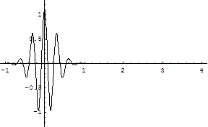
5.3 WAVE GROUPS AND DISPERSION
The main characteristic of a pulse is localization in time and space; whereas a single harmonic wave is not localized in either time or space. The description of a pulse can be obtained by the superposition of a group of harmonic waves of different frequencies and wavelengths.

Slide 12
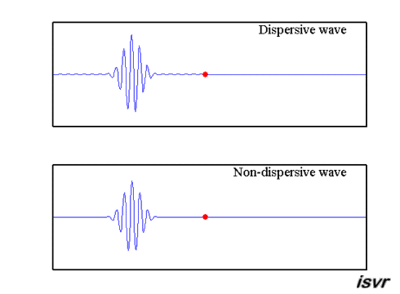
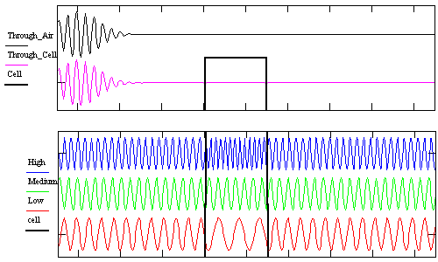
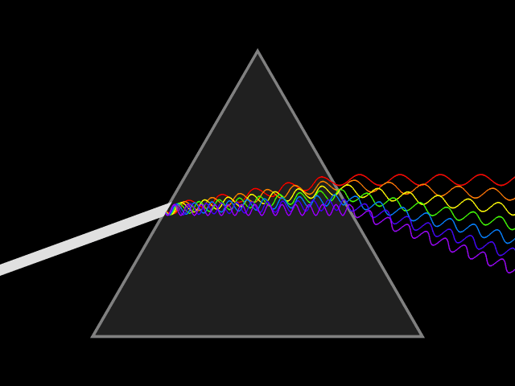
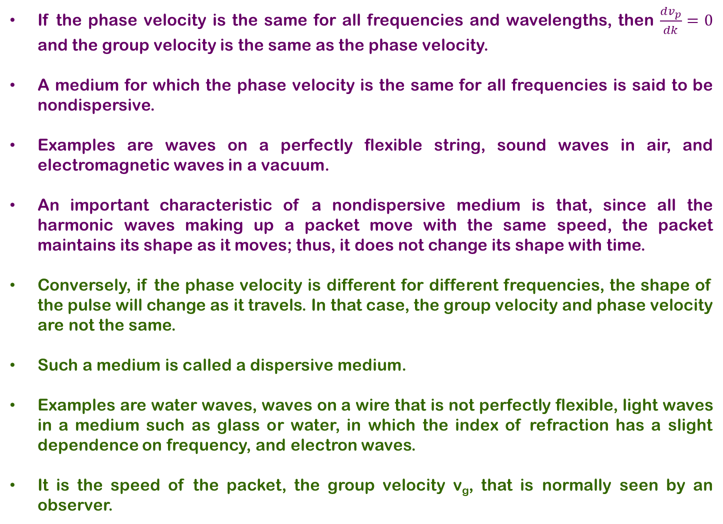
5.3 WAVE GROUPS AND DISPERSION
If the phase velocity is the same for all frequencies and wavelengths, then $\frac{dv_{p}}{dk}=0$ and the group velocity is the same as the phase velocity.
A medium for which the phase velocity is the same for all frequencies is said to be nondispersive.
Examples are waves on a perfectly flexible string, sound waves in air, and electromagnetic waves in a vacuum.
An important characteristic of a nondispersive medium is that, since all the harmonic waves making up a packet move with the same speed, the packet maintains its shape as it moves; thus, it does not change its shape with time.
Conversely, if the phase velocity is different for different frequencies, the shape of the pulse will change as it travels. In that case, the group velocity and phase velocity are not the same.
Such a medium is called a dispersive medium.
Examples are water waves, waves on a wire that is not perfectly flexible, light waves in a medium such as glass or water, in which the index of refraction has a slight dependence on frequency, and electron waves.
It is the speed of the packet, the group velocity v_{g}, that is normally seen by an observer.

Slide 13
5.3 WAVE GROUPS AND DISPERSION
Example: In a particular substance the phase velocity of waves doubles when the wavelength is halved. Show that wave groups in this system move at twice the central phase velocity.

Slide 14
5.3 WAVE GROUPS AND DISPERSION
Example: Newton showed that the phase velocity of deep water waves having wavelength λ is given by
where g is the acceleration of gravity and where the minor contribution of surface tension has been ignored. Show that in this case the velocity of a group of these waves is one-half of the phase velocity of the central wavelength.

Slide 15
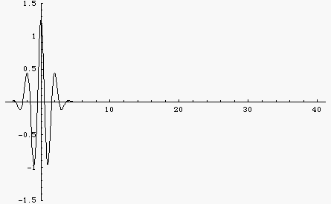
5.5 THE HEISENBERG UNCERTAINTY PRINCIPLE
We want to use de Broglie waves to describe particles. In particular, the amplitude of the wave will tell us something about the location of the particle.
A pure sinusoidal wave is not much use in locating a particle—the wave extends from −∞ to +∞, so the particle might be found anywhere in that region.
On the other hand, a narrow wave pulse does a pretty good job of locating the particle in a small region of space, but this wave does not have an easily identifiable wavelength.
In the first case, we know the wavelength exactly but have no knowledge of the location of the particle.
In the second case we have a good idea of the location of the particle but a poor knowledge of its wavelength.

Slide 16
5.5 THE HEISENBERG UNCERTAINTY PRINCIPLE

Slide 17

5.5 THE HEISENBERG UNCERTAINTY PRINCIPLE
In the period 1924–25, Werner Heisenberg introduced the notion that it is impossible to determine simultaneously with unlimited precision the position and momentum of a particle.
The smaller the size of the wave packet of the particle, the larger is the uncertainty in its momentum (and thus in its velocity).
Heisenberg uncertainty relationships sets the limit of the best we can possibly do in an experiment to measure simultaneously the location and the momentum of a particle.

Slide 18
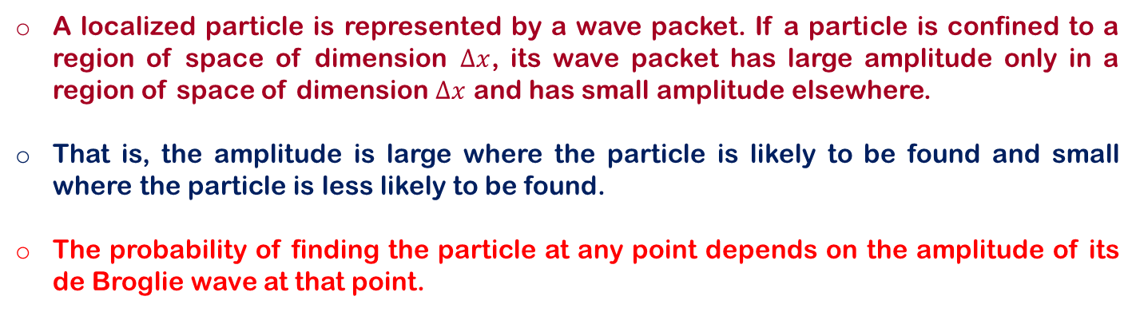
5.5 THE HEISENBERG UNCERTAINTY PRINCIPLE
A localized particle is represented by a wave packet. If a particle is confined to a region of space of dimension $∆x$, its wave packet has large amplitude only in a region of space of dimension $∆x$ and has small amplitude elsewhere.
That is, the amplitude is large where the particle is likely to be found and small where the particle is less likely to be found.
The probability of finding the particle at any point depends on the amplitude of its de Broglie wave at that point.
probability to observe particles ∝ | de Broglie wave amplitude |²
probability to observe photons ∝ | electric field amplitude |²

Slide 19
5.5 THE HEISENBERG UNCERTAINTY PRINCIPLE
Example: An electron moves in the x direction with a speed of 3.6 × 10⁶ m/s. We can measure its speed to a precision of 1%. With what precision can we simultaneously measure its x coordinate?
Repeat the calculations of the previous example in the case of a baseball m = 0.15 kg moving at a speed of 42 m/s. Again assume that its speed can be measured to a precision of 1%.

Slide 20
5.5 THE HEISENBERG UNCERTAINTY PRINCIPLE
Example: (a) A charged pi meson has a rest energy of 140MeV and a lifetime of 26 ns. Find the energy uncertainty of the pi meson, expressed in MeV and also as a fraction of its rest energy. (b) Repeat for the uncharged pi meson, with a rest energy of 135 MeV and a lifetime of 8.3 × 10⁻¹⁷ s. (c) Repeat for the rho meson, with a rest energy of 765MeV and a lifetime of 4.4 × 10⁻²⁴ s.

Slide 21
5.5 THE HEISENBERG UNCERTAINTY PRINCIPLE
Example: Estimate the minimum velocity that would be measured for a billiard ball (m ≈ 100 g) confined to a billiard table of dimension 1 m.

Slide 22
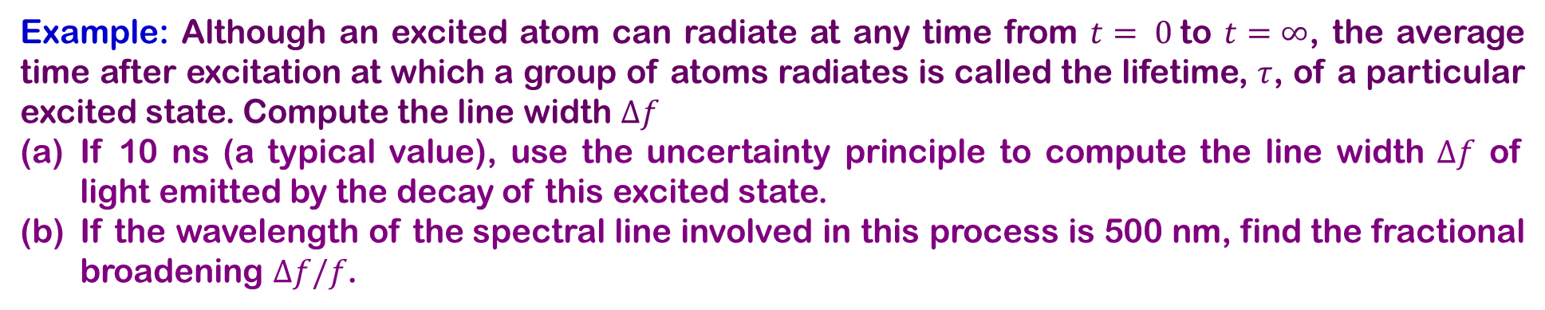
5.5 THE HEISENBERG UNCERTAINTY PRINCIPLE
Example: Although an excited atom can radiate at any time from $t= 0$to $t=∞$, the average time after excitation at which a group of atoms radiates is called the lifetime, $τ$, of a particular excited state. Compute the line width $∆f$
If 10 ns (a typical value), use the uncertainty principle to compute the line width $∆f$ of light emitted by the decay of this excited state.
If the wavelength of the spectral line involved in this process is 500 nm, find the fractional broadening $∆f/f$.

Slide 23
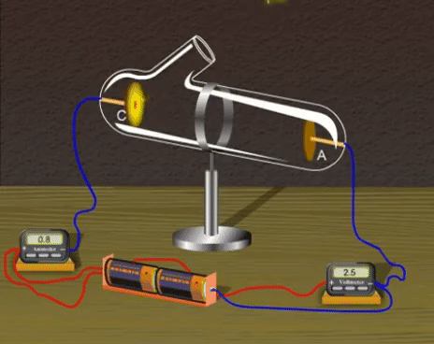
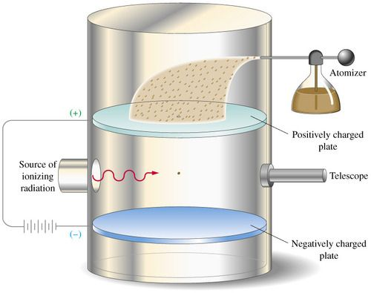
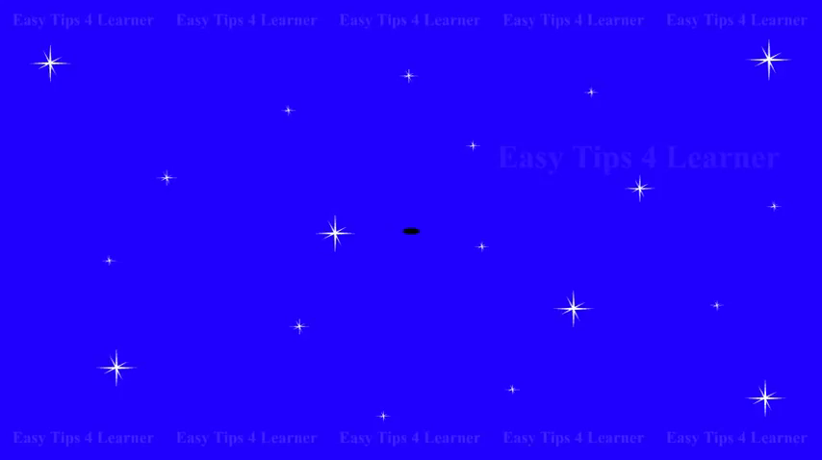
5.7 THE WAVE–PARTICLE DUALITY
JJ Thomson Experiment
Millikan’s Oil drop experiment
DAVISSON–GERMER EXPERIMENT
Electrons are very delicate and rather plastic—they behave like either particles or waves, depending on the kind of experiment performed on them. In any case, it is impossible to measure both the wave and particle properties simultaneously.
The view of Bohr was expressed in an idea known as complementarity. As different as they are, both wave and particle views are needed and they complement each other to fully describe the electron.

Slide 24
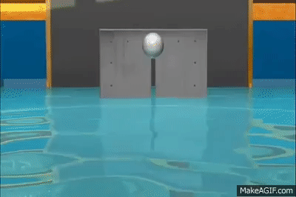
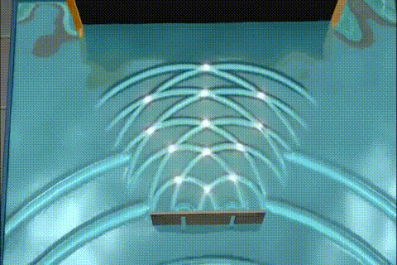
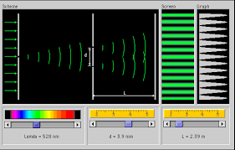


5.7 THE WAVE–PARTICLE DUALITY
Matter Waves
Young’s Double Slit Experiments
Richard Feynman Experiment
although the electrons are detected as particles at a localized spot at some instant of time, the probability of arrival at that spot is determined by finding the intensity of two interfering matter waves.

Slide 25
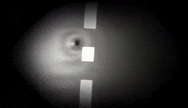

5.7 THE WAVE–PARTICLE DUALITY
Although the electrons are detected as particles at a localized spot at some instant of time, the probability of arrival at that spot is determined by finding the intensity of two interfering matter waves.

Slide 26
5.7 THE WAVE–PARTICLE DUALITY
Example: A neutron beam with a selected speed of 0.40 m/s is directed through a double slit with a 1.0-mm separation. An array of detectors is placed 10 m from the slit. (a) What is the de Broglie wavelength of the neutrons? (b) How far off axis is the first zero-intensity point on the detector array? (c) Can we say which slit any particular neutron passed through?

Slide 27
5.7 THE WAVE–PARTICLE DUALITY
Example: A monoenergetic beam of electrons is incident on a double slit with a 0.50 nm separation. A diffraction pattern is formed on a screen 20 cm from the slit. If the distance between successive minima of the diffraction pattern is 2.1 cm, what is the energy of the incident electrons?

Slide 28

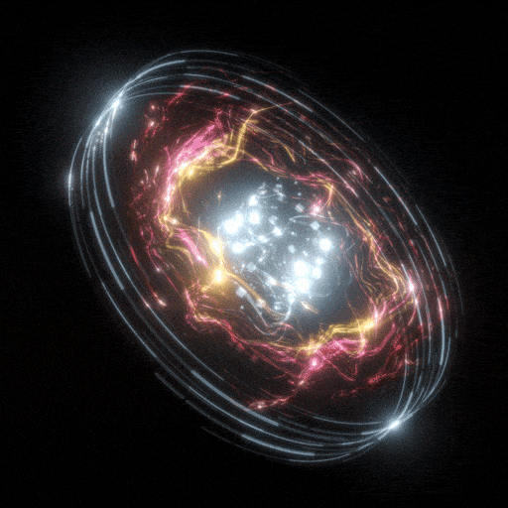
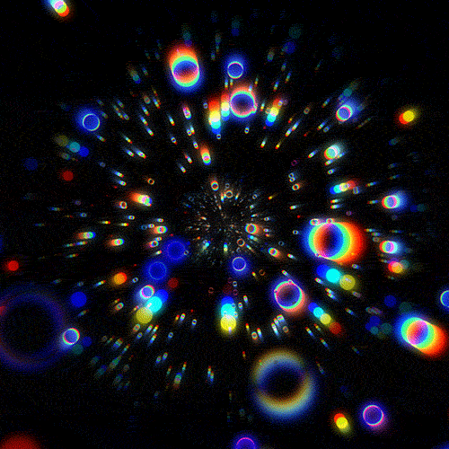
End of Ch 5

Slide 29
Current
Suggested
Assessment | Grade
HW & Quizzes | 15%
Mapping & Presentation | 15%
Midterm Exam | 30%
Final Exam | 40%
Total | 100%
Assessment | Grade
HW & Quizzes | 10%
Mapping & Presentation | 10%
Major 1 | 20 %
Major 2 | 20%
Final Exam | 40%
Total | 100%

