Slide 1

CH 6
Quantum Mechanics in One Dimension
Dr. Tariq Al-Abdullah

Slide 2
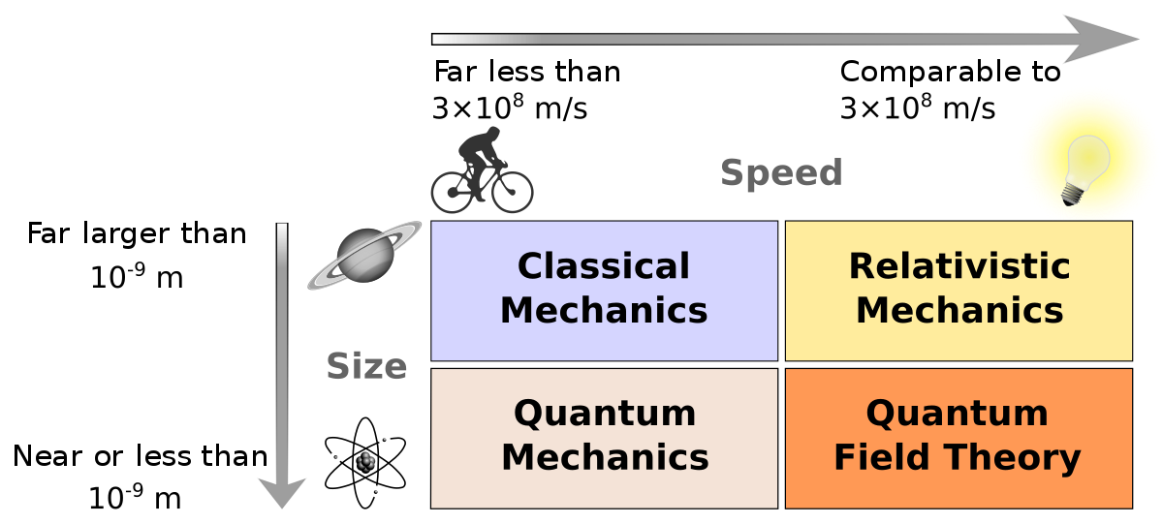


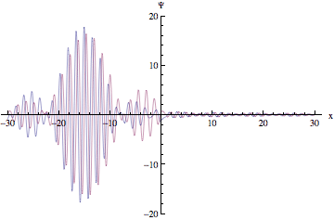
Introduction

Slide 3
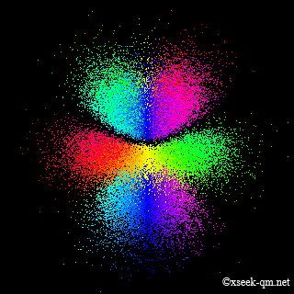

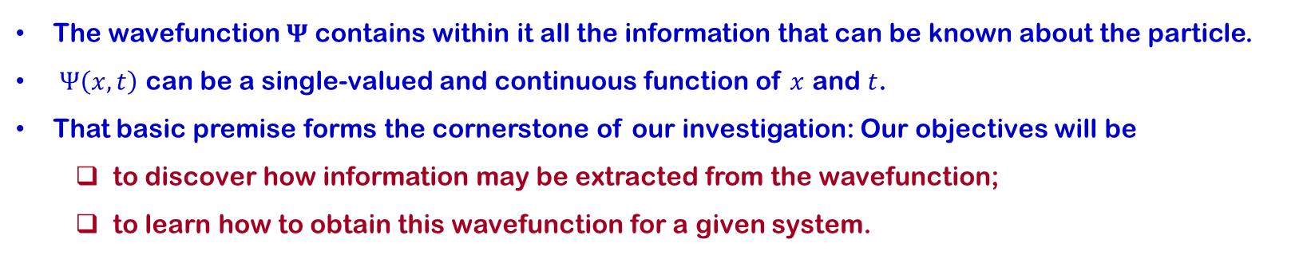
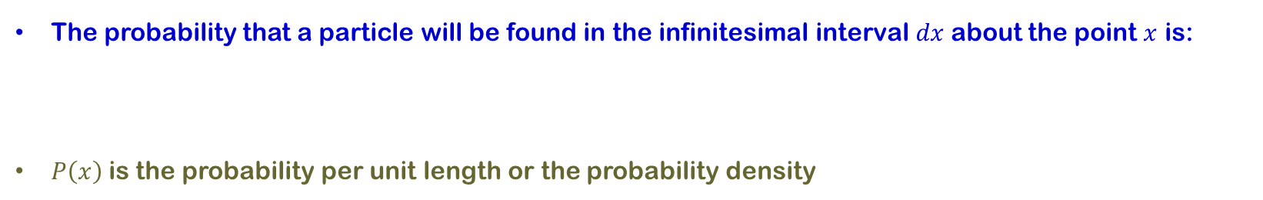
6.1 The Born Interpretation
The wavefunction $Ψ$ contains within it all the information that can be known about the particle.
$Ψ\left(x,t\right)$ can be a single-valued and continuous function of $x$ and $t$.
That basic premise forms the cornerstone of our investigation: Our objectives will be
  to discover how information may be extracted from the wavefunction;
  to learn how to obtain this wavefunction for a given system.
The probability that a particle will be found in the infinitesimal interval $dx$ about the point $x$ is:
$P\left(x\right)$is the probability per unit length or the probability density

Slide 4
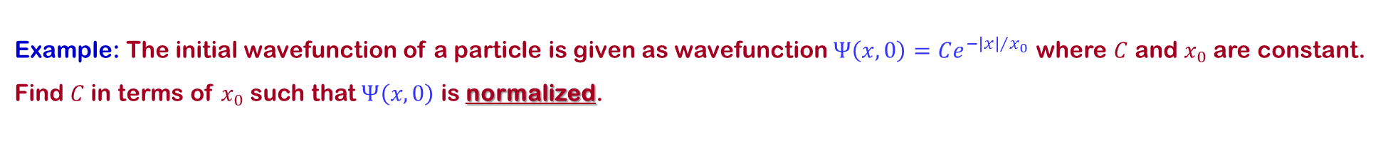
6.1 The Born Interpretation
Example: The initial wavefunction of a particle is given as wavefunction $Ψ\left(x,0\right)=Ce^{−{\left|x\right|}/{x_{0}}}$ where $C$ and $x_{0}$ are constant. Find $C$ in terms of $x_{0}$ such that $Ψ\left(x,0\right)$ is normalized.

Slide 5
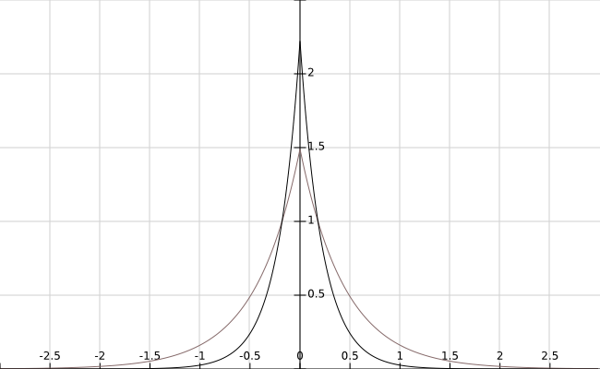
6.1 The Born Interpretation
Example: Calculate the probability that the particle in the previous example will be found the interval $−x_{0}≤x≤+x_{0}$

Slide 6
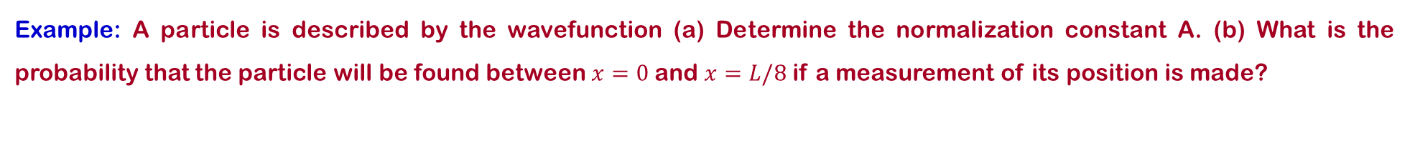
6.1 The Born Interpretation
Example: A particle is described by the wavefunction (a) Determine the normalization constant A. (b) What is the probability that the particle will be found between $x=0$and $x=L/8$if a measurement of its position is made?

Slide 7
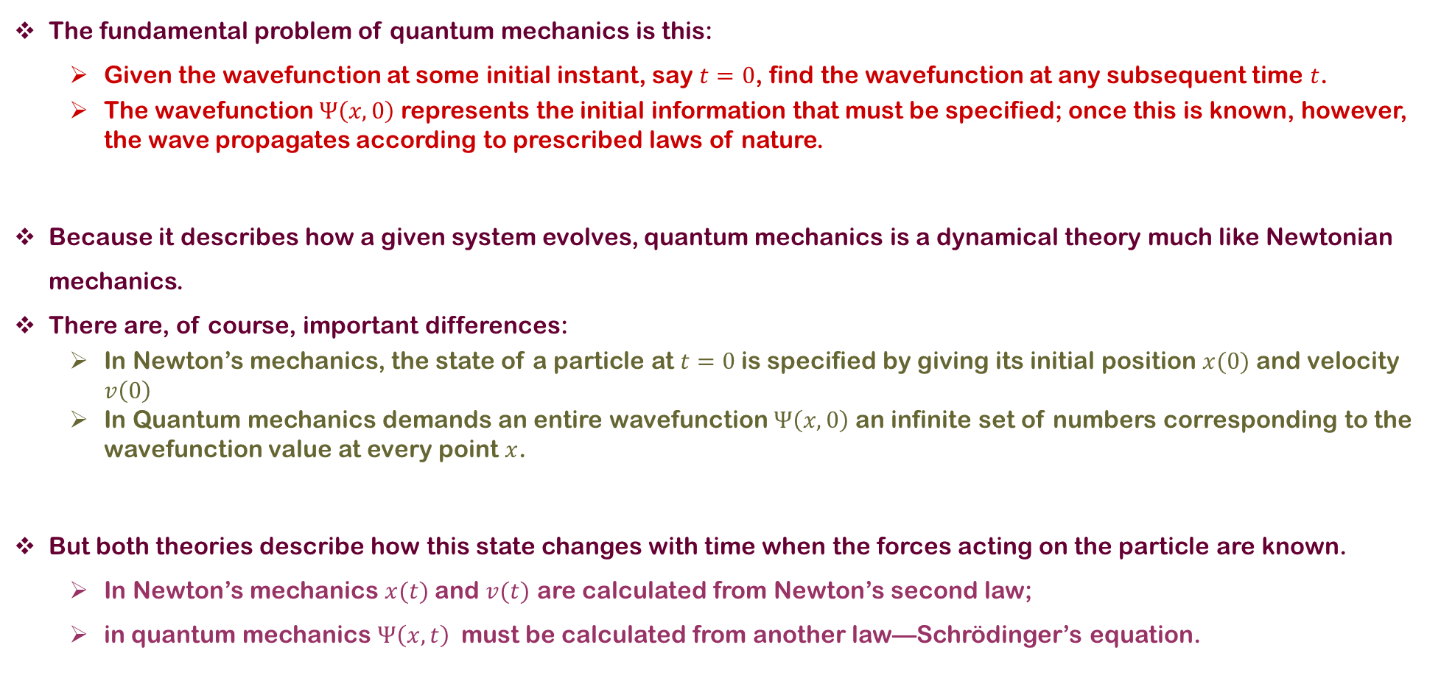
6.1 The Born Interpretation
The fundamental problem of quantum mechanics is this:
  Given the wavefunction at some initial instant, say $t=0$, find the wavefunction at any subsequent time $t$.
  The wavefunction $Ψ\left(x,0\right)$ represents the initial information that must be specified; once this is known, however, the wave propagates according to prescribed laws of nature.
Because it describes how a given system evolves, quantum mechanics is a dynamical theory much like Newtonian mechanics.
There are, of course, important differences:
  In Newton’s mechanics, the state of a particle at $t=0$is specified by giving its initial position $x(0)$ and velocity $v\left(0\right)$
  In Quantum mechanics demands an entire wavefunction $Ψ\left(x,0\right)$ an infinite set of numbers corresponding to the wavefunction value at every point $x$.
But both theories describe how this state changes with time when the forces acting on the particle are known.
  In Newton’s mechanics $x(t)$ and $v(t)$ are calculated from Newton’s second law;
  in quantum mechanics $Ψ\left(x,t\right)$ must be calculated from another law—Schrödinger’s equation.

Slide 8
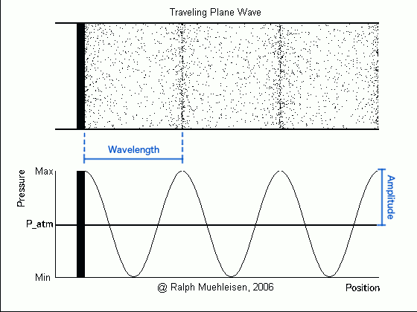
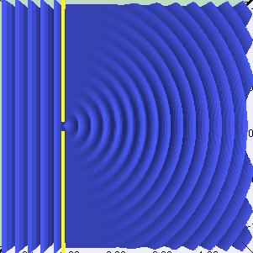
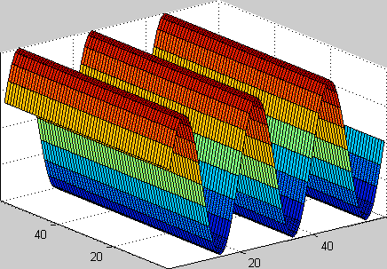
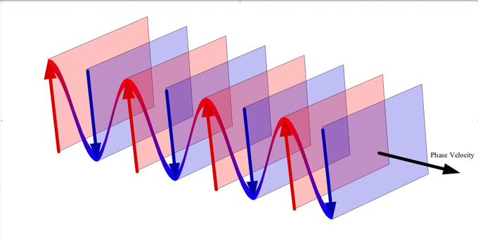
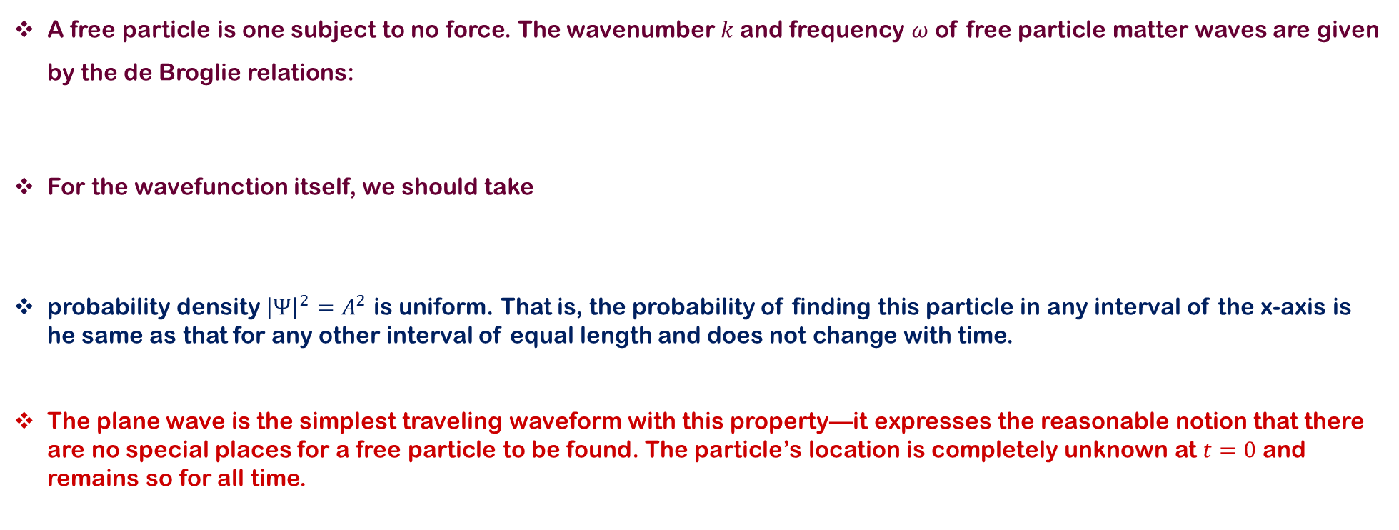
6.2 Wavefunction for a Free Particle
A free particle is one subject to no force. The wavenumber $k$ and frequency $ω$ of free particle matter waves are given by the de Broglie relations:
For the wavefunction itself, we should take
probability density ${\left|Ψ\right|}^{2}=A^{2}$ is uniform. That is, the probability of finding this particle in any interval of the x-axis is he same as that for any other interval of equal length and does not change with time.
The plane wave is the simplest traveling waveform with this property—it expresses the reasonable notion that there are no special places for a free particle to be found. The particle’s location is completely unknown at $t=0$ and remains so for all time.

Slide 9
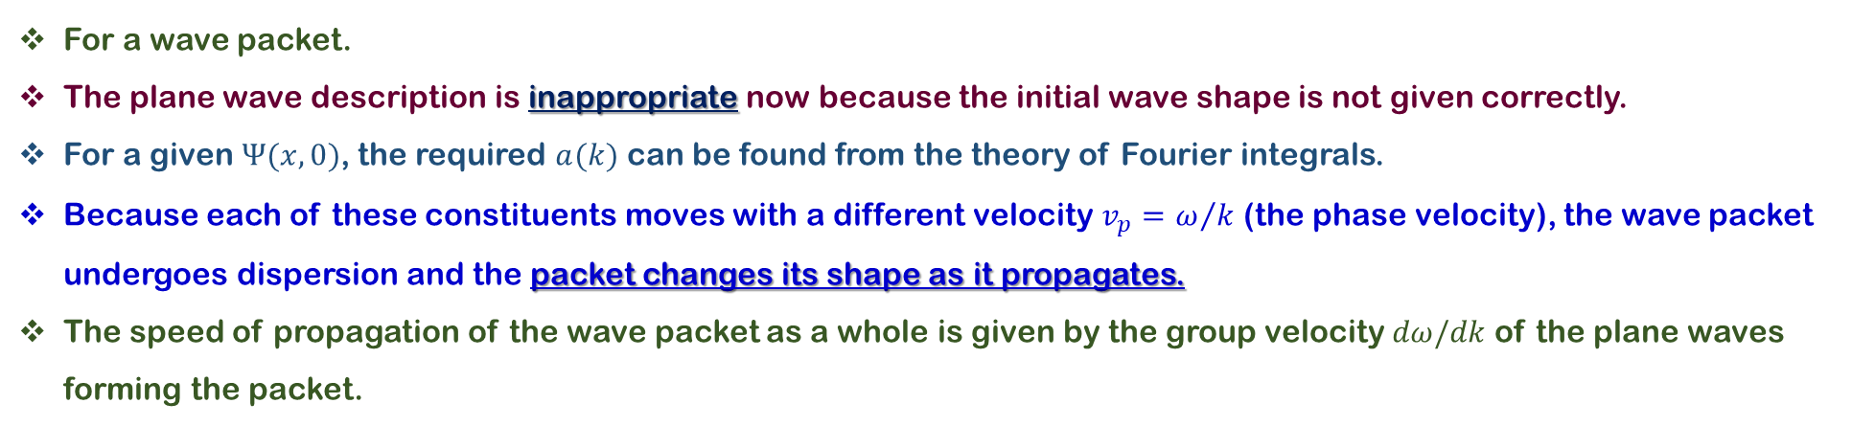
6.2 Wavefunction for a Free Particle
For a wave packet.
The plane wave description is inappropriate now because the initial wave shape is not given correctly.
For a given $Ψ(x, 0)$, the required $a(k)$ can be found from the theory of Fourier integrals.
Because each of these constituents moves with a different velocity $v_{p}=ω/k$ (the phase velocity), the wave packet undergoes dispersion and the packet changes its shape as it propagates.
The speed of propagation of the wave packet as a whole is given by the group velocity $dω/dk$of the plane waves forming the packet.

Slide 10
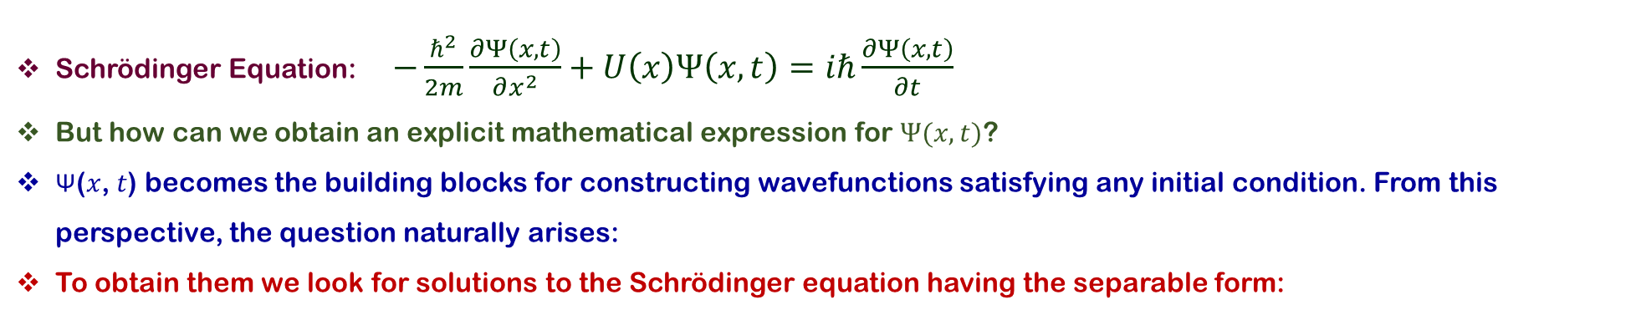
6.3 Wavefunctions in the Presence of Forces
Schrödinger Equation: $−\frac{ℏ^{2}}{2m}\frac{∂Ψ\left(x,t\right)}{∂x^{2}}+U\left(x\right)Ψ\left(x,t\right)=iℏ\frac{∂Ψ\left(x,t\right)}{∂t}$
But how can we obtain an explicit mathematical expression for $Ψ(x, t)$?
Ψ(𝑥, 𝑡) becomes the building blocks for constructing wavefunctions satisfying any initial condition. From this perspective, the question naturally arises:
To obtain them we look for solutions to the Schrödinger equation having the separable form:

Slide 11
6.3 Wavefunctions in the Presence of Forces
In separable form, solutions are called stationary states. Thus, for stationary states all probabilities are static and can be calculated from the time-independent wavefunction $ψ(x)$

Slide 12
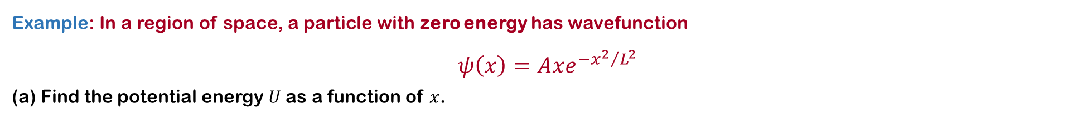
6.3 Wavefunctions in the Presence of Forces
Example: In a region of space, a particle with zero energy has wavefunction
$$ψ\left(x\right)=Axe^{−{x^{2}}/{L^{2}}}$$
(a) Find the potential energy $U$as a function of $x$.

Slide 13
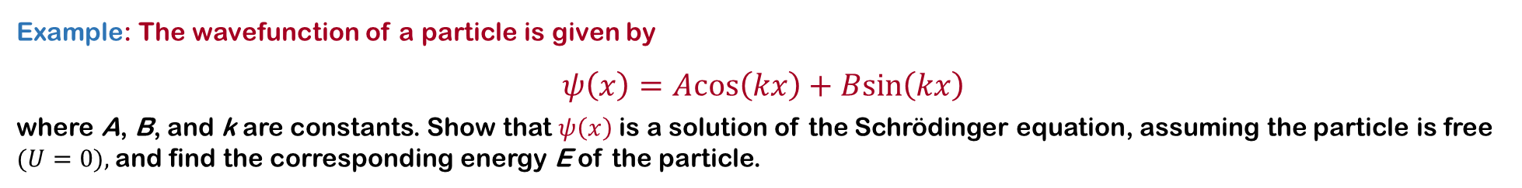
6.3 Wavefunctions in the Presence of Forces
Example: The wavefunction of a particle is given by
$$ψ\left(x\right)=Acos\left(kx\right)+Bsin\left(kx\right)$$
where A, B, and k are constants. Show that $ψ\left(x\right)$ is a solution of the Schrödinger equation, assuming the particle is free $(U=0),$and find the corresponding energy E of the particle.

Slide 14
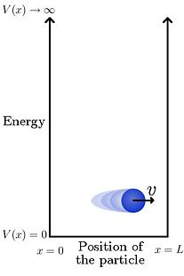
6.4 THE PARTICLE IN A BOX

Slide 15
6.4 THE PARTICLE IN A BOX

Slide 16
6.4 THE PARTICLE IN A BOX

Slide 17
6.4 THE PARTICLE IN A BOX

Slide 18
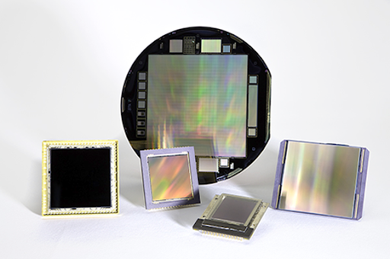
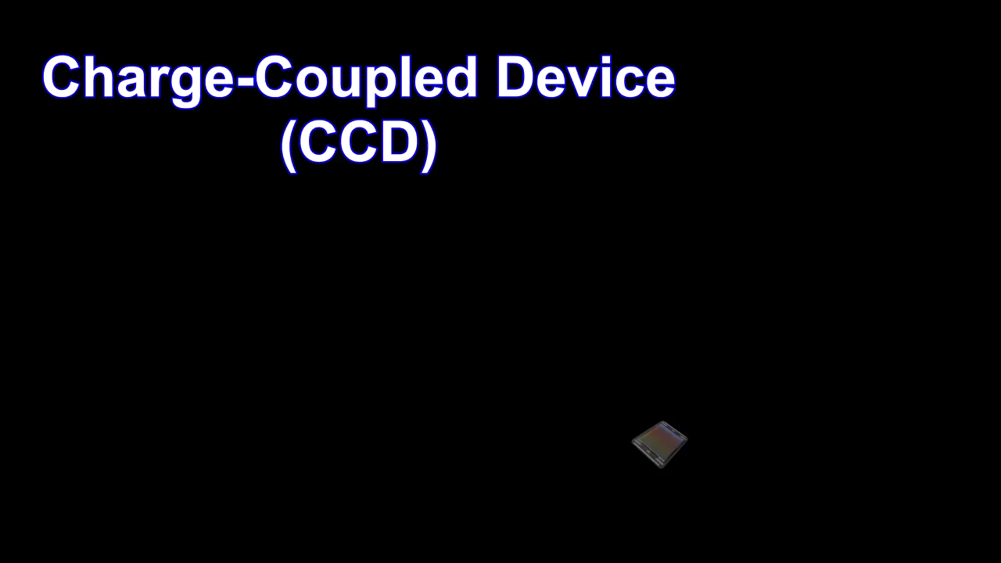
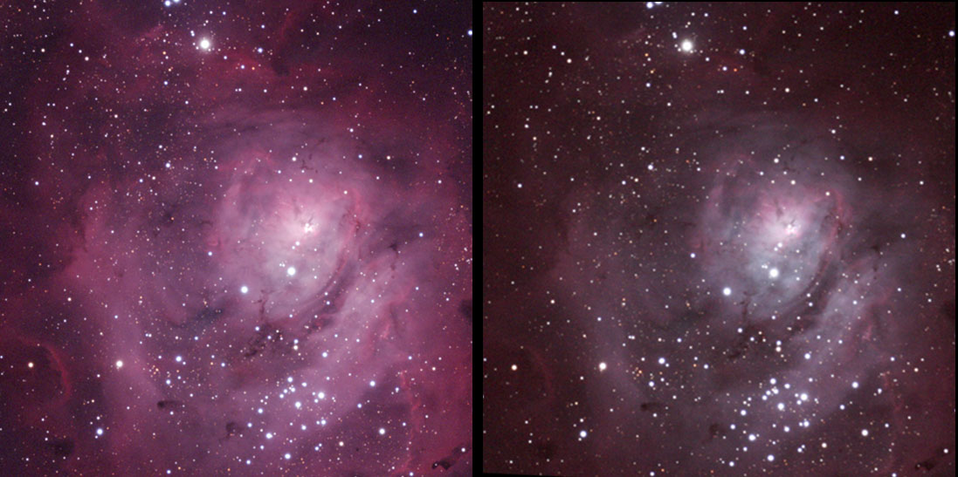


6.4 Applications-CCD
Potential wells are essential to the operation of many modern electronic devices.
Each well ismodeled by the infinite square. The charge-coupled device, or CCD, uses potential wells to trap electrons.
Then create a faithful electronic reproduction of light intensity across the active surface.
(CCD) is an integrated circuit containing an array of linked, or coupled, capacitors. Under the control of an external circuit, each capacitor can transfer its electric charge to a neighboring capacitor.
It helps astronomers see amazing detail in distant galaxies using much shorter exposure times than with traditional photographic emulsions.
https://diffractionlimited.com/ccd-versus-cmos-better/

Slide 19
6.5 The finite Square Well

Slide 20
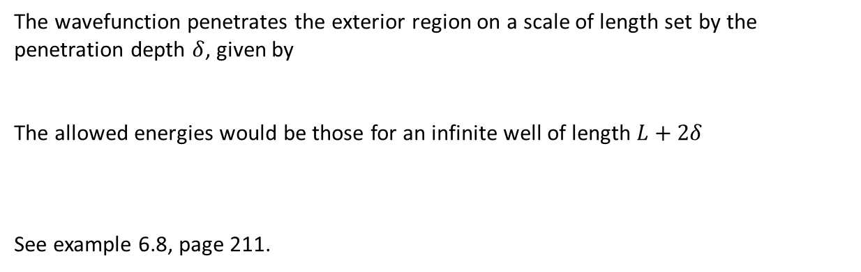
6.5 The finite Square Well
The wavefunction penetrates the exterior region on a scale of length set by the penetration depth $δ$, given by
The allowed energies would be those for an infinite well of length $L+2δ$
See example 6.8, page 211.

Slide 21
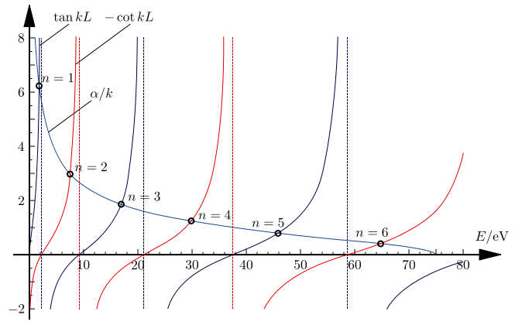
6.5 The finite Square Well

Slide 22

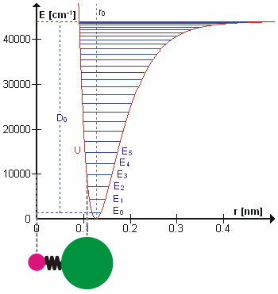
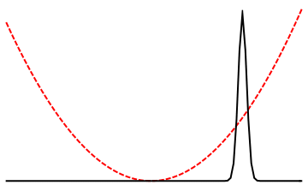
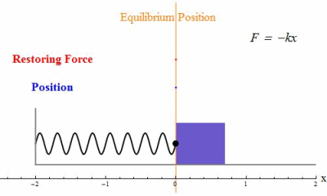
6.6 The Quantum Oscillator

Slide 23
6.6 The Quantum Oscillator

Slide 24
6.6 The Quantum Oscillator
The probability densities for some of the oscillator states.
The dashed lines, representing the classical probability densities for the same energy, are provided for comparison.
Note that as n increases, agreement between the classical and quantum probabilities improves, as expected from the correspondence principle.

Slide 25
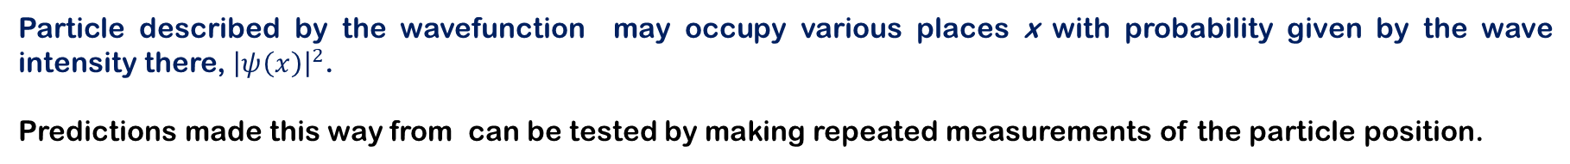
6.7 Expectation Values
Particle described by the wavefunction may occupy various places x with probability given by the wave intensity there, ${\left|ψ\left(x\right)\right|}^{2}$.
Predictions made this way from can be tested by making repeated measurements of the particle position.
The average position of the particle:
This same number can be found in a different way. First, order the table entries by value, starting with the smallest: 1.4, 2.5, 3.3, . . . , 5.4, 6.2, . . . , 8.0, 8.8. Now take each value, multiply by its frequency of occurrence, and sum the results:

Slide 26
6.7 Expectation Values

Slide 27
6.7 Expectation Values

Slide 28
6.8 Observables and Operators
An observable is any particle property that can be measured.
The position and momentum of a particle are observables, as are its kinetic and potential energies.
In quantum mechanics, we associate an operator with each of these observables.
Using this operator, one can calculate the average value of the corresponding observable.
An operator here refers to an operation to be performed on whatever function follows the operator

Slide 29
6.8 Observables and Operators

