Slide 1
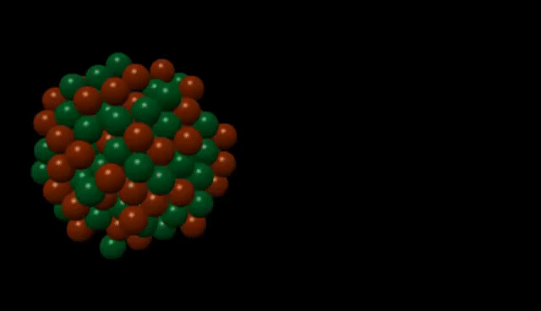
CH 7
Tunneling Phenomena
Dr. Tariq Al-Abdullah

Slide 2
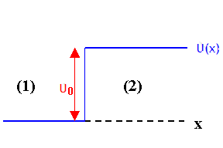
Example
The potential step may be regarded as a square barrier in the special case where the barrier width L is infinite. Apply the ideas of this section to discuss the quantum scattering of particles incident from the left on a potential step, in the case where the step height U exceeds the total particle energy E.

Slide 3
Example

Slide 4
Example

Slide 5
Example

Slide 6
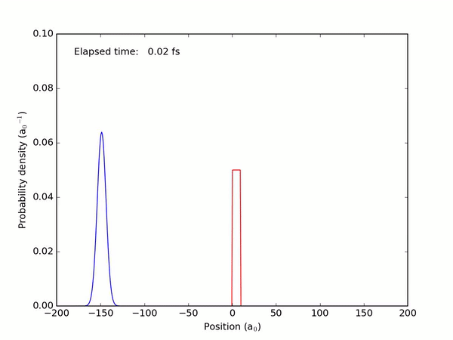

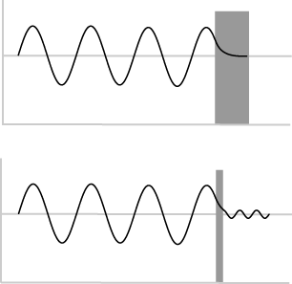
7.1 THE SQUARE BARRIER
According to quantum mechanics, however, there is no region inaccessible to our particle, regardless of its energy, since the matter wave associated with the particle is nonzero everywhere.
The process of penetrating the barrier is called tunneling: we say the particle has tunneled through the barrier.

Slide 7
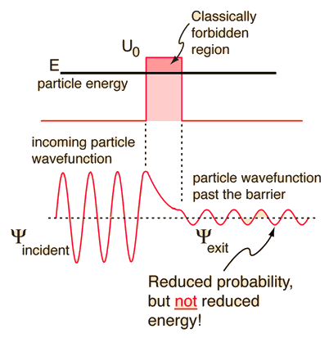
7.1 THE SQUARE BARRIER
The degree of transmission or reflection will depend on particle

Slide 8
7.1 THE SQUARE BARRIER

Slide 9
7.1 THE SQUARE BARRIER
Example: Two copper conducting wires are separated by an insulating oxide layer (CuO). Modeling the oxide layer as a square barrier of height 10.0 eV, estimate the transmission coefficient for penetration by 7.00-eV electrons (a) if the layer thickness is 5.00 nm and (b) if the layer thickness is 1.00 nm.

Slide 10
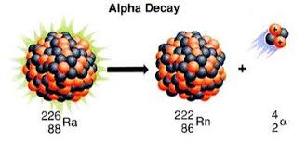
7.2 BARRIER PENETRATION: α Decay
All particles emitted from any one source have nearly the same energy and, for all known emitters, emerge with kinetic energies in the same narrow range, from about 4 to 9 MeV.
In contrast to the uniformity of energies, the half-life of the emitter (time taken for half of the emitting substance to decay) varies over an enormous range—more than 20 orders of magnitude!—according to the emitting element
The tunneling probability and associated decay rate are calculated in much the same way as for field emission, apart from the fact that the barrier shape now is Coulombic, rather than triangular.

Slide 11
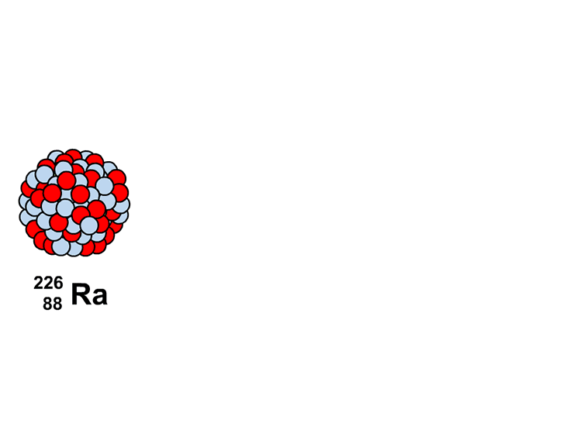
7.2 BARRIER PENETRATION: α Decay

Slide 12
7.2 BARRIER PENETRATION: α Decay
Example: Using the tunneling model just developed, estimate the half-lives for α decay of the radioactive elements thorium and polonium. The energy of the ejected alphas is 4.05 MeV and 8.95 MeV, respectively, and the nuclear size is about 9.00 fm in both cases.

Slide 13
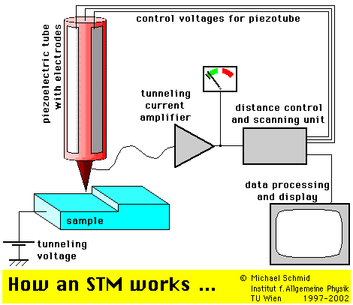
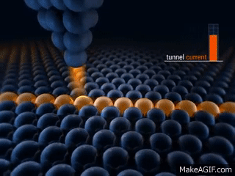
7.2 BARRIER PENETRATION: STM
An important application of tunneling is the scanning tunneling microscope (STM), developed in the 1980s by Gerd Binnig and Heinrich Rohrer.
In this device a narrow gap between a conducting sample and the tip of a tiny probe acts as a potential barrier to electrons bound in the sample through the barrier separating the two surfaces if the surfaces.
A small bias voltage applied between the probe and the specimen causes the electrons to tunnel are close enough together.
The tunneling current is extremely sensitive to the size of the gap, that is, the width of the barrier, between the probe and specimen.
Thus, the surface of the specimen can be mapped out by the vertical motions of the probe.
In this way, the surface features of a specimen can be measured by STMs with a resolution of the order of the size of a single atom (Example the accompanying STM images of gold nanoparticles).

Slide 14
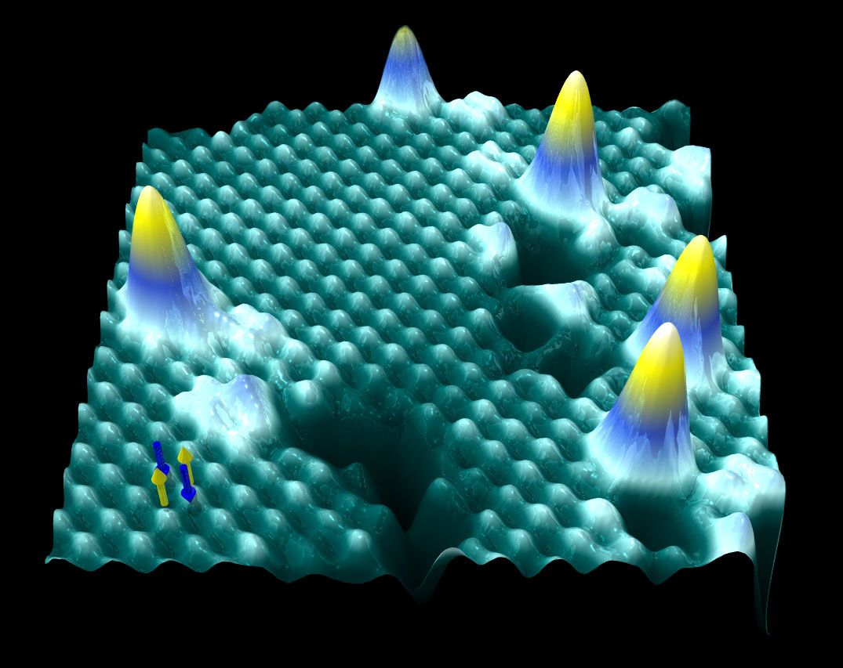
End of CH 7

