Slide 1

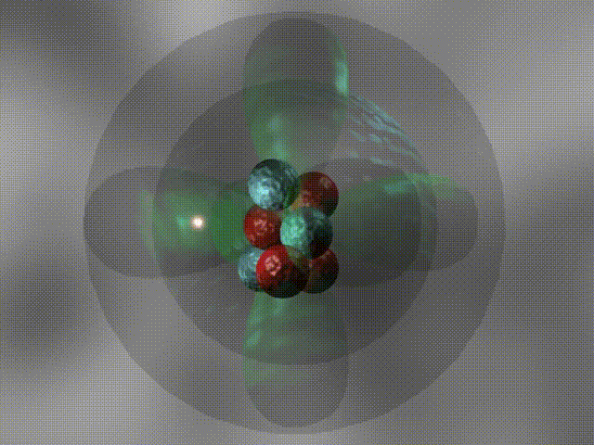
CH 8
Quantum Mechanics in 3D
Dr. Tariq Al-Abdullah

Slide 2
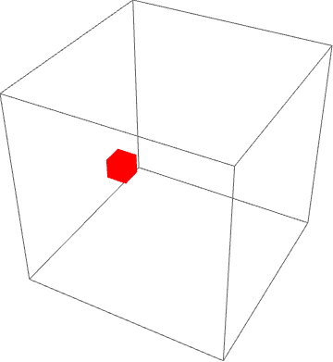
8.1 PARTICLE IN A THREE-DIMENSIONAL BOX
Let us explore the workings of wave mechanics in three dimensions through the example of a particle confined to a cubic “box.” The box has edge length L and occupies the region 0 < x, y, z < L

Slide 3
8.1 PARTICLE IN A THREE-DIMENSIONAL BOX

Slide 4
8.1 PARTICLE IN A THREE-DIMENSIONAL BOX

Slide 5
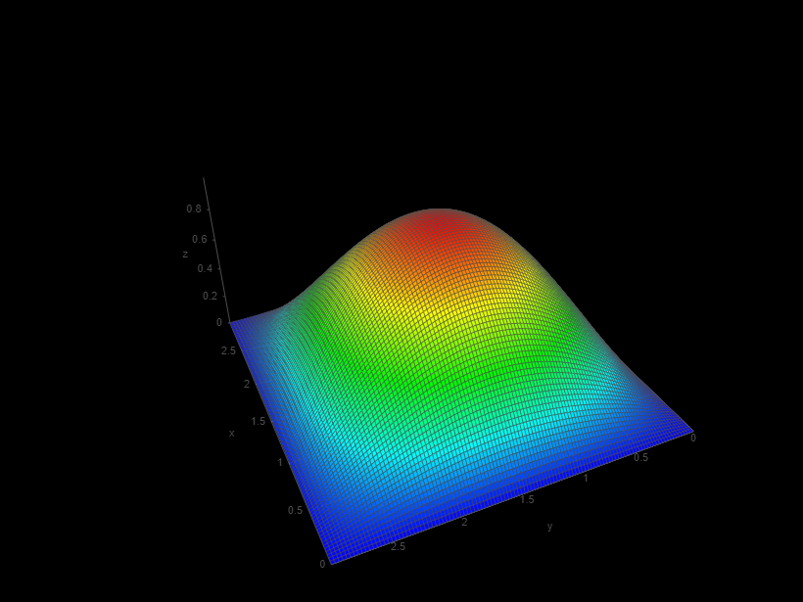
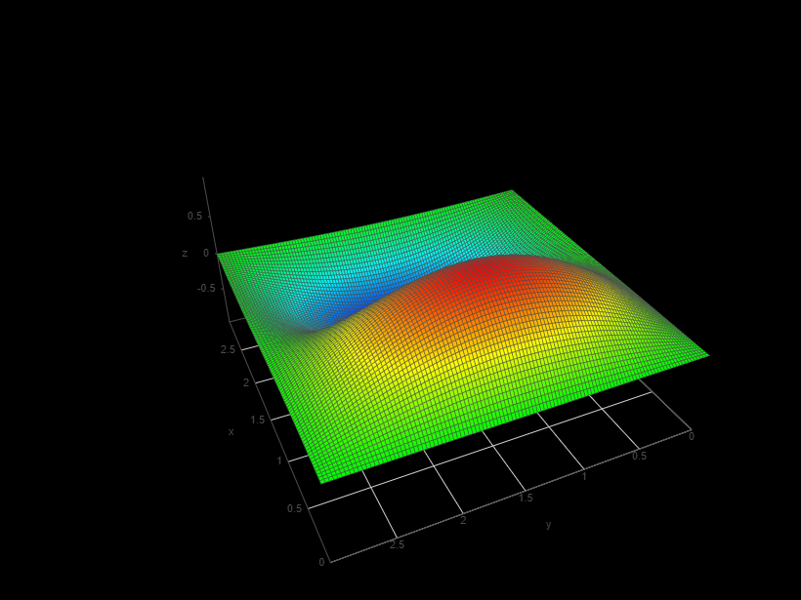
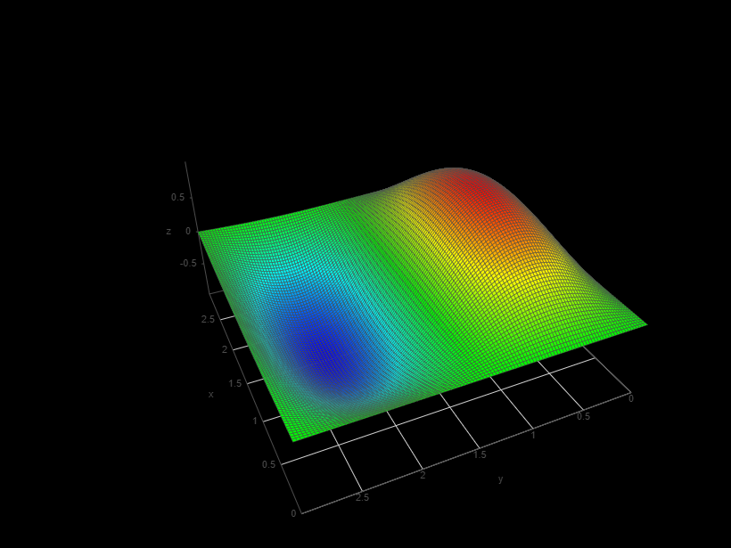
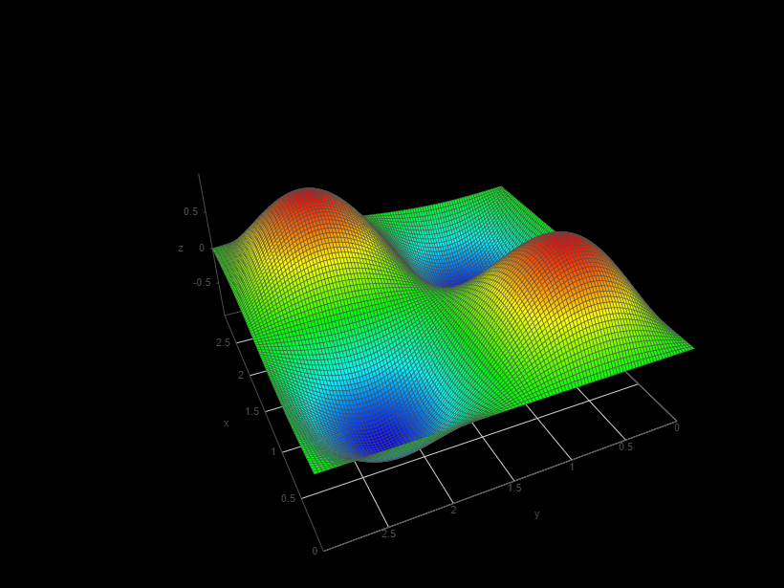
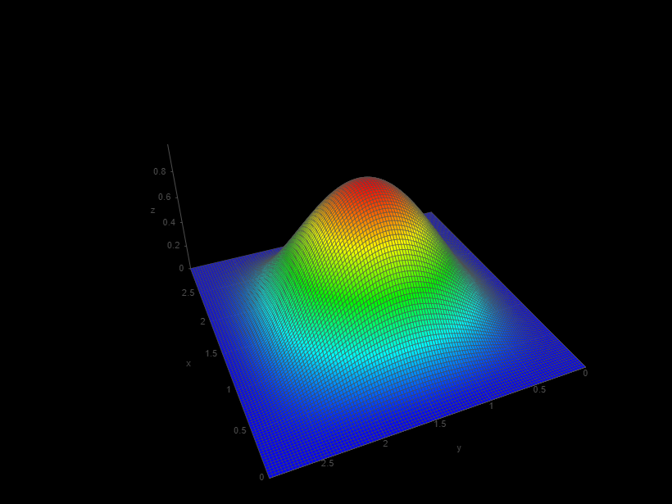
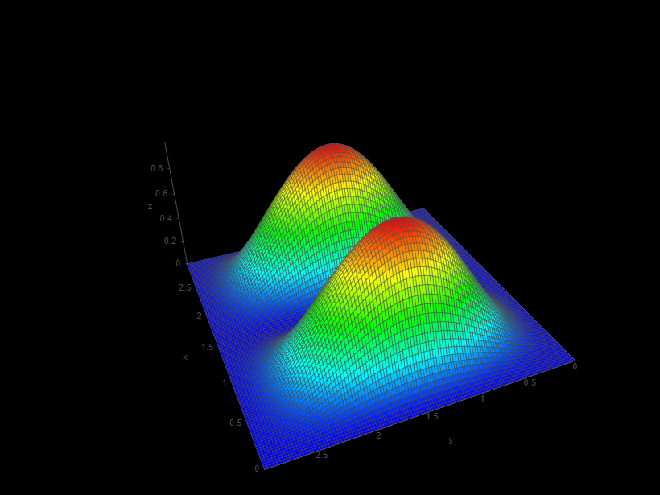
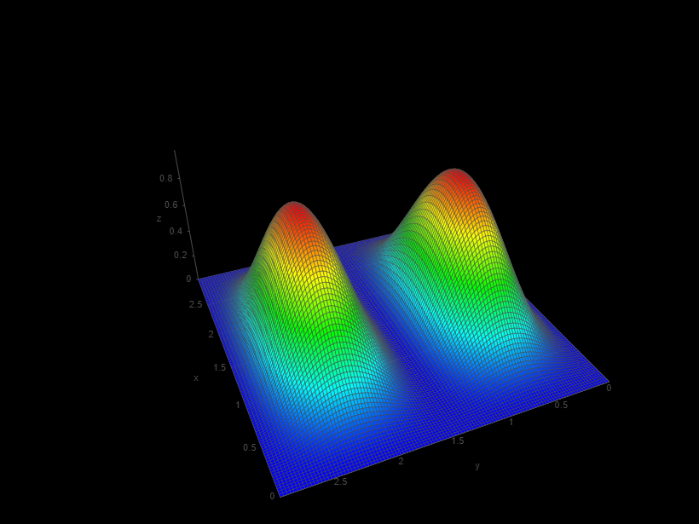
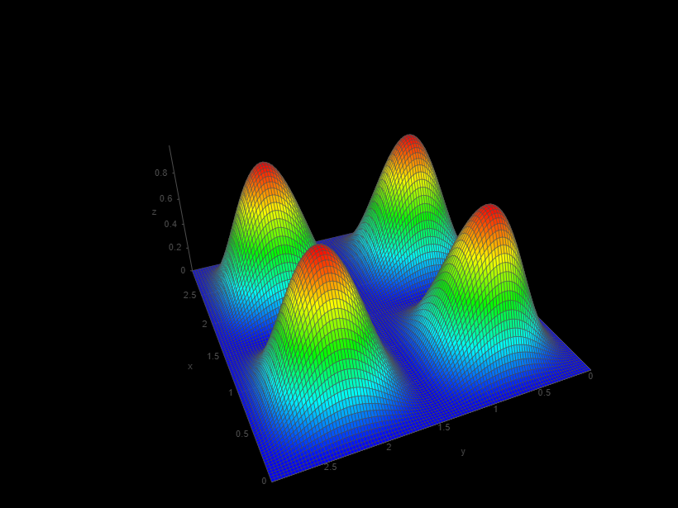






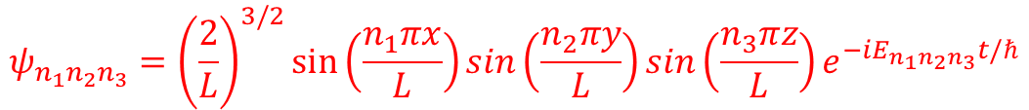



8.1 PARTICLE IN A THREE-DIMENSIONAL BOX
$$ψ_{n_{1}n_{2}n_{3}}={\left(\frac{2}{L}\right)}^{3/2}\sin\left(\frac{n_{1}πx}{L}\right)\sin\left(\frac{n_{2}πy}{L}\right)\sin\left(\frac{n_{3}πz}{L}\right)e^{−iE_{n_{1}n_{2}n_{3}}t/ℏ}$$
$$E_{n_{1}n_{2}n_{3}}=\frac{πℏ^{2}}{2mL^{2}}\left(n_{1}^{2}+n_{2}^{2}+n_{3}^{2}\right)$$
$$ψ_{11}$$
$$ψ_{21}$$
$$ψ_{12}$$
$$ψ_{22}$$
$${\left|ψ_{11}\right|}^{2}$$
$${\left|ψ_{21}\right|}^{2}$$
$${\left|ψ_{12}\right|}^{2}$$
$${\left|ψ_{22}\right|}^{2}$$

Slide 6
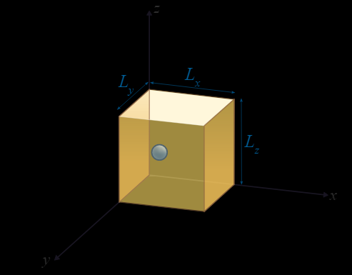
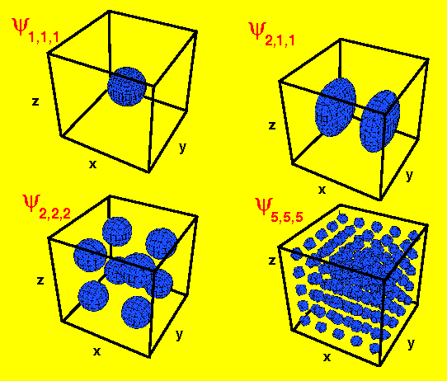



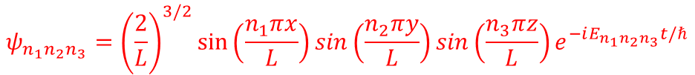

8.1 PARTICLE IN A THREE-DIMENSIONAL BOX
$$ψ_{n_{1}n_{2}n_{3}}={\left(\frac{2}{L}\right)}^{3/2}\sin\left(\frac{n_{1}πx}{L}\right)\sin\left(\frac{n_{2}πy}{L}\right)\sin\left(\frac{n_{3}πz}{L}\right)e^{−iE_{n_{1}n_{2}n_{3}}t/ℏ}$$
$$E_{n_{1}n_{2}n_{3}}=\frac{πℏ^{2}}{2mL^{2}}\left(n_{1}^{2}+n_{2}^{2}+n_{3}^{2}\right)$$
$$ψ_{122}={\left(\frac{2}{L}\right)}^{3/2}\sin\left(\frac{πx}{L}\right)\sin\left(\frac{2πy}{L}\right)\sin\left(\frac{2πz}{L}\right)e^{−iE_{122}t/ℏ}$$
$$ψ_{221}={\left(\frac{2}{L}\right)}^{3/2}\sin\left(\frac{2πx}{L}\right)\sin\left(\frac{2πy}{L}\right)\sin\left(\frac{πz}{L}\right)e^{−iE_{221}t/ℏ}$$
$$ψ_{122}={\left(\frac{2}{L}\right)}^{3/2}\sin\left(\frac{2πx}{L}\right)\sin\left(\frac{πy}{L}\right)\sin\left(\frac{2πz}{L}\right)e^{−iE_{212}t/ℏ}$$

Slide 7
8.1 PARTICLE IN A THREE-DIMENSIONAL BOX
Example: An electron moves in a cube whose sides have a length of 0.2 nm. Find values for the energy of (a) the ground state and (b) the first excited state of the electron.

Slide 8
8.1 PARTICLE IN A THREE-DIMENSIONAL BOX
Example: A particle of mass m moves in a three-dimensional box with edge lengths L₁, L₂, and L₃. Find the energies of the six lowest states if L₁ = L, L₂ = 2L, and L₃ = 2L. Which of these energies are degenerate?

Slide 9
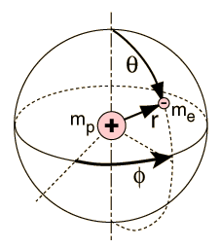
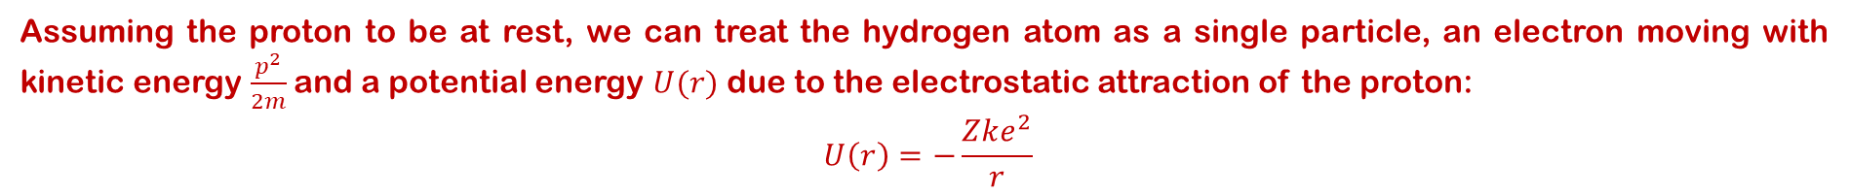
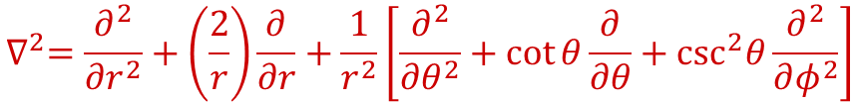

8.2 Central Forces and Angular Momentum
Assuming the proton to be at rest, we can treat the hydrogen atom as a single particle, an electron moving with kinetic energy $\frac{p^{2}}{2m}$and a potential energy $U(r)$ due to the electrostatic attraction of the proton:
$$U\left(r\right)=−\frac{Zke^{2}}{r}$$
$$−\frac{ℏ^{2}}{2m_{e}}∇^{2}ψ\left(\vec{r}\right)+U\left(r\right)ψ\left(\vec{r}\right)=Eψ\left(\vec{r}\right)$$
$$∇^{2}=\frac{∂^{2}}{∂r^{2}}+\left(\frac{2}{r}\right)\frac{∂}{∂r}+\frac{1}{r^{2}}\left[\frac{∂^{2}}{∂θ^{2}}+\cot{θ\frac{∂}{∂θ}+\csc^{2}θ\frac{∂^{2}}{∂φ^{2}}}\right]$$
The first step in the solution of a partial differential equation is to search for separable solutions by writing the wave function $ψ\left(r,θ,φ\right)$ as a product of functions of each single variable. We write:$ψ\left(r,θ,φ\right)=R\left(r\right)Θ\left(θ\right)Φ\left(φ\right)$

Slide 10
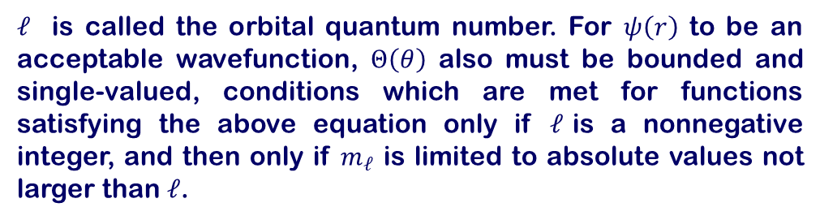
8.2 Central Forces and Angular Momentum
$ℓ$ is called the orbital quantum number. For $ψ\left(r\right)$ to be an acceptable wavefunction, $Θ\left(θ\right)$ also must be bounded and single-valued, conditions which are met for functions satisfying the above equation only if $ℓ$is a nonnegative integer, and then only if $m_{ℓ}$ is limited to absolute values not larger than $ℓ$.

Slide 11
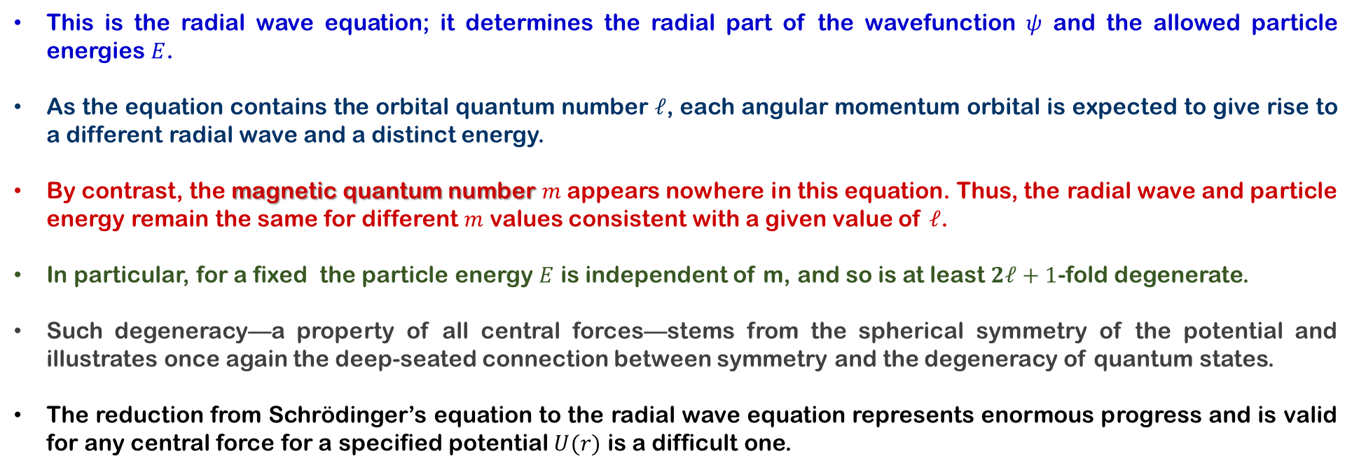

8.2 Central Forces and Angular Momentum
This is the radial wave equation; it determines the radial part of the wavefunction $ψ$ and the allowed particle energies $E$.
As the equation contains the orbital quantum number $ℓ$, each angular momentum orbital is expected to give rise to a different radial wave and a distinct energy.
By contrast, the magnetic quantum number $m$ appears nowhere in this equation. Thus, the radial wave and particle energy remain the same for different $m$ values consistent with a given value of $ℓ$.
In particular, for a fixed the particle energy $E$ is independent of m, and so is at least $2ℓ+1$-fold degenerate.
Such degeneracy—a property of all central forces—stems from the spherical symmetry of the potential and illustrates once again the deep-seated connection between symmetry and the degeneracy of quantum states.
The reduction from Schrödinger’s equation to the radial wave equation represents enormous progress and is valid for any central force for a specified potential $U(r)$ is a difficult one.
$$ψ\left(r,θ,φ\right)=R\left(r\right)Θ\left(θ\right)Φ\left(φ\right)$$

Slide 12
8.3 Space Quantization
Thus, we have the very important result that, for all potentials where $U= U(r),$the angular momentum is quantized and its allowed magnitudes (eigenvalues) are given by
if we use the same substitution method on L_{z}, the z component of L, we find that the z component of the angular momentum is also quantized and its allowed values are given by
From a three-dimensional perspective, L must lie on the surface of a cone that makes an angle with the z-axis. From the figure, we see that θ also is quantized and that its values are specified by the relation.

Slide 13
8.3 Space Quantization
Example: If a system has angular momentum characterized by the quantum number $ℓ=2$, what are the possible values of L_{z}, what is the magnitude L, and what is the smallest-possible angle between L and the z axis?

Slide 14
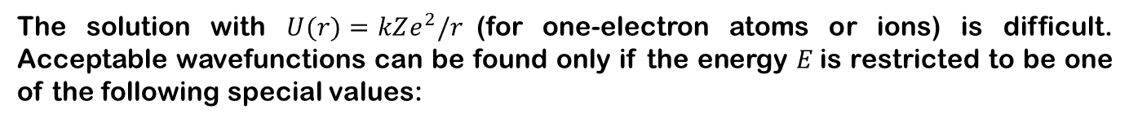
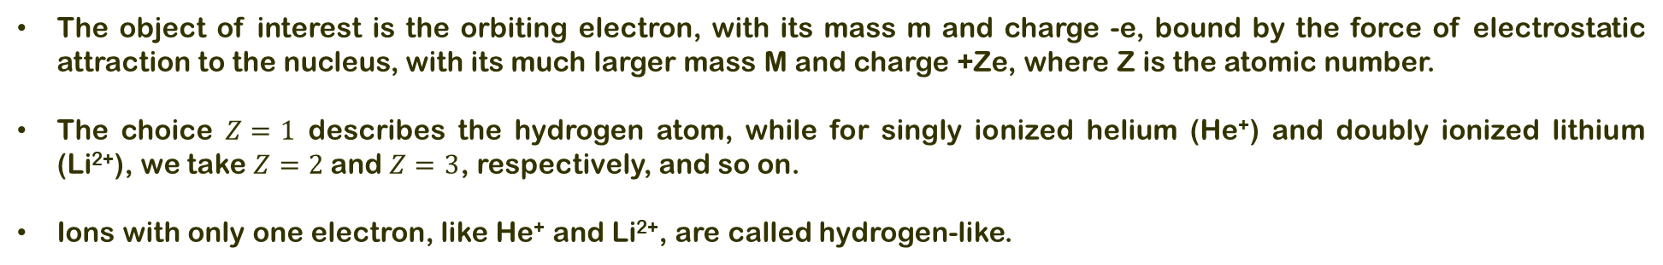
8.5 ATOMIC HYDROGEN AND HYDROGEN-LIKE IONS
The object of interest is the orbiting electron, with its mass m and charge -e, bound by the force of electrostatic attraction to the nucleus, with its much larger mass M and charge +Ze, where Z is the atomic number.
The choice $Z=1$ describes the hydrogen atom, while for singly ionized helium (He⁺) and doubly ionized lithium (Li²⁺), we take $Z=2$and $Z=3$, respectively, and so on.
Ions with only one electron, like He⁺ and Li²⁺, are called hydrogen-like.
The solution with $U(r)=kZe^{2}/r$(for one-electron atoms or ions) is difficult. Acceptable wavefunctions can be found only if the energy $E$is restricted to be one of the following special values:
The integer $n$ is called the principal quantum number. Although $n$ can be any positive integer, the orbital quantum number now is limited to values less than $n:$

Slide 15
8.5 ATOMIC HYDROGEN AND HYDROGEN-LIKE IONS

Slide 16
8.5 ATOMIC HYDROGEN AND HYDROGEN-LIKE IONS
spectroscopic notation

Slide 17
8.5 ATOMIC HYDROGEN AND HYDROGEN-LIKE IONS
For optical transitions, photons carry off the surplus energy, but not all energy-conserving optical transitions may occur. A selection rule that must be obeyed in optical transitions.
How many possible states are there for the n=4 level of hydrogen?

Slide 18
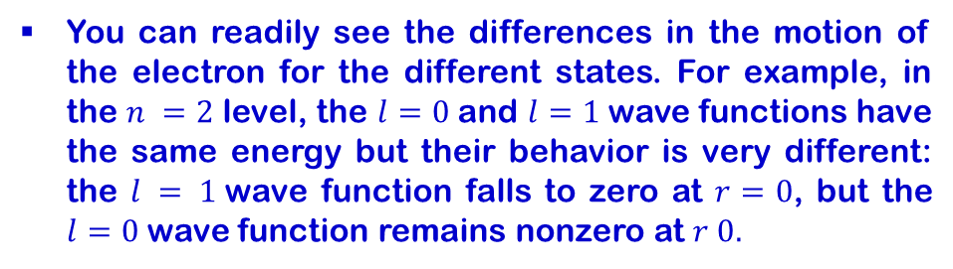
8.5 ATOMIC HYDROGEN AND HYDROGEN-LIKE IONS
You can readily see the differences in the motion of the electron for the different states. For example, in the $n =2$ level, the $l=0$and $l=1$wave functions have the same energy but their behavior is very different: the $l = 1$wave function falls to zero at $r=0$, but the $l=0$wave function remains nonzero at $r 0.$

Slide 19
8.5 ATOMIC HYDROGEN AND HYDROGEN-LIKE IONS – Radial Probability Density
The probability of finding the electron in any spatial interval is determined by the square of the wave function. For the hydrogen atom, ${|ψ(r, θ, φ)|}^{2}$ gives the volume probability density (probability per unit volume) at the location $(r, θ, φ).$
We can determine the radial probability from the complete probability by integrating over the θ and φ coordinates.
Using the radial probability densities, it is possible to find the average value of the radial coordinate, that is, the average distance between the proton and the electron.
The principal quantum number n thus determines not only the energy level of the electron, it also determines to a great extent the average distance of the electron from the nucleus.

Slide 20
8.5 ATOMIC HYDROGEN AND HYDROGEN-LIKE IONS – Radial Probability Density
Prove that the most likely distance from the origin of an electron in the $n=2$, $l=1$state is $4a_{0}$.

Slide 21
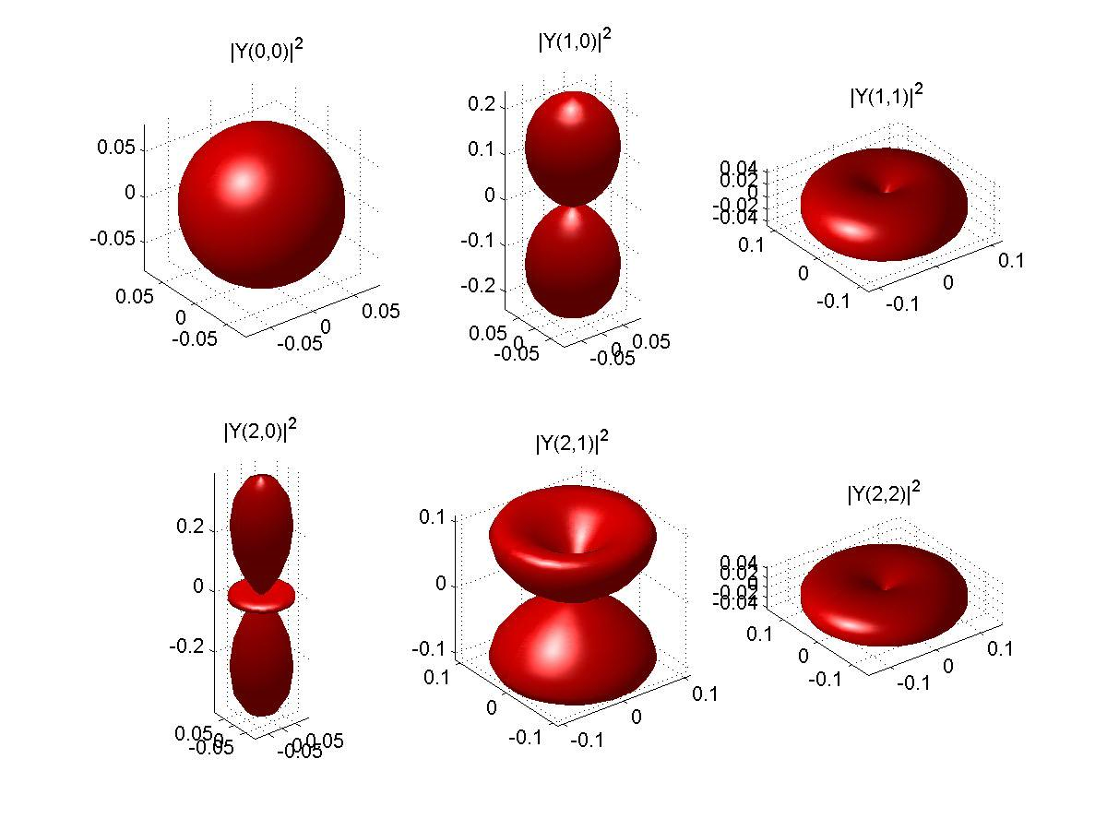
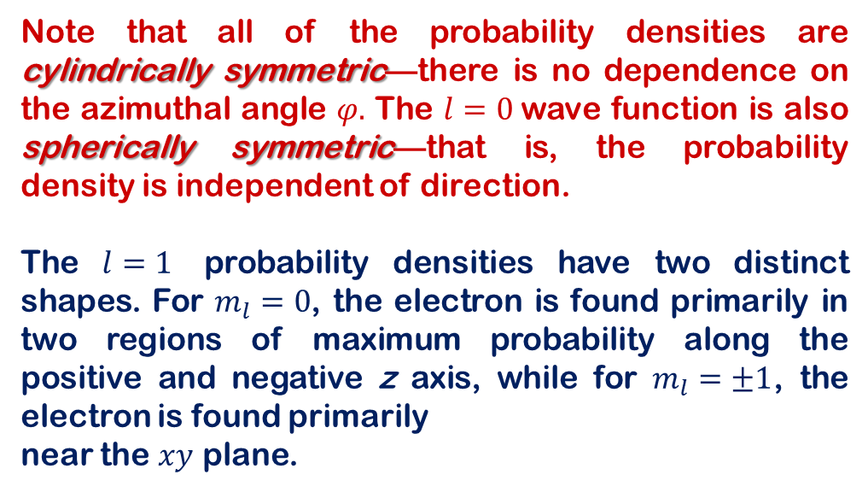
8.5 ATOMIC HYDROGEN AND HYDROGEN-LIKE IONS – ANGULAR PROBABILITY DENSITIES
In this section, we consider the angular part of the probability density, which is obtained from the squared magnitudes of the angular parts of the wave function:
Note that all of the probability densities are cylindrically symmetric—there is no dependence on the azimuthal angle $φ.$ The $l=0$wave function is also spherically symmetric—that is, the probability density is independent of direction.
The $l=1$ probability densities have two distinct shapes. For $m_{l}=0$, the electron is found primarily in two regions of maximum probability along the positive and negative z axis, while for $m_{l}=±1$, the electron is found primarily
near the $xy$ plane.
http://www.falstad.com/qmatom/

Slide 22
8.5 ATOMIC HYDROGEN AND HYDROGEN-LIKE IONS – ANGULAR PROBABILITY DENSITIES

Slide 23
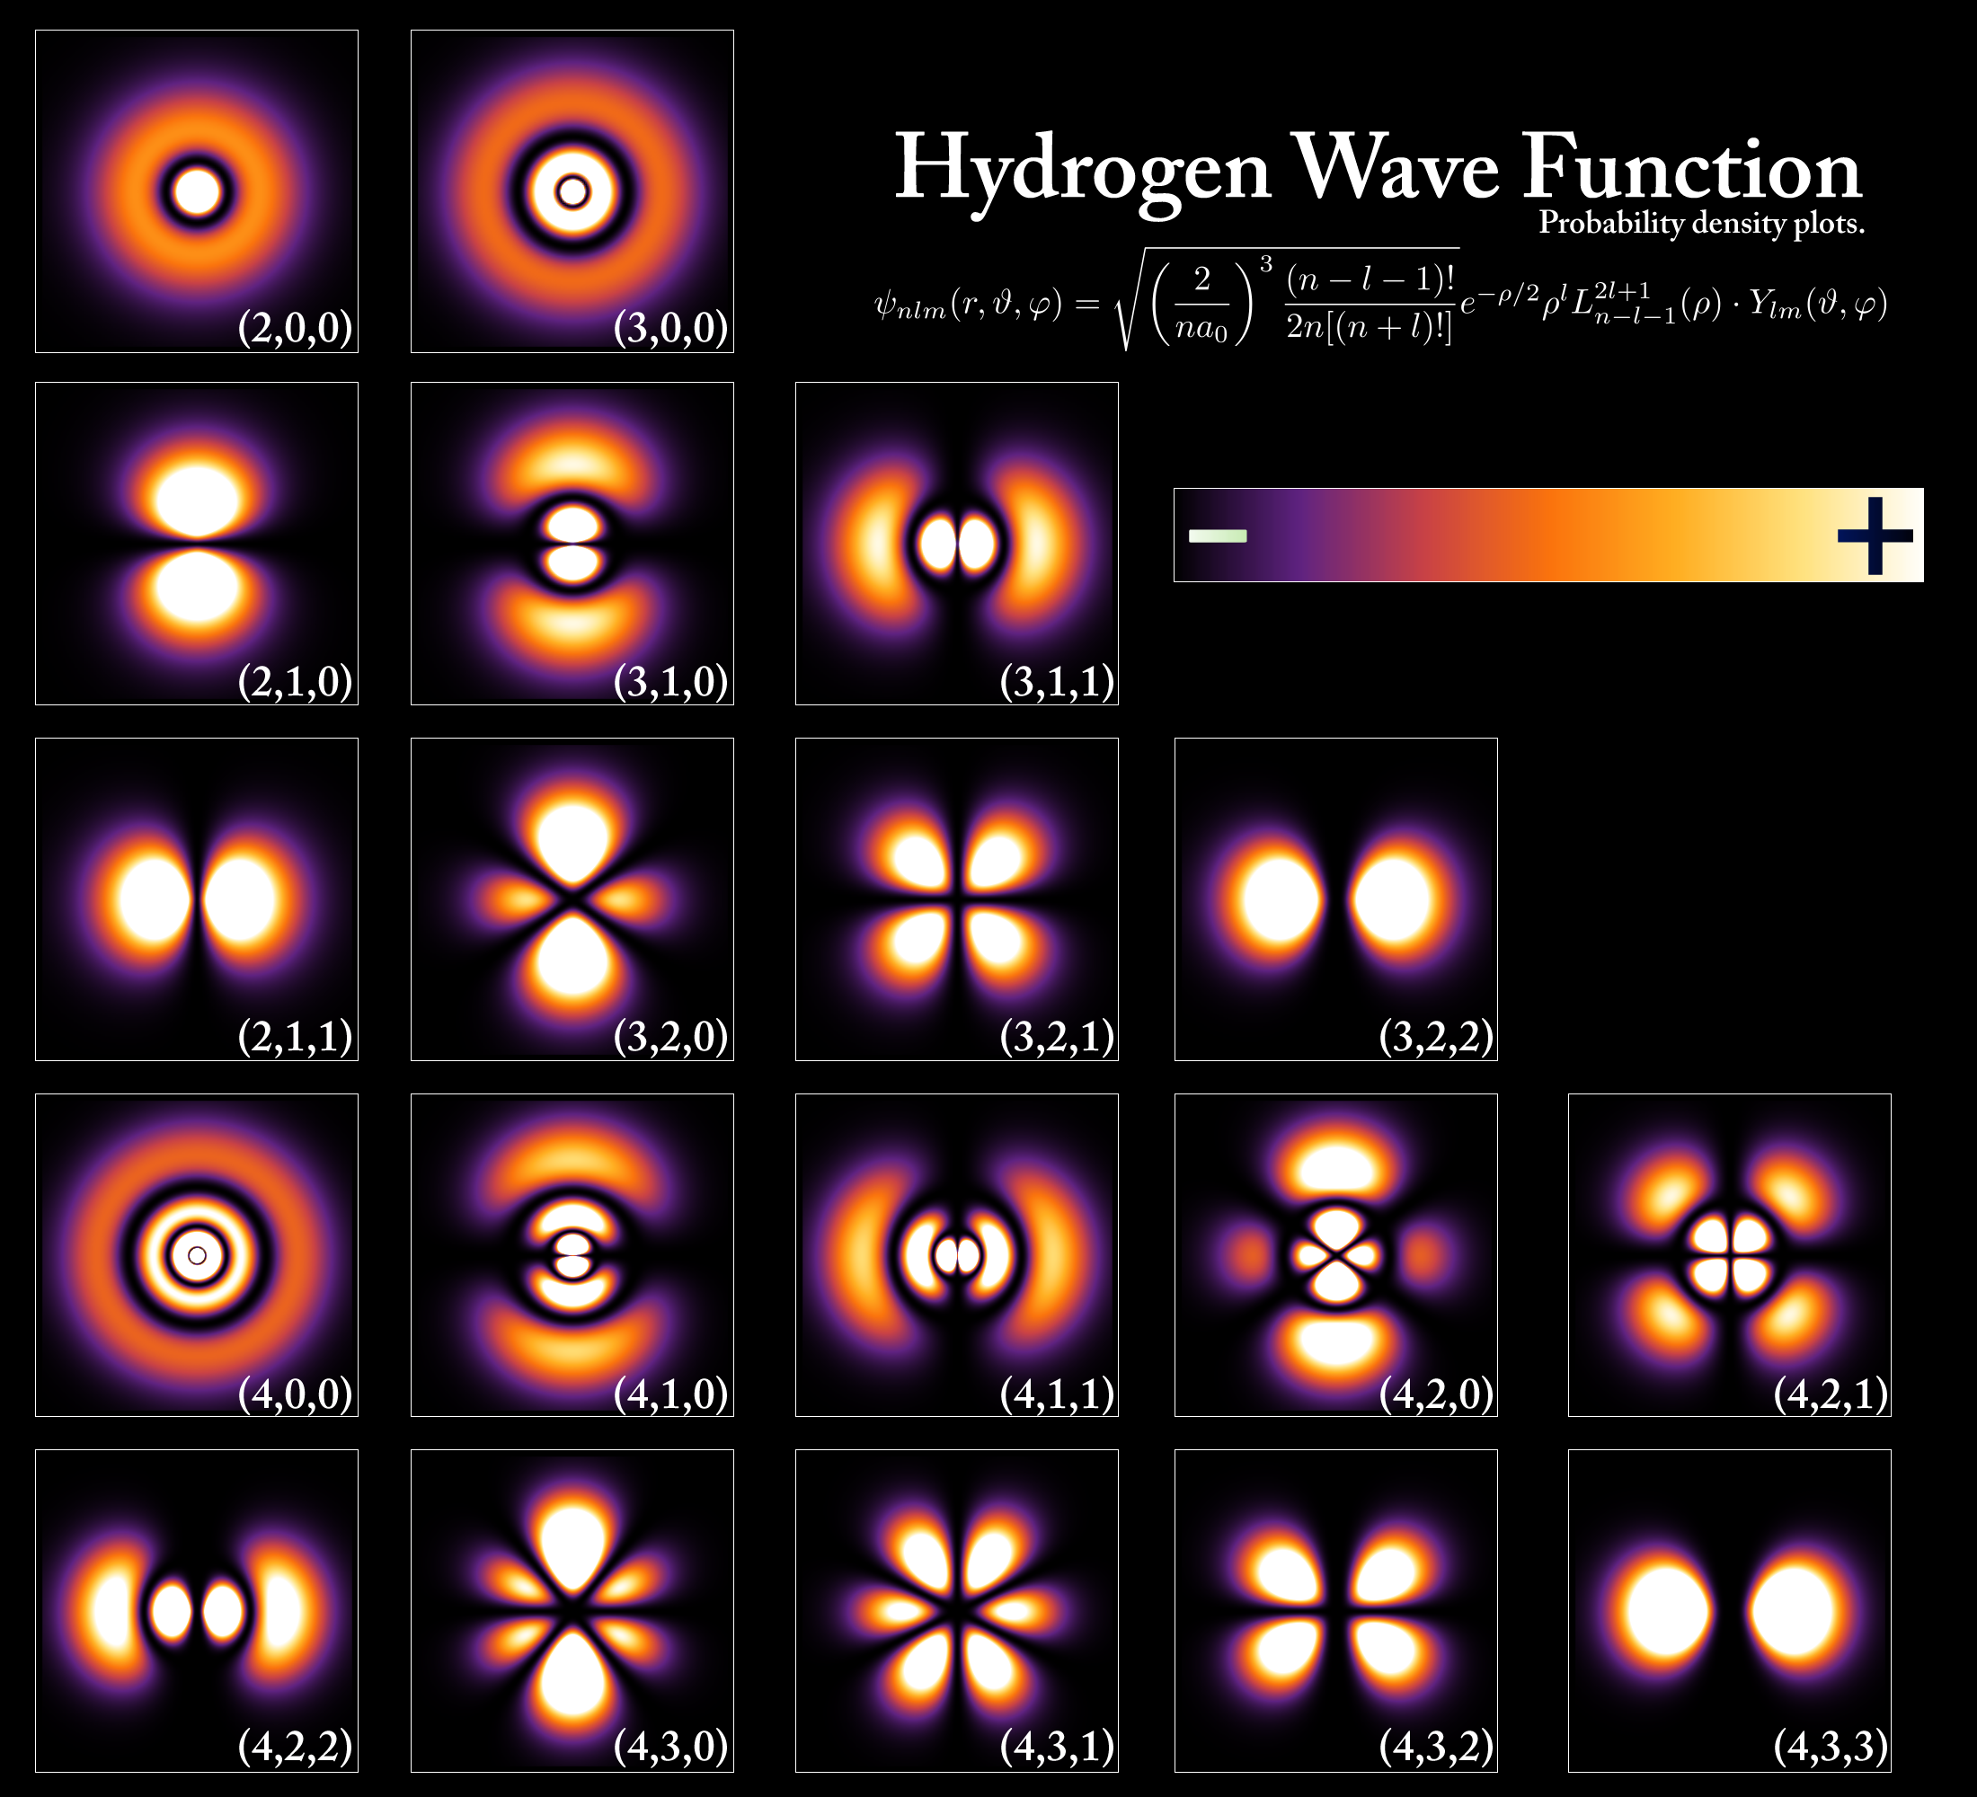
8.5 ATOMIC HYDROGEN AND HYDROGEN-LIKE IONS – ANGULAR PROBABILITY DENSITIES

Slide 24
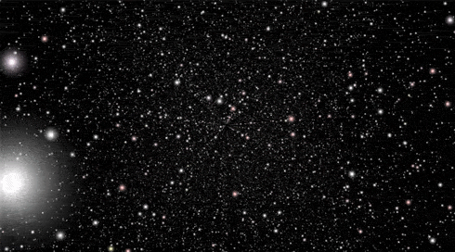
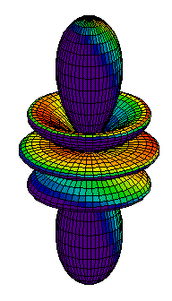
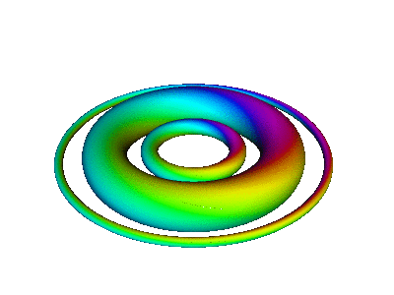
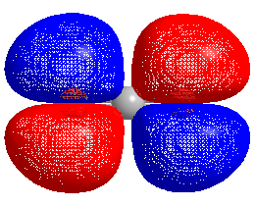
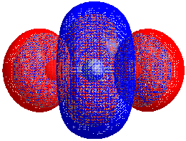
End of CH 8

