Slide 1
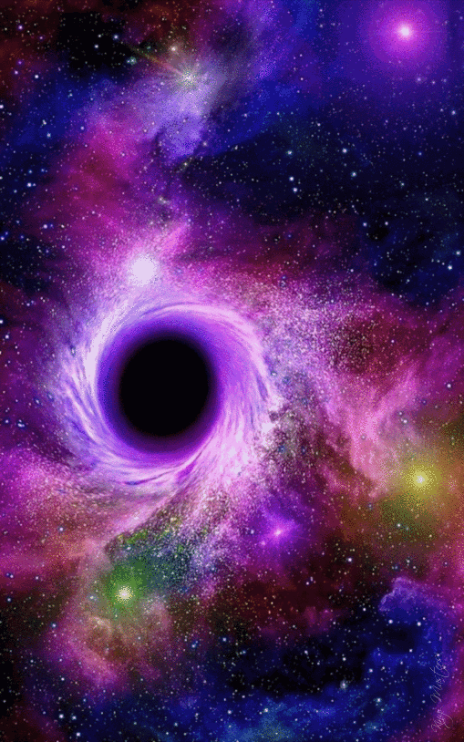
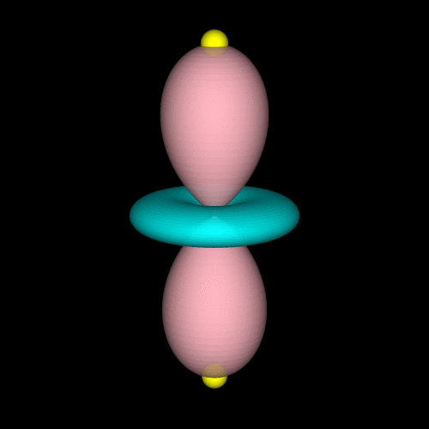
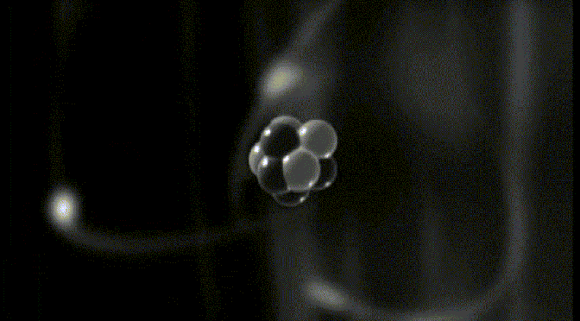
CH 8
Atomic Structure
Dr. Tariq Al-Abdullah

Slide 2
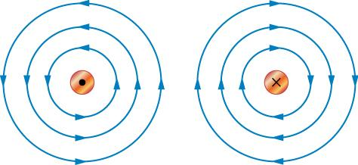
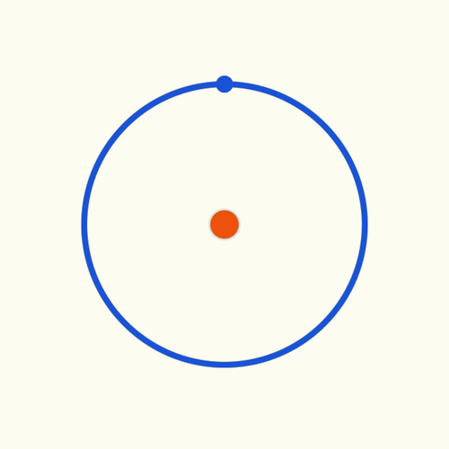
9.1 Orbital Magnetism and the Normal Zeeman Effect
An electron orbiting the nucleus of an atom should give rise to magnetic effects, much like those arising from an electric current circulating in a wire loop.
In particular, the motion of charge generates a magnetic field within the atom, and the atom as a whole is subject to forces and torques when it is placed in an external magnetic field.
These magnetic interactions can all be described in terms of a single property of the atom—the magnetic dipole moment.

Slide 3
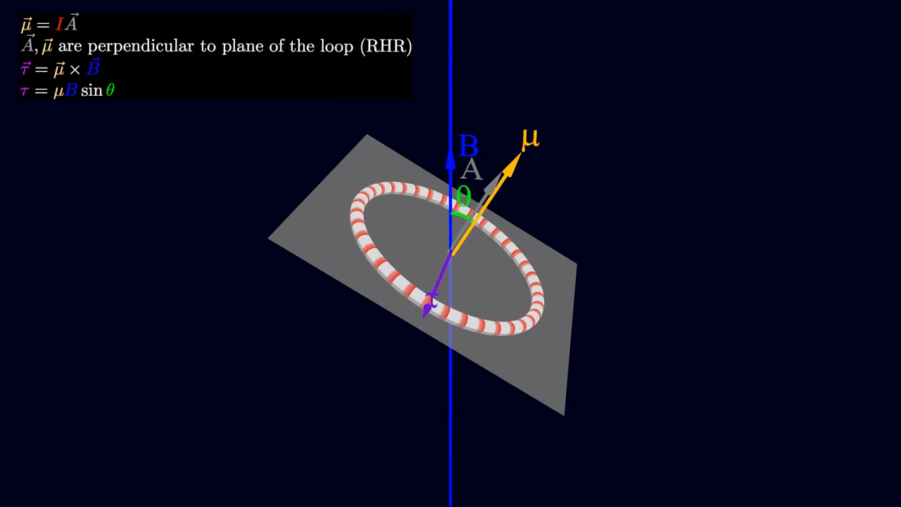
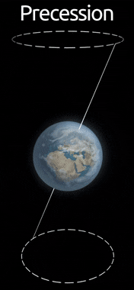
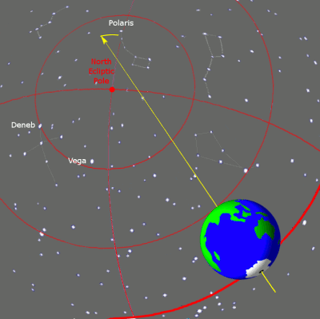
9.1 Orbital Magnetism and the Normal Zeeman Effect
The interaction of an atom with an applied magnetic field depends on the size and orientation of the atom’s magnetic moment. Suppose an external field B is applied along the z-axis of an atom.
For atoms in a magnetic field this is known as Larmor precession.

Slide 4
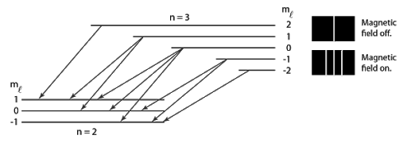
9.1 Orbital Magnetism and the Normal Zeeman Effect
The magnetic potential energy U.
This effect of spectral line splitting by a magnetic field is known as the normal Zeeman effect after its discoverer, Pieter Zeeman.

Slide 5
9.1 Orbital Magnetism and the Normal Zeeman Effect
Example: Compute the change in wavelength of the $2p → 1s$photon when a hydrogen atom is placed in a magnetic field of 2.00 T.

Slide 6

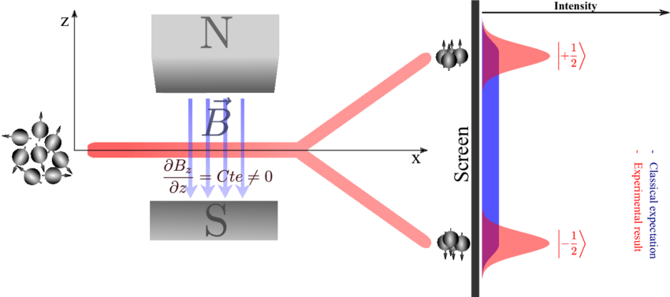
9.2 The Spinning Electron
A charged object in rotation produces magnetic effects related to the spin magnetic moment μ_{s}.
This angular momentum of rotation cannot be changed in any way, but is an intrinsic property of the electron, like its mass or charge.
The Stern–Gerlach experiment to detect space quantization.
https://www.youtube.com/watch?v=PH1FbkLVJU4

Slide 7
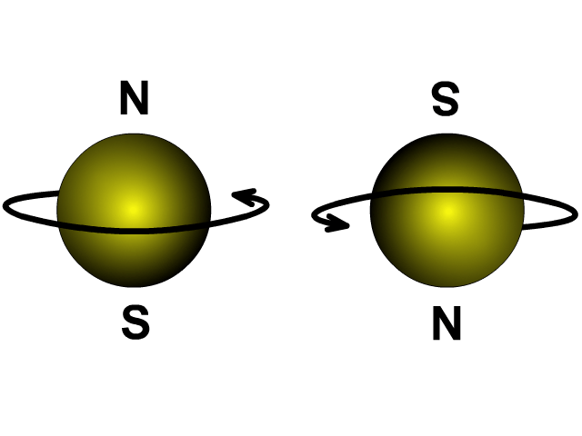
9.2 The Spinning Electron

Slide 8
9.2 The Spinning Electron
Example: Examine the Zeeman spectrum produced by hydrogen atoms initially in the $n=2$ state when electron spin is taken into account, assuming the atoms to be in a magnetic field of magnitude $B=1.00$ T.

Slide 9
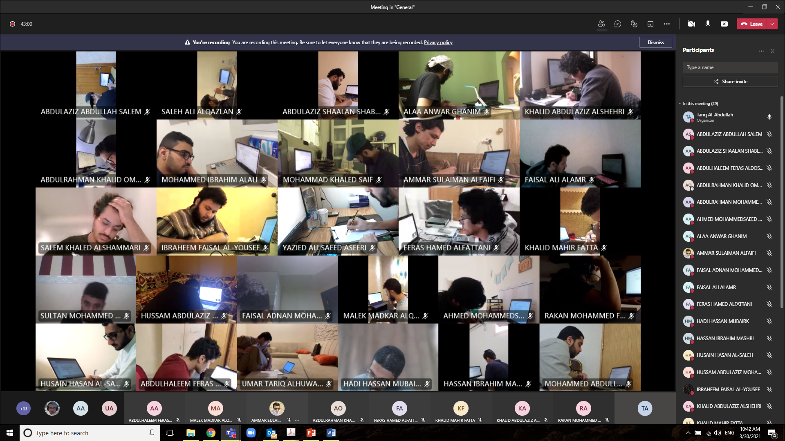

Slide 10
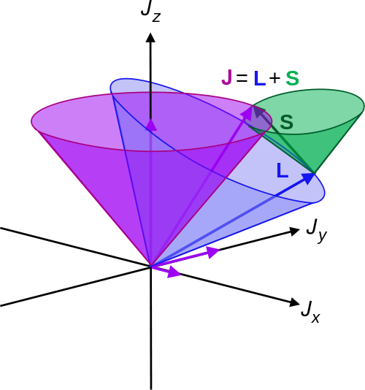
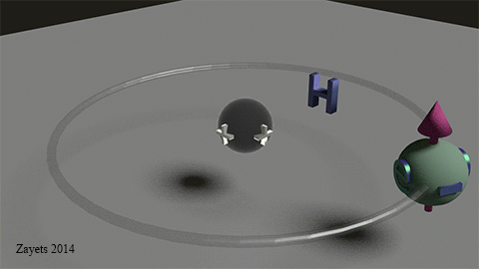
9.3 THE SPIN–ORBIT INTERACTION
In general, an electron in an atom has both orbital angular momentum characterized by the quantum number L and spin angular momentum characterized by the quantum number s. The total angular momentum

Slide 11
9.3 THE SPIN–ORBIT INTERACTION
Example: Two electrons each have zero orbital angular momentum. What are the possible quantum numbers for the total angular momentum of the two-electron system? (For example, these could be the He atom electrons in any of the S states.)

Slide 12
9.3 THE SPIN–ORBIT INTERACTION
Example: An electron in an atom has orbital angular momentum $L1$ with quantum number $L_{1}=2$, and a second electron has orbital angular momentum $L_{2}$ with quantum number $L_{2}=3$. What are the possible
quantum numbers for the total orbital angular momentum $L=L_{1}+L_{2}$?

Slide 13
9.3 THE SPIN–ORBIT INTERACTION
The existence of both spin and orbital magnetic moments for the electron inevitably leads to their mutual interaction. This so-called spin–orbit interaction.
The energy difference between the two spin orientations is responsible for the fine structure doubling of many atomic spectral lines.
The coupling of spin and orbital moments implies that neither orbital angular momentum nor spin angular momentum is conserved separately.
But total angular momentum J = L + S is conserved.

Slide 14

9.3 THE SPIN–ORBIT INTERACTION
Example: The famed sodium doublet arises from the spin–orbit splitting of the sodium 3p level, and consists of the closely spaced pair of spectral lines at wavelengths of 588.995 nm and 589.592 nm. Find $ΔE.$

Slide 15
9.3 THE SPIN–ORBIT INTERACTION

Slide 16
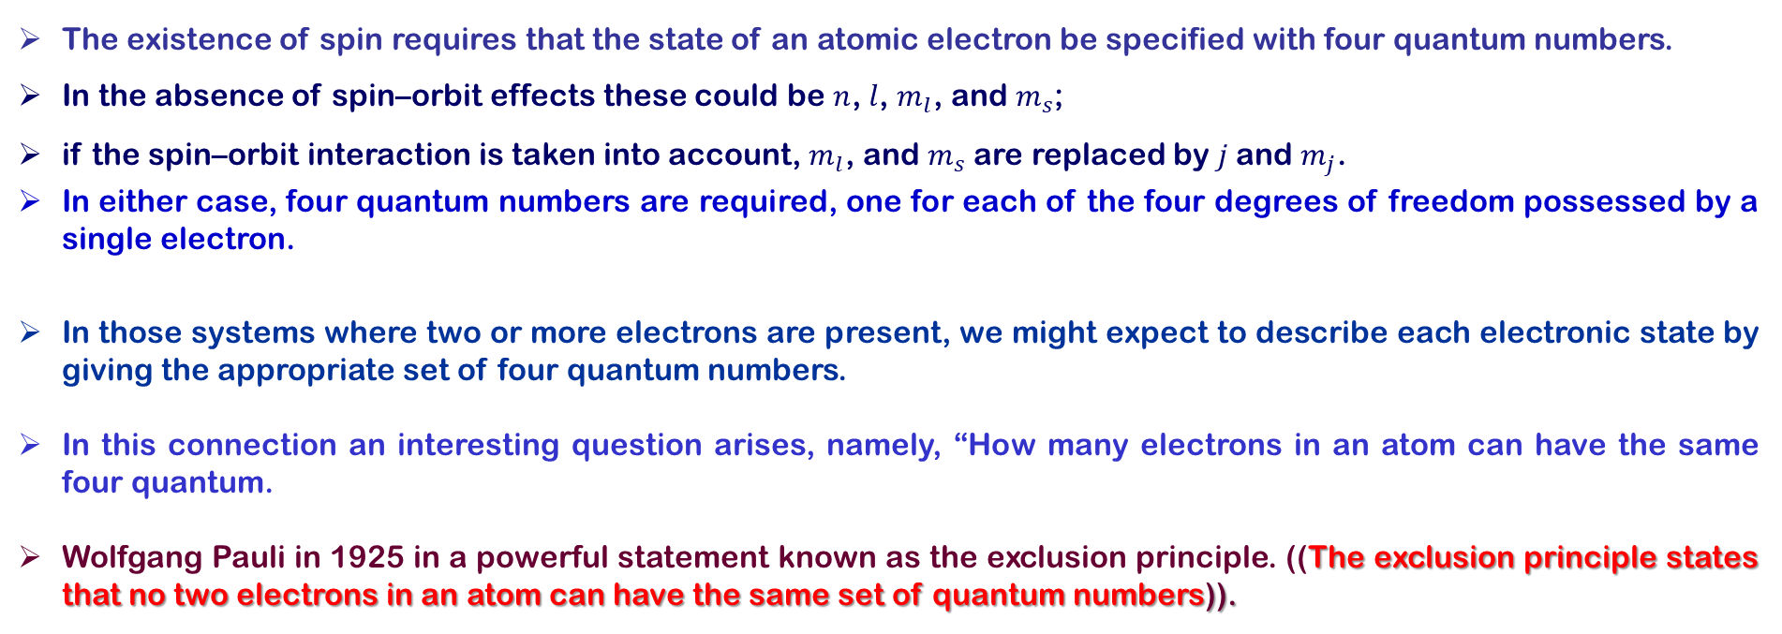
9.4 EXCHANGE SYMMETRY AND THE EXCLUSION PRINCIPLE
The existence of spin requires that the state of an atomic electron be specified with four quantum numbers.
In the absence of spin–orbit effects these could be $n$, $l$, $m_{l}$, and $m_{s}$;
if the spin–orbit interaction is taken into account, $m_{l}$, and $m_{s}$ are replaced by $j$and $m_{j}$.
In either case, four quantum numbers are required, one for each of the four degrees of freedom possessed by a single electron.
In those systems where two or more electrons are present, we might expect to describe each electronic state by giving the appropriate set of four quantum numbers.
In this connection an interesting question arises, namely, “How many electrons in an atom can have the same four quantum.
Wolfgang Pauli in 1925 in a powerful statement known as the exclusion principle. ((The exclusion principle states that no two electrons in an atom can have the same set of quantum numbers)).

Slide 17
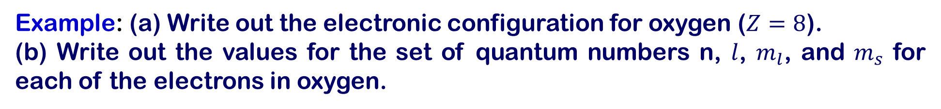
9.6 THE PERIODIC TABLE
Example: (a) Write out the electronic configuration for oxygen ($Z=8$).
(b) Write out the values for the set of quantum numbers n, $l$, $m_{l}$, and $m_{s}$ for each of the electrons in oxygen.

Slide 18
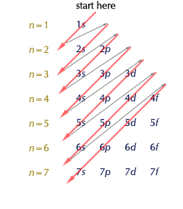
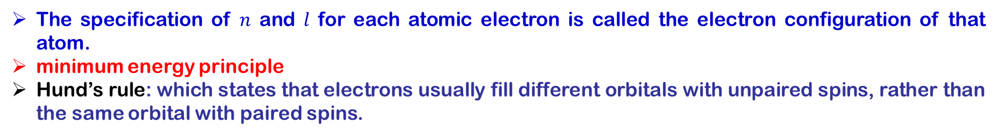
9.6 THE PERIODIC TABLE
The specification of $n$ and $l$ for each atomic electron is called the electron configuration of that atom.
minimum energy principle
Hund’s rule: which states that electrons usually fill different orbitals with unpaired spins, rather than the same orbital with paired spins.

Slide 19
9.6 THE PERIODIC TABLE

Slide 20
9.6 THE PERIODIC TABLE

Slide 21
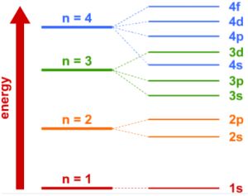
9.6 THE PERIODIC TABLE
Ionization energy of the elements versus atomic number Z.

Slide 22
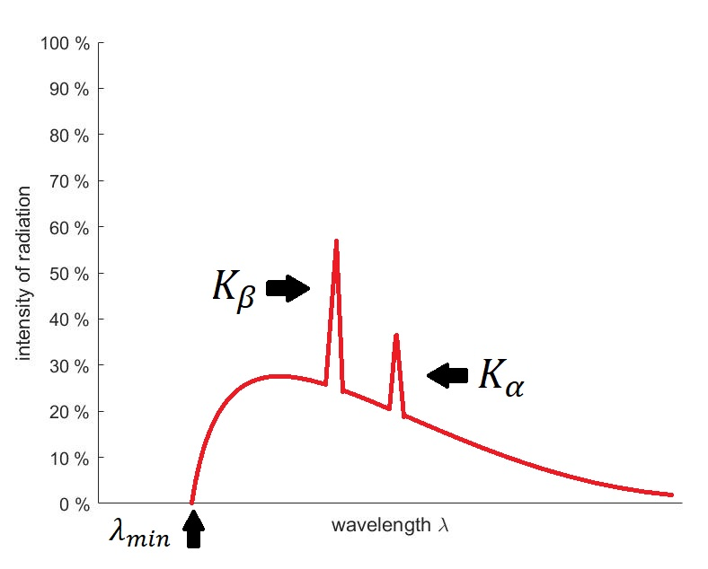
9.7 X-RAY SPECTRA AND MOSELEY’S LAW
Electronic transitions within the inner shells of heavier atoms are accompanied by large energy transfers.
If the excess energy is carried off by a photon, x rays are emitted at specific wavelengths peculiar to the emitting atom.
This explains why discrete x-ray lines are produced when energetic electrons bombard a metal target.

Slide 23
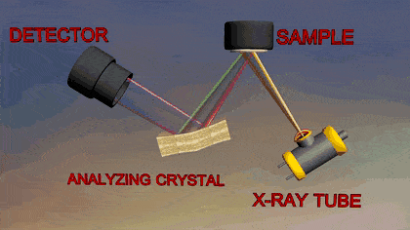
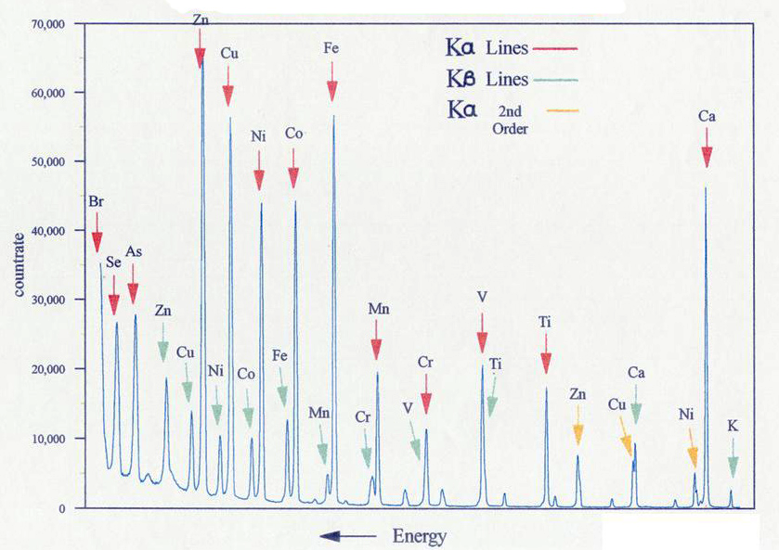
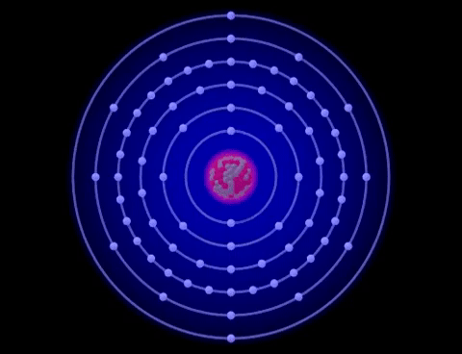
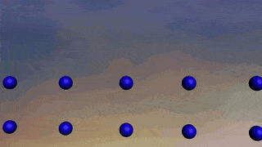
9.7 X-RAY SPECTRA AND MOSELEY’S LAW
X-ray fluorescence (XRF) is the emission of characteristic "secondary" (or fluorescent) X-rays from a material that has been excited by being bombarded with high-energy X-rays.
The phenomenon is widely used for elemental analysis and chemical analysis, particularly in the investigation of metals, glass, ceramics and building materials, and for research in geochemistry, forensic science, archaeology and art objects.

Slide 24
